Slide 1
GMP Training
Documentation and Record Keeping
Biopharmaceutical Development Program

Slide 2
WHAT WE KNOW SO FAR….
Key points from the general GMP orientation session. In that session, we learned that:
Regulations for drug products are a result of tragedies that resulted from a lack of control by drug manufacturers
The Good Manufacturing Practice (GMPs) are one of the regulations applied to drugs
GMPs are found in the Code of Federal Regulations (CFR)
GMPs define the minimum requirements for control in the manufacture, holding and distribution of drugs to assure the quality of drugs.

Slide 3
WHAT WE HAVE LEARNED….
HOW manufacturers design their processes and systems to provide this control is up to them and will be judged by FDA based on the control achieved and current industry practice.
Failure to produce drug products within a system that is compliant with GMPs causes the products produced from the system to be ADULTERATED and subject to regulatory action.

Slide 4
MORE OF WHAT WE KNOW SO FAR….
Reading the GMPs is easy. APPLYING them appropriately to your operation takes knowledge of GMP requirements, knowledge of the specific needs of your products and processes, knowledge of current industry practice, and knowledge of how FDA is currently interpreting this issue.
And because compliance is affected by current industry practice, and because current practice can CHANGE, we all need to be on our toes.
It’s good to ask questions about what we do and why we do it. These are the same questions FDA will ask.
4

Slide 5
What’s in the GMPs about Quality?
SISQP
Safety: Does no harm
Identity: Is what it’s supposed to be
Strength: Sufficiently potent
Quality: Meeting specifications
Purity: Free of contamination
What’s in the GMPs about quality?
Many people remember these attributes with the acronym SISQP because most often, that is the order you find them in the GMP regulations. In fact the phase “identity, strength, quality, and purity” or some combination thereof appears in the GMPs at least 20 times, and in almost all of the 11 subparts in the regulation. It’s hard to miss the theme that the GMPs have been written to assure the SISQP of the product.

Slide 6

Drugs are Different
Drugs are different than most other consumer products because there’s no way for a consumer to judge the quality
you can’t tell by looking at it,
you can’t play with it in the store,
you can’t test drive it,
you can’t try a little and see if you like it ……
You, as a consumer, are forced to trust the manufacturer that the drug was made properly (and the drug product has the appropriate SISQP).

Slide 7
IPO Model – Making a Drug
(IPO: Input-Process-Output)
Think of the GMPs from the perspective of an IPO model. IPO stands for input process output. You can use an IPO diagram to visualize your process inputs and the desired process outputs. For drug products, the FDA has identified the inputs that are important to control. These are things like personnel and buildings and equipment. Once you have an output, in this case a drug product, feedback about the drug product can be collected and if the product isn’t what it needs to be or what you want it to be, you can change an input so that next time to run the process, you’ll get a better outcome.

Slide 8
CGMPs – The Short Course
Develop processes and procedures
Put the processes and procedures in writing
Follow written process and procedures
Document performance of processes and procedures at the time they are performed.
GMPs require that companies develop processes and procedures for the manufacture of drug products. The GMPs specifically require that those processes and procedures be in writing. Additionally, the GMPs require that the written processes and procedures be followed and that the activity be documented at the time it is performed.
If this is done, it is clear what your processes and procedures are and it will be clear how and when you performed them. Five years from now, maybe when you aren’t here, these records may be the only resources to tell reviewers what was the plan, how it was executed and when it was executed. If the documentation was generated with quality, they will allow reviewers to make well-informed decisions about the product.

Slide 9
GMPs – in 4 words
Plan
  Document
Execute
  Document
To distill this down more, this is what you would come up with. Plan the processes, document them, execute them and document the execution. You have to appreciate the huge role documentation plays in GMPs. Of the 4 words chosen to summarize GMPs to this level, two of the words are the same – “Document”. Without written documents, we can’t prove that there was ever a plan, or how processes were executed.

Slide 10
Diagram – Manufacturing Process
Cell Bank
(Mammalian/ Bacterial / Viral)
Cell Bank
(Mamm./ Bacterial / Viral)
This diagram represents a typical manufacturing process activities for making a biopharmaceutical from the creation of a cell bank to the vialing of the final product.
Cell Cult./ Fermentat’n
Cell Culture/ Fermentation
Harvest
Harvest
Purification
Purification
Fill Finish
Fill Finish
QC Testing
QC Testing
Product

Slide 11
Diagram – Manufacturing Process Controls
PROCESS CONTROLS
Cell Bank
(Mammalian/ Bacterial / Viral)
Cell Culture/ Fermentation
₊
Harvest
PERSONNEL ●● BUILDINGS ●● EQUIPMENT ●● RAW MATERIALS
Purification
PACKAGING, LABELING
CONTROLS
Fill Finish
LABORATORY
CONTROLS
QC Testing
Inputs to this process include the personnel, buildings, equipment and raw materials need to perform each step in the process as well as the operational controls for these steps.

Slide 12
Diagram – Manufacturing Process Documents
PROCESS CONTROLS
Cell Bank
(Mammalian/ Bacterial / Viral)
Cell Bank
(Mamm./ Bacterial / Viral)
Cell Cult./ Fermentat’n
Cell Culture/ Fermentation
₊
Harvest
Harvest
PERSONNEL ●● BUILDINGS ●● EQUIPMENT ●● RAW MATERIALS
Purification
Purification
PACKAGING, LABELING
CONTROLS
Fill Finish
Fill Finish
LABORATORY
CONTROLS
QC Testing
QC Testing
Documentation is created for each of the inputs and steps in the process

Slide 13
Diagram – Planning Documents Manufacturing Process
PLAN / DOCUMENT
PROCESS CONTROLS
Cell Bank
(Mammalian/ Bacterial / Viral)
Cell Bank
(Mamm./ Bacterial / Viral)
Cell Cult./ Fermentat’n
Cell Culture/ Fermentation
PERSONNEL ●● BUILDINGS ●● EQUIPMENT ●● RAW MATERIALS
₊
Harvest
Harvest
Purification
Purification
PACKAGING, LABELING
CONTROLS
Fill Finish
Fill Finish
LABORATORY
CONTROLS
QC Testing
QC Testing
The inputs to the manufacturing process are part of the Planning and Documentation phase of the manufacturing operation.

Slide 14
Diagram – Planning Documents Manufacturing Process continued
PLAN / DOCUMENT
PROCESS CONTROLS
Cell Bank
(Mammalian/ Bacterial / Viral)
Cell Bank
(Mamm./ Bacterial / Viral)
Cell Cult./ Fermentat’n
Cell Culture/ Fermentation
PERSONNEL ●● BUILDINGS ●● EQUIPMENT ●● RAW MATERIALS
₊
Harvest
Harvest
Purification
Purification
PACKAGING, LABELING
CONTROLS
Fill Finish
Fill Finish
LABORATORY
CONTROLS
QC Testing
QC Testing
The inputs to the manufacturing process are captured in a company's documentation (specifications, master production records, standard operating procedures, etc.)

Slide 15
Plan and Execute Diagram
PLAN / DOCUMENT
EXECUTE / DOCUMENT
PROCESS CONTROLS
Cell Bank
(Mammalian/ Bacterial / Viral)
Cell Bank
(Mamm./ Bacterial / Viral)
Cell Cult./ Fermentat’n
Cell Culture/ Fermentation
PERSONNEL ●● BUILDINGS ●● EQUIPMENT ●● RAW MATERIALS
₊
Harvest
Harvest
Purification
Purification
PACKAGING, LABELING
CONTROLS
Fill Finish
Fill Finish
LABORATORY
CONTROLS
QC Testing
QC Testing
Inputs to the manufacturing process are part of the Execute and Document phase of the manufacturing operation and are captured in the documentation of Batch Production Records (BPRs) and QC testing documentation

Slide 16
Plan and Execute Diagram Slide 2
PLAN / DOCUMENT
EXECUTE / DOCUMENT
PROCESS CONTROLS
Cell Bank
(Mammalian/ Bacterial / Viral)
Cell Bank
(Mamm./ Bacterial / Viral)
Cell Cult./ Fermentat’n
Cell Culture/ Fermentation
PERSONNEL ●● BUILDINGS ●● EQUIPMENT ●● RAW MATERIALS
₊
Harvest
Harvest
Purification
Purification
PACKAGING, LABELING
CONTROLS
Fill Finish
Fill Finish
LABORATORY
CONTROLS
QC Testing
QC Testing
The testing of the product as well as the documentation and records from the manufacturing process create a package that is reviewed by Quality Assurance to determine if the product meets specification and was made under GMPs. If yes, them the product is released.
+
Product meets
testing specs ?
Product made
by GMPs?
RELEASE
16

Slide 17
WHAT HAPPENS TO THESE PRODUCTS OF
THE PROCESS? (according to the GMPs?)
confirm
product conformance
to specifications
PRODUCT RELEASE
confirm
process conformance to GMPs
You may be aware that the drug manufacturing process produces TWO products, the drug in the vial and all the documentation related to the manufacturing of the drug. BOTH of these products will be evaluated before a product can be released to consumers. In these reviews, DOCUMENTATION is critical. Documentation is needed to confirm that the product was tested properly and is within the established specs set for the product. Documentation is also needed to confirm that the process was executed properly and meets the requirements of the MPR and the GMPs. You can’t get to a defendable product release decision without documentation that you can trust, or that is clear and understandable.

Slide 18
Here is an FDA Warning letter example
The GMPs also identify specific requirements for certain records
Your facility’s quality control unit
failed to review production records
to assure that no errors have
occurred or, if errors have occurred,
that they have been fully
investigated.
(Chiron Corporation)
FDA WARNING LETTER

Slide 19
QUALITY OF DOCUMENTATION
The QUALITY OF OUR DOCUMENTATION
becomes critical to assuring the
QUALITY OF THE DECISIONS
made about our product

Slide 20
FROM THE DOCUMENTATION
FROM THE DOCUMENTATION . . .
Can you explain it today?
Will you be able to explain it tomorrow?
        Next year?
        In five years?
Will someone ELSE be able to explain it?

Slide 21
Rationale for Good Documentation
Practices – Canadian GMPs
“Good documentation is an essential part of the quality assurance system and should therefore be related to all aspects of GMP. Its aims are to define the specifications for all materials and methods of fabrication, packaging/labeling, and control; to ensure that the quality control department has all the information necessary to decide whether or not to release a batch of a drug for sale; and to provide an audit trail that will permit investigation of the history of any batch that is suspected to be defective.”
http://www.hc-sc.gc.ca/dhp-mps/alt_formats/hpfb-dgpsa/pdf/compli-conform/gmp-bfp/docs/gui-0001-eng.pdf

Slide 22
“Procedures must be in writing for…”
There are requirements for written procedures throughout the GMP sections. The GMPs have requirements for written procedures for:
QA
Sanitation
Pesticides
Cleaning and maintenance of equipment
Equipment calibration program
Receipt, identification, storage, handling, sampling, testing and approval or rejection of components
Production processes
In-process controls and tests
Containers & closures – methods of cleaning, sterilization, processing
Prevention of objectionable microorganisms
Control of labeling
Testing of final drug product
Warehousing of drug products
Distribution of drug products
Stability testing program

Slide 23

Procedures must be in WRITING . . .
… such written procedures
shall be FOLLOWED”
24 times throughout the GMPs
It is very clear that following written procedures is critical to complying with GMPs. At times, this is a challenge, and it is important to explore ways to optimize our systems so that we ALWAYS follow written procedures.

Slide 24
GMP RECORDS – Examples
GMP records do not exist isolated by themselves but are interrelated.
Take for example the GMP requirement for calibration: Equipment shall be routinely calibrated according to a written program” (21 CFR 211.68(a))
The calibration program would include ( see records highlighted in blue)
Equipment Cleaning and Use Logs
Component (raw material) records
Master production and control records
Batch production and control records
Production record review records
Laboratory Records
Distribution Records
Complaint files
Standard Operating Procedures
Calibration Program
Validation Records
Training Records
Specifications
Change Control Records
Facility Diagrams
Investigations (Deviations, OOS etc.)

Slide 25
Categories of CGMP Documentation
Generally, CGMP documents fall into one of these categories.
Commitment Documents formalize the promises you make about your processes and procedures. A document that describes your company’s calibration program would be a commitment document. It would describe what you are going to do (like calibrate equipment at appropriate intervals) with oversight by Quality Assurance and investigations when equipment fails.
Directive Documents describe how you are going to execute your promises. How exactly are you going to calibrate equipment XYZ?, How exactly are you training employees so that an employee knows how to calibrate equipment XYZ? What exactly are you going to do when a piece of equipment fails its calibration?
Commitment Documents
WHAT YOU’RE GOING TO DO
Company policies
Specifications
Validation master plans
Regulatory submissions
Communications with customers and regulatory agencies (FDA)
Directive Documents
HOW TO DO IT
Standard Operating Procedures (SOPs)
QC methods and procedures
Master Production Records
Training Manuals
Clinical Protocols

Slide 26
Categories of CGMP Documentation Continued
EXECUTION DOCUMENTS
Data Collection Documents prove that you did what you promised. They create a record of your calibration of equipment XYZ on September 15, 2012. They document that the technician that executed that calibration procedure was trained, and if an investigation was required because the equipment failed, there are documents that describe the investigations, the conclusions drawn from the investigation, and the corrective actions required as a result of the situation.
Yes, it sometimes gets complicated. But ultimately, the documents work together to show that the Company developed a plan and executed that plan.
Examples of data collection documents:
Batch Production Records
Equipment Logs
Laboratory Notebooks
Test Result Reports
Complaint Files
Training Records
Validation Studies
Deviation Reports

Slide 27
Subpart J – Records and Reports
In addition to the requirement for documents that occur throughout the GMPs, the GMPs also present specific requirement for documents and for some documents in particular. These specific requirements are in Subpart J – Records and Reports.
Specifically Required Documents
General Requirements
Equipment Cleaning & Use Log
Component, container/closure, labeling records
Master Production & Control Records
Batch Production & Control Records
Production Record Review
Laboratory Records
Distribution Records
Complaint Files

Slide 28
Subpart J – Records and Reports
General Requirements
Records and reports associated with a product lot must be retained at least 1 year after the product expiration
Records of components, containers, closures, labeling must be retained at least 1 year after the product expiration
The BDP doesn’t have product expiration dates as the products made are for use in clinical trials and therefore per the GMPs:
  Documentation associated with particular lots of product must be retained for at least 2 years past the last use of the product in a clinical trial (21 CFR 312.57).
  Must ensure that there is no remaining product or the remaining product has been returned, destroyed, etc.
  Active stability program and reporting

Slide 29
Subpart J – Records and Reports
General Requirements - Continued
Records must be available during inspections at the establishment where the activity occurred
May be retained as originals, true & exact copies, microfilm, microfiche, etc. if accurate
Must be able to be viewed and copied
Requirement for annual product review of relevant documentation to detect quality issues (Licensed firms)
Alerting responsible officials of a firm (in writing) of significant quality issues
  Quality Board
  Monthly Reports

Slide 30
General Requirements
Comments to the Preamble
1978 PREAMBLE TO THE GMPs
Comment 432: Several comments objected to the requirement for officials to be informed in writing of significant quality issues …
Response: “… From time to time it has been the agency’s experience that corporate officials have not been advised of potential or real adverse conditions brought to light either by the firm’s own quality control system or by FDA. As a result, corrective actions have not been instituted where they might have been...”

Slide 31
Subpart J – Records and Reports
General Requirements - Example
United States vs. Park (1975)
  Park was a CEO of a food warehouse
  His company's warehouses were rodent-infested and had contaminated the food being stored in the warehouse.
  FDA brought suit: Company guilty of shipping adulterated food. Park also guilty.
  Park appealed: He had delegated warehouse sanitation to subordinates, therefore HE cannot be held responsible.
IS PARK GUILTY????
https://caselaw.findlaw.com/us-supreme-court/421/658.html

Slide 32
United States Supreme Court
UNITED STATES v. PARK, (1975), No. 74-215
The Court found Park strictly liable for the unsanitary conditions that his company had created, arguing for strict liability under the rationale that the Federal Food, Drugs, and Cosmetics Act was a 'public welfare' statute. The Court concluded that as a welfare statute, the purpose was to prevent egregious social harm; therefore, the Defendant could be held strictly liable for the crime.
The Court held that, “If someone were to willingly be in charge of a company, and therefore its problems, then he or she willingly accepts the consequences of any illegal practices that his or her company or organization is involved in.”
32

Slide 33
Equipment Cleaning & Use Log
“A written record of major equipment cleaning, maintenance …, and use shall be included in individual equipment logs that show the date, time, product, and lot number of each batch processed. …
The persons performing and double-checking the cleaning and maintenance shall date and sign or initial the log indicating that the work was performed. Entries in the log shall be in chronological order.”
21 CFR 211.182
The GMPs are just reinforcing and requiring an activity that makes quality sense.

Slide 34
GMP Records must be CONTROLLED
If you need to rely on records to determine that a lot was manufactured as planned and according to GMPs. The FDA will rely on records to determine whether your company is operating in compliance to GMPs,
The records that provide this information need to be credible and accurate. There needs to be some controls on these records.

Slide 35
Attributes of Controlled Documents
Controlled documents have certain common characteristics. NOTE: NOT SPECIFIED IN GMPS
Identification system (SOP numbering sequences, etc.)
Issue/effective dates
Change control: revision levels, identification & justification of changes
Approval signatures/dates
Control of the master
Control of copies (often using tracking numbers, “True and Exact” Certification)

Slide 36
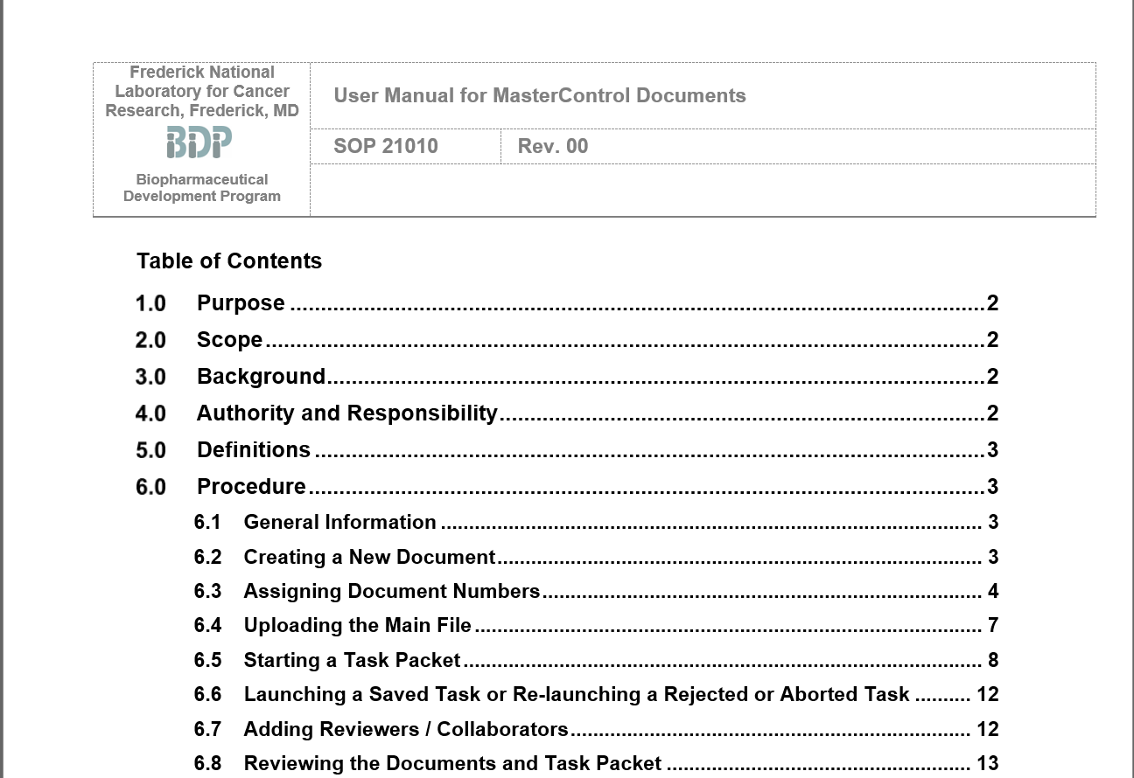
ATTRIBUTES OF CONTROLLED DOCUMENTS
Identification: Title, Type of document, Numbering Scheme
For example, a controlled document, such as this SOP example has a numbering scheme (SOP number), title, revision number.
On the next slide, you can see the approvals and effective date of the SOP on the right in screen shots from our electronic Documentation Management system (eDMS).
36

Slide 37
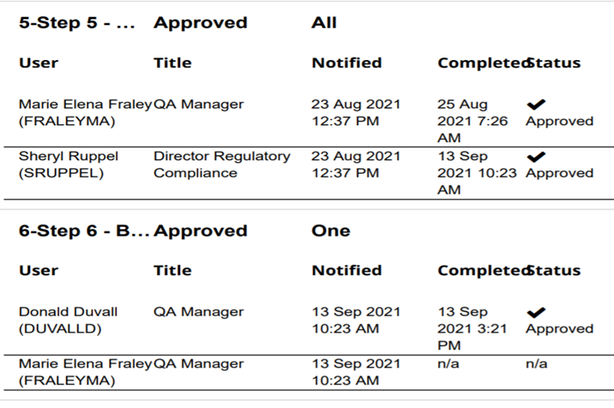
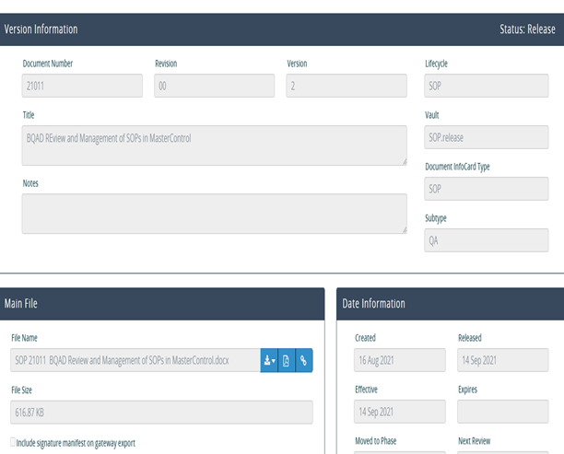

Approval Signatures and Effective Dates in eDMS
Signatures are in the eDMS Software under the History Tab; there is a link to the Complete History (screen shot on left below); Effective Dates are seen on the Info Card (screen shot on right)
37

Slide 38
Numbering of SOPs
Number Series | Description | Abbreviated | Start at Number
10000 | Manufacturing Operations | Mfg-Ops | 10306
11000 | Facilities and Equipment | Fac-Equip | 11170
12000 | Late Process Sciences – Fermentation | Mfg-Ferm | 12242
13000 | Early Process Sciences Cell Culture | Mfg-Cell Cult | 13249
14000 | Late Process Sciences – Purification | Mfg- Purif | 14154
15000 | Late Process Sciences - Fill/Finish | Mfg- Fill/Fin | 15154
16000 | PA Development – Analytical | PA-Dev | 16166
17000 | Early Process Sciences – Virology | Virus Dev/Mfg | 17130
19000 | Late Process Sciences – Support | Mfg-Support | 19505
20000 | Materials Management and Inventory Control | MMIC | 20405
21000 | Quality Assurance | QA | 21915
22000 | Process Analytics | PA-QC | 22978
24000 | Regulatory Affairs | RA | 24415
25000 | Early Process Sciences - Research and Development | EPS-RD | 25125
26000 | Safety | Safety | 26303
38

Slide 39
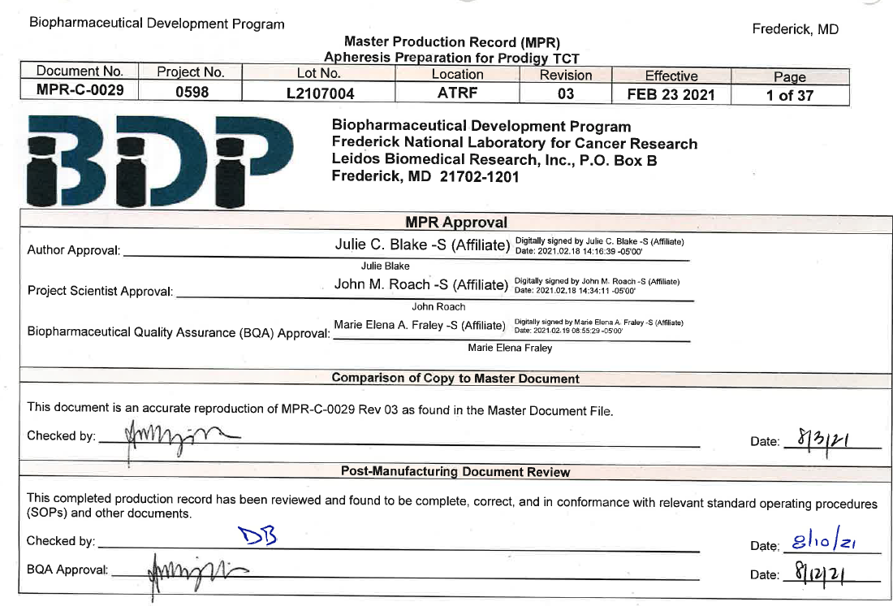
ATTRIBUTES OF CONTROLLED DOCUMENTS
Identification: Title, Type of document, Numbering Scheme
This MPR (Master Production Record) is also a controlled document. (An MPR provides all the instructions and requirements for the production of a product or subproduct). This MPR is assigned a number (MPR-C-0029) as well as a title “Apheresis Preparation for Prodigy TCT”. You can see that this document has an effective date (FEB 23 2021), revision number, and a list of MPR Approvers.

Slide 40
ATTRIBUTES OF CONTROLLED DOCUMENTS
Controlling Originals
Masters – the original documents with the actual signature of authors and reviewers or the original of executed processes (like an original MPR), is protected in Document Control. Masters are retained for time periods according to established policies. In five years, when we need to research how a particular process was designed, or if we need to review the records of a batch, we’ll consult the original documents. Therefore, these originals must be protected.
They must be protected from loss, misfiling, adulteration. And they must be protected from physical hazards like fires or water damage (for example from leaking roofs or basements).
We archive original documents in our high-density file room (E2814) – see next slide. Older documents are stored in off-site storage at a commercial archive service.
Document storage areas have access restricted to personnel with the combination to the door.
40

Slide 41
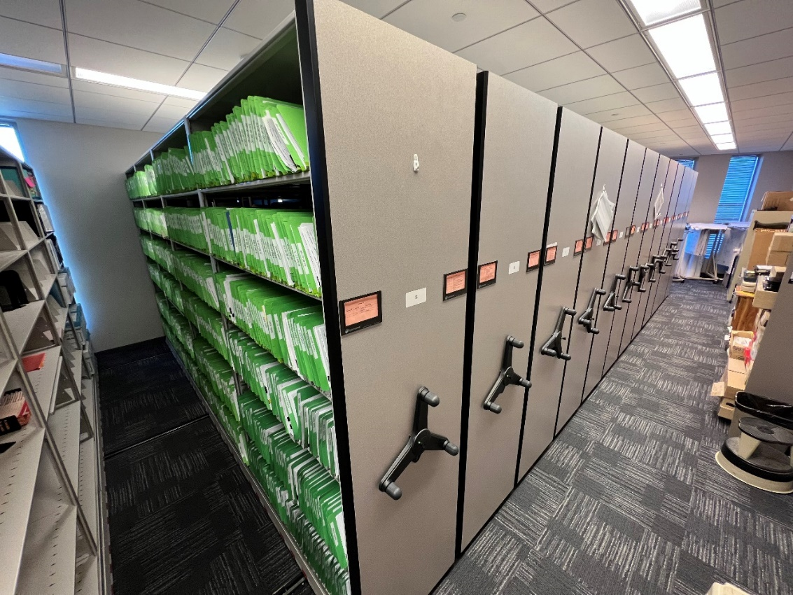
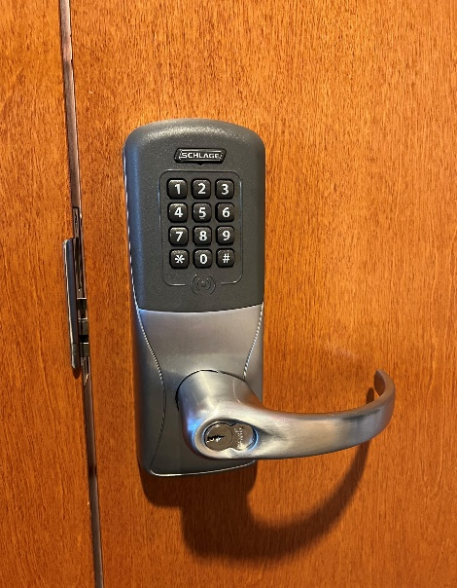
ATTRIBUTES OF CONTROLLED DOCUMENTS
Controlling Originals
This is the BDP’s Document Control room.
The entrance door is kept always locked. The access to the combination code is controlled to limit the access the documents.

Slide 42
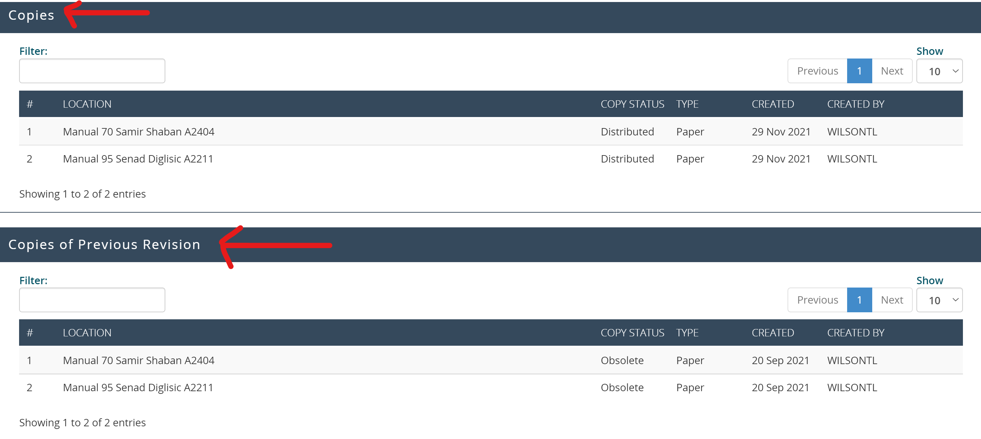
ATTRIBUTES OF CONTROLLED DOCUMENTS
Tracking of Copies
Companies develop different strategies to control copies of documents. For the BDP, controlled copies are managed through our eDMS system. This is important because as SOPs change or are revised, the current version must be available to people who need it. The tracking in the system allows controlled copies of updated SOPs to be issued and obsolete copies to be returned. Returned copies are identified as destroyed.

Slide 43
ATTRIBUTES OF CONTROLLED DOCUMENTS
Tracking of Copies
Official copies of controlled SOP documents are tracked in QA Document Control so that they know what SOPs have been issued and which old ones have been retrieved.
Information Tracked:
Manual Number
Manual Owner
Location of Manual
Paper or E-Copy
Date Printed – on the physical copy
Printed by – on the physical copy
Copy Status, Distributed, Obsolete or Destroyed

Slide 44
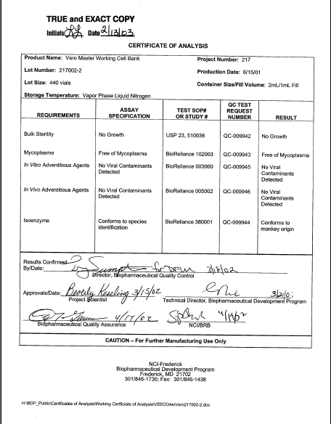
ATTRIBUTES OF CONTROLLED DOCUMENTS
Copying
The originals of MPRs, SOPs Spec Sheets are GMP documents and must be controlled. COPIES of these documents, when used for GMP purposes must also be controlled. We’ve seen how QA Documentation tracks copies of SOPs by a tracking number on individual copies, and how MPRs are copied and issued by QA Documentation for use in a specific lot.
Sometimes we need COPIES of GMP documents, especially data worksheets, for example, to put in a report or if the document will be filed in several locations. COPIES of worksheets and data sheets are also controlled to assure that they present accurate information. Copies of original data sheets need to be stamped “true and exact copy” with the name and date of the person making this certification. It’s easy to alter copies so that they no longer reflect the information on the original. This can be done inadvertently or purposefully. A spec on the glass of a copier can add an apparent decimal point where there shouldn’t be one. Stamping copies “true and exact” and having someone take responsibility for the accuracy of the copy (by signature and date) is an important part of document control.

Slide 45
Tracking of Forms
Data Integrity and Compliance with CGMP
Questions and Answers
Guidance for Industry
How should blank forms be controlled?
There must be document controls in place to assure product quality (see §§ 211.100, 211.160(a), 211.186, 212.20(d), and 212.60(g)). For example, bound paginated notebooks, stamped for official use by a document control group, provide good document control because they allow easy detection of unofficial notebooks as well as any gaps in notebook pages. If used, blank forms (e.g., electronic worksheets, laboratory notebooks, and MPCRs) should be controlled by the quality unit or by another document control method. As appropriate, numbered sets of blank forms may be issued and should be reconciled upon completion of all issued forms. Incomplete or erroneous forms should be kept as part of the permanent record along with written justification for their replacement (see, e.g., §§ 211.192, 211.194, 212.50(a), and 212.70(f)(1)(vi)). All data required to recreate a CGMP activity should be maintained as part of the complete record.
45

Slide 46
Summary
Forms that document work are GMP documents.
Forms have form numbers and revision numbers. Our eDMS electronic documentation system shows the approval signatures and effective dates for forms.
If you are using a form to document a GMP activity and that form does not have this information, then you are not using a GMP form.
Remember, procedures must be written and approved. Without tracking information for controlled documents, you can’t prove that the document was ever approved for use.
46

Slide 47
Templates – Starting Points
Use of a template is one of the mechanisms that Companies use to improve the presentation and readability of their documents. The BDP have templates for things like SOPs, Certificates of Analysis, Master Production Records, Master Specifications, and Raw Material Specifications.
Documents presented in the same format make it easier for readers to find information. It also prompts document writers to provide consistent information.
For example, templates for raw material specifications have a section for manufacturer, for manufacturer’s part number, the product name, etc. GMPs don’t specifically require the use of templates, but using templates makes it easier for everyone to organize and digest information.
(See next slide for examples of templates)
47

Slide 48
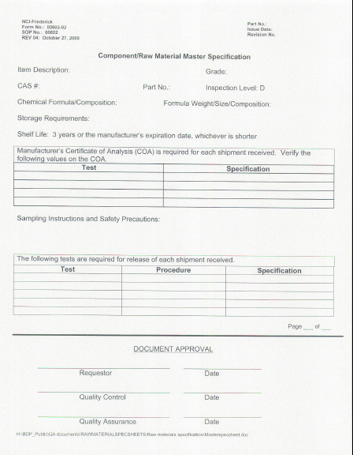
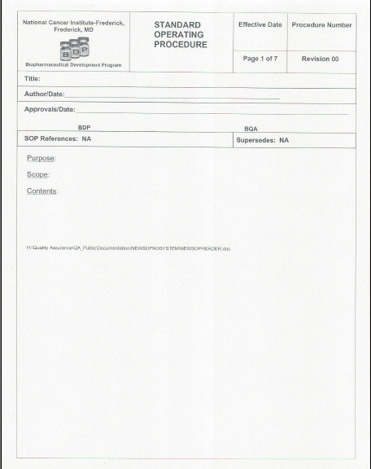
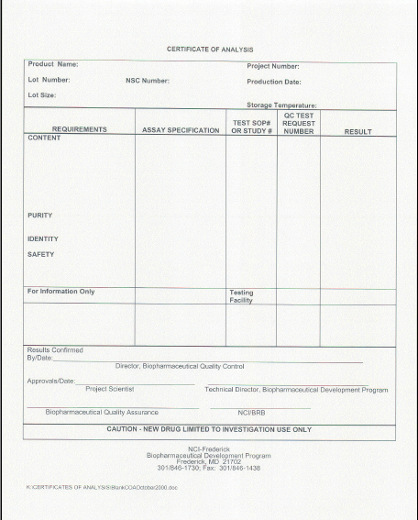
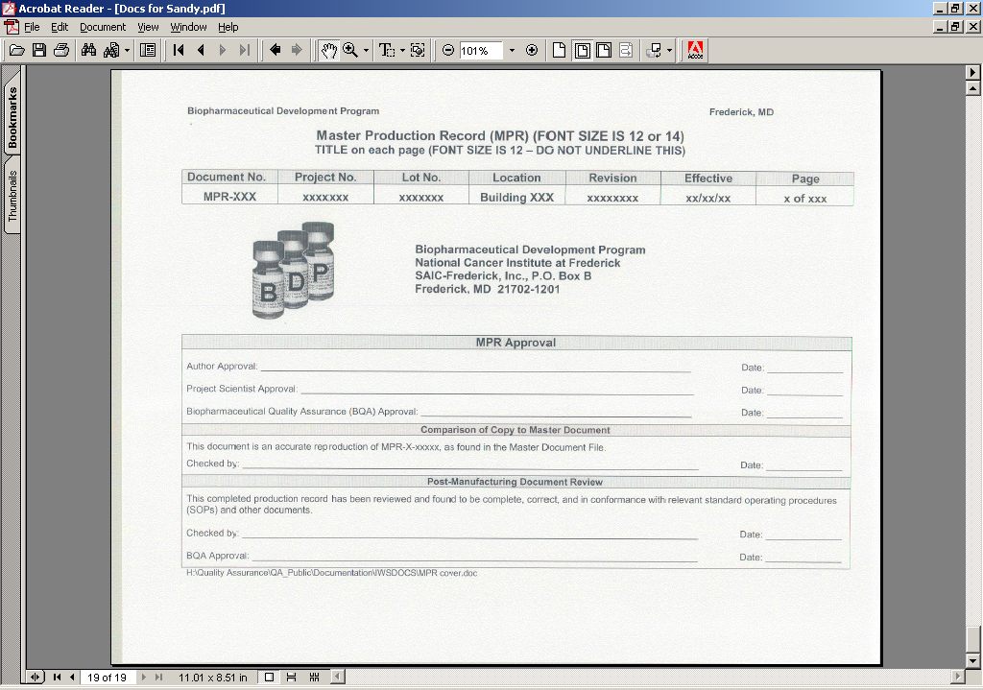
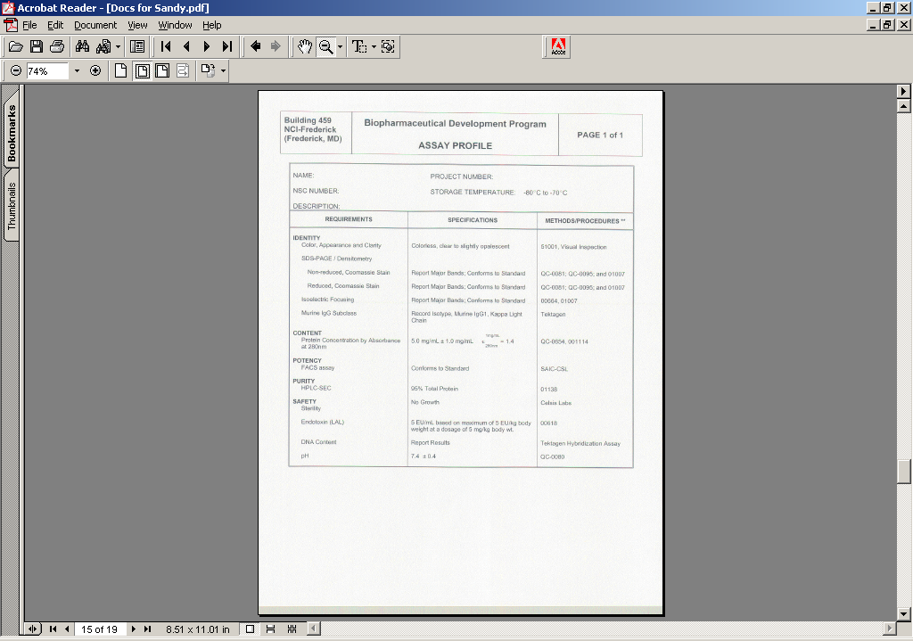
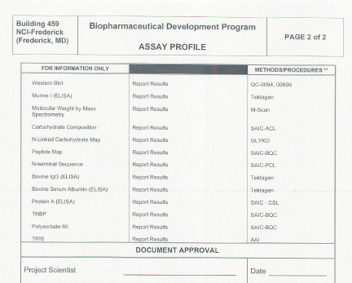
Templates – Starting Points for Records
48

Slide 49
CONTROLLED DOCUMENTS:
OPTIONAL ATTRIBUTES
Companies can use other mechanisms to help them control documents.
Paper color
Use of watermarks
Use of document print dates
Use of security paper (lines appear as document “ages”)

Slide 50
  How These Documents Are Written is Important
We work from GMP documents like SOPs. For a process, they tell us what to do and how to do it.
These documents need to be well-written so that it’s clear to all readers what is being specified. Although operators and technicians are the most common users of these types of documents, they are not the only audience for a document. QA auditors, outside auditors and inspectors are all readers of the document and therefore the document needs to be written at least with some consideration that these individuals may be an audience.
Another challenge is that these documents create the record of an activity that might be reviewed years after the event. You, the technician, may no longer be here to explain the document. The document has to speak for itself and it has to do that clearly.
The procedures must be detailed enough that someone who has never performed the procedure, but has some general expertise in the science, can pick up the document and carry out the instructions sufficiently to prepare product/process that meets specifications and expectations.
50

Slide 51
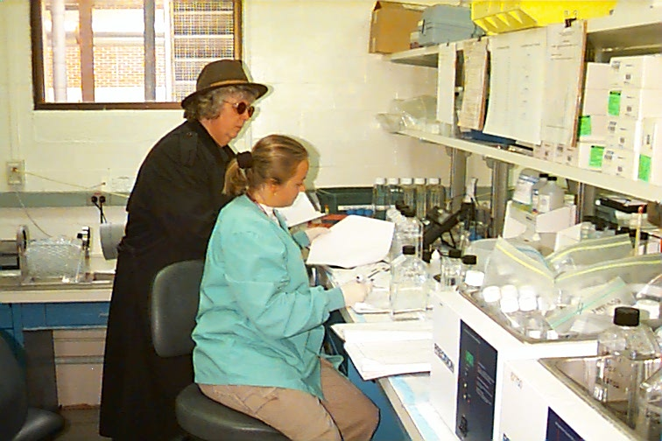
How These Documents Are Written is Important - Summary
They document our policies, processes, procedures, specifications, and data capture
  We work from them
  We make decisions from them
  We troubleshoot from them
  They create the history of our work
  They are reviewed during audits & inspections

Slide 52
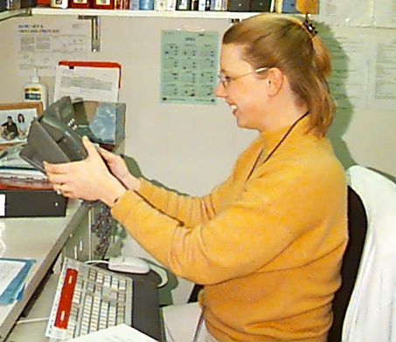
CLARITY OF INSTRUCTIONS
Placing a phone call
Hello ?….
Hello ? …
HELLO !!!
Instructions for placing phone call could be written like this.
Pick up phone
Dial number
Start talking
For new hire, the instructions were not clear enough to perform the task properly.
52

Slide 53
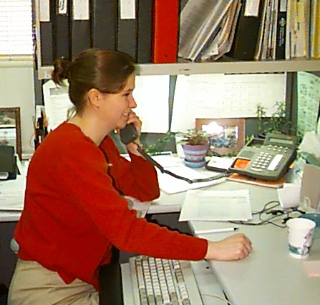
Placing a phone call
Or it might to written like this (see below). Obviously, this set of instructions is more thorough. And probably over-kill for most of us. But, for a new hire, an auditor, an inspector or to completely describe the process, these set of instructions might be useful.
Pick up the phone handset and listen for a dial tone.
When the dial tone sounds, input the phone number.
Listen for tones in the handset to indicate call status.
Hello, I’m calling..
  Ringing - call is being placed
  Busy signal - receiving phone is in
  use
  Fast busy signal- phone circuits are
  busy (and not necessarily the receiving phone)
  Screeching sounds- receiver is a fax machine
4. If the call is answered, start talking.
  Some receiving phones have “voicemail”
  capabilities and will allow you to leave a
  message if a person is unavailable.
For all other results, (busy signals, screeching sounds, no answer), hang up and try again later.

Slide 54
Users of Documents - It’s not all about YOU
The clarity of documents is subjective. A technician who performs a process every day doesn’t need an SOP that presents the theory of the process or very detailed instructions. But this technician is not the only person who will ever use this document. It will be used to train new hires, it will be used by auditors as they perform oversight for the department, it will be used by Regulatory Affairs personnel as they prepare CMC sections for submissions to FDA, it will be used by inspectors and third-party auditors, and it may be consulted years from now to troubleshoot an event, or as part of technology transfer.
Remember the potential users of your document. Your document must meet the basic needs of these users.
54

Slide 55
“Wiggle” words in the GMPs
(appear over 100 times)
“Appropriate” ; “Adequate” ; “Suitable” ; “Sufficient” ; “As necessary”
For example: “Equipment . . . shall be of appropriate design, adequate size and suitably located ….” (21 CFR 211.63)
If you read the GMPs, they are full of “wiggle words”. In the GMPs, the words “suitable”, “appropriate”, “adequate”, “sufficient” and “as necessary” appear over 100 times. For example, “Equipment shall be of appropriate design, adequate size and suitably located ….” or “In-process materials shall be tested for identity, strength, quality, and purity as appropriate”.
Because the GMPs were not written in a prescriptive manner (you must do it this way, or you can’t do it that way), companies are able to design their processes so that they are effective and productive in that company’s environment. FDA didn’t want to lock industry into one way to accomplish a goal.

Slide 56
BUT … flexibility in the GMPs does not translate to flexibility in SOPs
GMP REQUIREMENT
21 CFR 211.101(c ): “Weighing, measuring, or subdividing operations for components shall be adequately supervised”.
WHAT SHOULD YOUR SOP SAY?
Weighing operations must be supervised by appropriate personnel.
or
2) Weighing operations must be supervised by department staff members that have up-to-date training on BDP policies and procedures for weighing (SOP 21500, General Policies and Procedures for Balances).
We like the phrases appropriate, suitable, adequate etc, in the GMPs,
We don’t like them in our Company procedures. We WANT our procedures to be prescriptive. We want it to be very clear how a procedure is to be performed.

Slide 57
Clarity of Documents
Obviously, this is a challenge for us since part of what we do is to develop processes. It’s hard to define a process when it’s still being developed. If you need some degree of flexibility because you don’t have experience with a process, build the limits of flexibility into the instructions. Set the limits of operator discretion into the instructions. so for example:
“The flow rate should be set to 1 mL/minute or to a rate that is appropriate.”
(Too much operator discretion – no limits)
“Select a flow rate that allows the elution tracing to return to baseline between the elution of the various components (generally 1.0 ± 0.5 mL/minute).”
(More defined process – some basic limits)
Need a target value and limits

Slide 58
Watch Out for Words Like:
Watch out for words like these in SOPs or procedures. These words may be a signal that the procedure isn’t as well described as it could be.
Suitable
Appropriate
Adequate
Sufficient
As necessary
At technician discretion
Frequently
Occasionally
When needed
If desired
May
Might
Should
Can

Slide 59
Documentation Practices
Documentation is important. In FDA inspections, over half of the time is devoted to review of documentation and records. This is how FDA evaluates how your systems are designed and if you are following them. We also devote a significant time resource reviewing documentation.
Many different people will meet you through the documentation that you complete and they will form an opinion about your credibility and competence based on your documentation.
After the product is distributed or the project completed, only the paperwork remains to tell the story.
59

Slide 60
RECORDING DATA
GMPs require that you prepare written procedures to describe your procedures. The GMPs also require that these written procedures be followed. (Imagine that!). GMPs also require that activities performed as a result of these GMP procedures, be documented at the time of performance.
The data captured in these records needs to be sufficient to reconstruct the events.

Slide 61
Are Your Documents Credible?
Records are the testimony to the activities that were performed in the manufacture of a product. These records will be judged for their credibility by everyone reviewing them in the same way that a jury judges the credibility of a witness at a trial.
A record that is clear, complete and legible presents the impression that the activity documented was also conducted in a careful and complete manner. Similarly, incomplete, illegible and/or inaccurate records present the impression that an activity was conducted without the concentration and care required to produce quality work.
YOUR credibility, based on the written records you complete, may be judged by whoever sees the document without ever having met you as a person face-to-face. Your records need to present you as a credible employee performing the documented activities with knowledge, training and competence.
The credibility of YOUR documents adds to the credibility of the Company as a whole.
Poor documentation in one department may make reviewers anticipate poor documentation in other departments.

Slide 62
WARNING LETTER
Throughout these GMP sessions, we’ll be looking at some Warning Letter citations. You may know that after an inspection FDA may leave a list of observations that the inspector or inspectors find objectionable. Theses are called 483 citations. When this citation is of high significance and FDA wants to get the Company’s attention, FDA re-issues these findings to the Company in a Warning Letter. These are the findings that the AGENCY finds objectionable and require a Company response. Warning Letter citations often start out as 483 citations.
Warning Letter citations will appear in a red stop sign as a subtle reminder that if this is what YOUR company is doing, you might want to STOP and think about how you would justify that activity.
FDA will test the credibility of your documents.
By the way - Warning Letters are public!
WARNING LETTER

Slide 63
WARNING LETTER – Cleaning Records
At Ranbaxy Labs, inspectors checked that signers of cleaning records were actually at work (based on the security logs) on the day they said they verified equipment cleaning. Now, FDA does not just have a concern with these cleaning records, but they now have a concern with ALL the company’s records. Wouldn’t you? Does this Company have a culture where fraudulent data recording is permitted?
WARNING LETTER
Our investigation team
discovered 14 instances where
cleaning records for equipment
used in manufacturing operations
included initials or signatures of
employees who reportedly verified
cleaning of equipment but were
not shown as present by
security log records.
Ranbaxy Laboratories
2

Slide 64
WARNING LETTER – Testing Records
This is a citation from a Warning Letter to Merck
At Merck, I would expect that FDA reviewed the report that stated the test results and then asked for the evidence that the reported results were accurate – for example, the test record. If the test record could not be located – that’s a problem. If the test record was falsified – that’s also a problem. If the test results from the test record were incorrectly transcribed to the test report – that’s a problem.
FDA found fraudulent documentation practices in one department. FDA then has been sensitized to this problem in one department and will tend to scrutinize documents from ALL departments to detect evidence of similar problems in these other departments.
Merck’s reputation as a credible company…? Not this year. It is standard practice for FDA and customers to review previous audit notes during subsequent inspections. Unfortunately, even if you’ve corrected the problem, the concern continues to be an issue inspection after inspection, year after year.
WARNING LETTER
According to your own internal
investigation, your employees
reported test results for which
no testing occurred.
Furthermore, your management
review of the qualification protocol,
test results, and the final reports
failed to prevent or even detect
the problem.
MERCK

Slide 65
Or look at this Warning Letter citation
Look at the position these companies are in. Their own people need to evaluate records to determine if lots were manufactured according to GMPs and are releasable. FDA needs to evaluate records to determine if the company is operating in compliance with GMPs.
Now there is information that the records are not accurate and credible. How can you make a decision based on records that are not accurate and credible.
WARNING LETTER
The authenticity of signatures (on
finished product testing records) purporting
to indicate review by a second person
is in question.
The person, who is represented as having
performed this review, has stated to our
Investigator that the signature
appearing on a number of these records
is not his.
Cardinal Enterprises, Inc

Slide 66
How your documentation looks can be as important as what it says
We all evaluate information for its credibility to help us decide whether or not to trust the information.
A jury will look for signs of credibility in a witness. Are they sweating, fidgeting? Are they straightforward with the answers to questions?
A parent will look for signs of credibility when their child explains that HE didn’t break the lamp.
And in documentation, we look for signs of credibility to help us decide whether or not to trust the information.
Like it or not, the records you generate will be evaluated for their credibility, and by association YOUR CREDIBILITY, and the credibility of the Company.

Slide 67
Characteristics of Credible Records
Our goal is to generate credible documents which may not be perfect documents. In fact, often a perfect document is not credible because it is unbelievable that a whole, usually complicated process can be performed without the need for any correction, deviation or need for an explanation.
So we need to use techniques in creating records that enhance the credibility of the record.
Some characteristics of credible records are on the next slide.
67

Slide 68
More Characteristics of Credible Records
Use pen
Be legible
Be accurate
Enter data at the time it is done
Insert printouts into the record properly
Do not transcribe from another piece of paper
Be complete, fill in blank spaces with data or use “N/A” (not applicable)
Document any deviations or unusual events
Make corrections properly (single line-out & add correct info, initial, date, and reason)
Don’t “overwrite”
No “white-out”
No post-it notes
Sign (or initial) your work and date it
Work is reviewed by another party

Slide 69
Characteristics of Credible Records
Use Pen
Ink identifies the record as permanent. Using pencil, because it is erasable, presents the impression that you are making it easier to change the record at some point in the future. For data written in pencil, you will never know if the entry you are looking at today, is the same entry that was initially recorded.
69

Slide 70
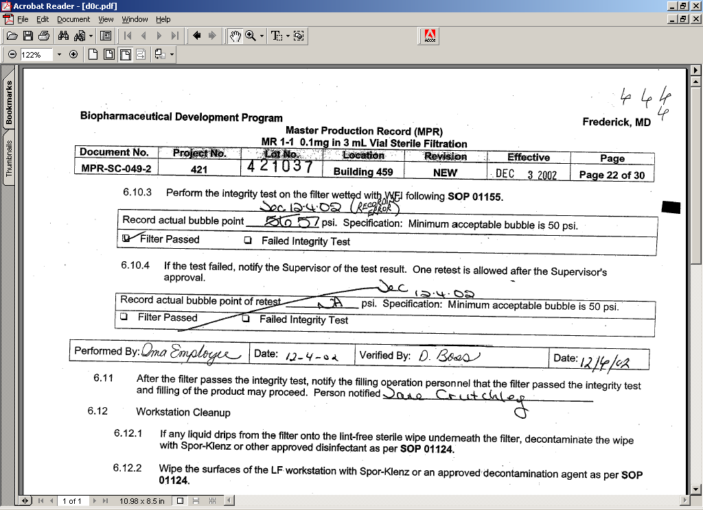
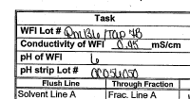
Characteristics of Credible Records
Be Legible
12/4 or 12/6?
0.95 or 0.45?
An illegible entry increases the risk that the entry will be misinterpreted. In the top right box, this activity was performed by Ima Employee on 12-4-02 and was verified by D. Boss on 12/4 or 12/6 ? In the bottom left box, is the conductivity of the WFI 0.95 or 0.45?

Slide 71
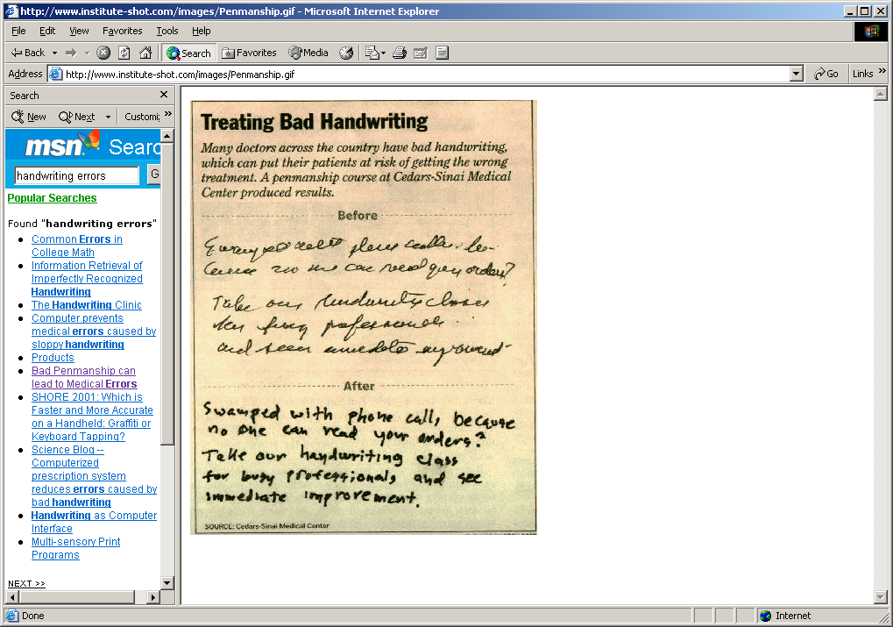
Characteristics of Credible Records
Be Legible – Example of Bad Handwriting
Try to read this example of bad handwriting. Then go to the next slide

Slide 72
Characteristics of Credible Records
Be Legible – Better Writing
Here is what the handwriting says:
Swamped with phone call, because no one can read your orders? Take our handwriting class for busy professionals and see immediate improvement.

Slide 73
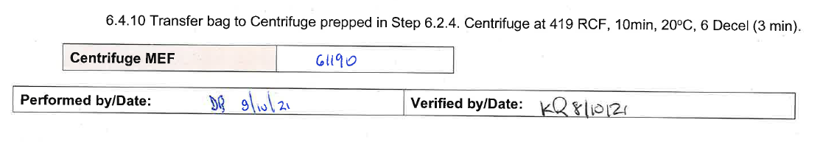
Characteristics of Credible Records
Enter Data At The Time It Is Done
Enter data at the time the activity is performed – not later when you need to rely on memory for the information.

Slide 74
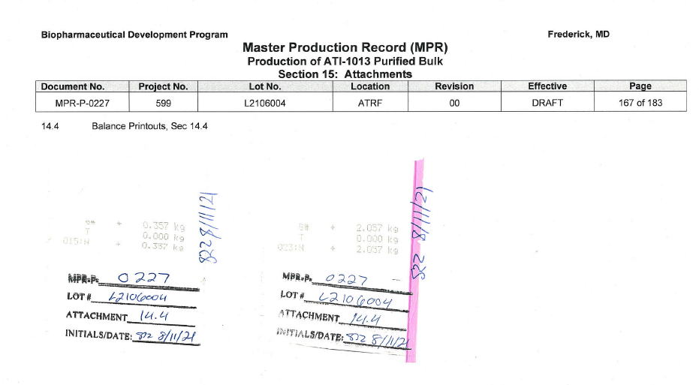
Characteristics of Credible Records
Insert Printouts Into Records Properly
Insert printouts properly into the record. Printouts should be clearly identified with run number, date, technician and with appropriate information indicated (sample location, etc). Printouts should also be inserted into the record using permanent tape and by signing across the page/printout interface.

Slide 75
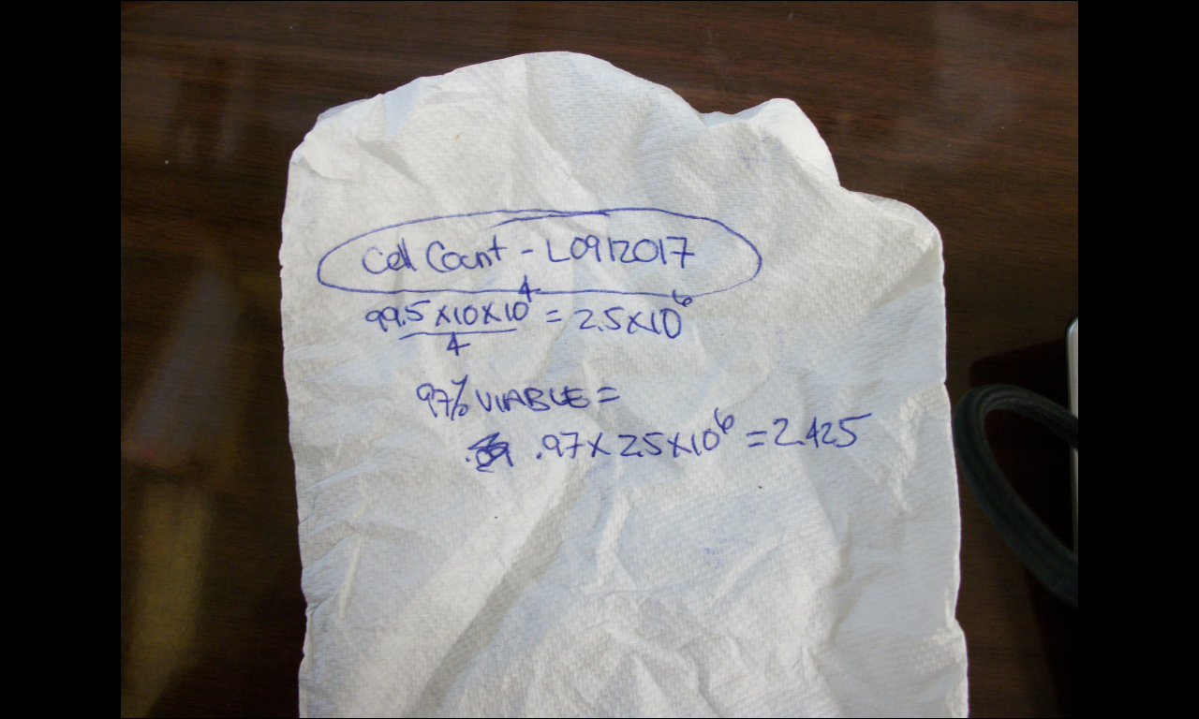
Characteristics of Credible Records
Do Not Transcribe From Another Piece Of Paper
The first time the data is written, it is RAW data. Recording raw data on one sheet of paper (like a paper towel, or a “sticky’ note) means that the raw data IS that paper towel or the “sticky’ note. Transcribing the data from the paper towel to the proper form allows transcription errors. Put the data where it is supposed to be (on the form)
However, if you DID record raw data on a sticky note or a paper towel, that is now the raw data and must be retained. So, you would need to permanently attach it to the batch record.

Slide 76
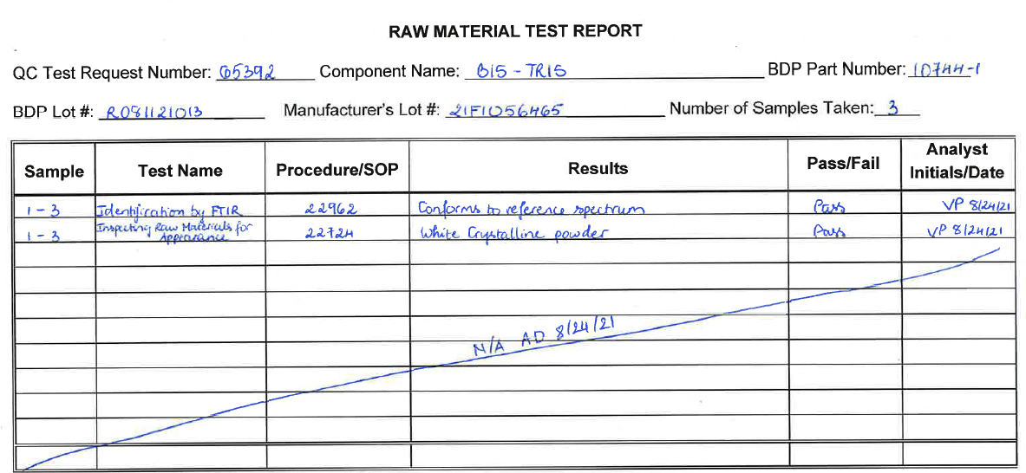
Characteristics of Credible Records
Be Complete, Fill In Blank Spaces With Data
Or Use “N/A” (Not Applicable)
Complete all the information asked for on the worksheet. If the document is asking for a temperature to be recorded, measure the temperature and record it. If it asks for a pH to be recorded, measure the pH and record it. If the information requested is not applicable, write “N/A”.
In this example, raw material testing was completed. All the tests performed are documented on this report. For this material, only two tests were performed. Therefore, the rest of the rows on the report are “not appliable”, and this was correctly noted on the document.

Slide 77
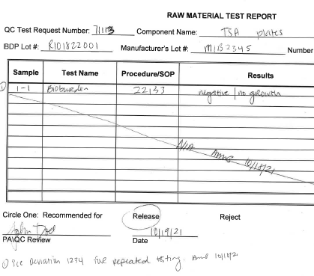
Characteristics of Credible Records
Document Any Deviations Or Unusual Events
DOCUMENT ANY DEVIATIONS OR UNUSUAL EVENTS. Footnoting documents when you need more room for an explanation is acceptable

Slide 78
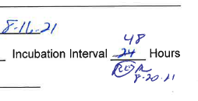
Characteristics of Credible Records
Make Corrections Properly
Make corrections properly. When corrections are required, make them so that it is clear what the correct data is, who made the correction and when the correction was made. Corrections need to be made with a single line cross-out, initials for the person making the correction, date and the explanation of the data change

Slide 79
Characteristics of Credible Records
Make Corrections Properly
Sometimes entries need to be explained. Corrections to data entries need an explanation, but sometimes other entries require an explanation to be truly accurate. Explanations can be provided with a short phrase near the data entry or explanation codes may be used. Whether you choose to use error codes or just a short explanation, the reason for the change in the entry needs to be clear.
These are the error codes defined in our SOP for Good Documentation Practices. Most of these codes are self evident. But a few may need clarification.
LE is used to indicate that the entry is being made late. It is not used to correct an original entry. So if you recorded that the calibration due date for your pH meter was 1/15/02 and later realized that you should have indicated 1/15/03, the explanation code is not LE, but would be RE “recording error”. If you did not record the calibration due date for the pH meter at the time you were using it and 2 days later reviewing the data, discovered the missing information, then you would enter the missing data, initial and date the entry and provide the explanation code “LE”.
Data for entry into a record may also be provided verbally and this should be clear in the record.

Slide 80
Characteristics of Credible Records
Make Corrections Properly – Correction Codes
Additional EXPLANATION CODES
LE Late Entry
CE Calculation Error
UR Upon Review
RE Recording Error
N/A Not Applicable
SE Sample Error
AE Assay Error
TE Typographical Error
ES Equivalent Substitution
VD Verbal Data (and who provided the data)

Slide 81
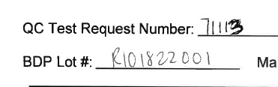
Characteristics of Credible Records
Don’t Overwrite
Overwriting is not acceptable. (Overwriting is turning a “3” into an “8”, or a “1” into a “4” or by darkening the correction so that it is no longer clear what the original entry was.
Once we allow over-writes, the credibility of all data is reduced. Next time you see an “8”, you’ll wonder whether it started life as a “3”. You’ll wonder WHO may have made it an “8”, when and why.
If it is clear that overwrites are prohibited, and you don’t see evidence of over-writes, your data becomes more credible and the documentation of the Company as a whole becomes more credible.

Slide 82
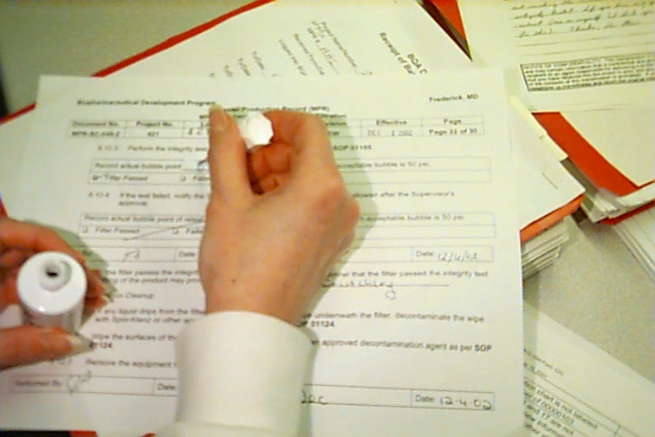
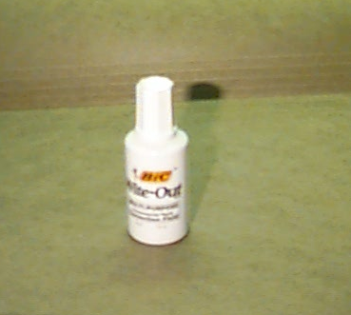
Characteristics of Credible Records
No White-Out
Use of “White-out”, correction tape, or anything else that obliterates the original entry is unacceptable because you can’t tell what the original entry was, who made the change and when the change was made. Use of white-out or correction tape may initially appear to make the document more “perfect”. Reviewers, however, aren’t looking for a PERFECT document. They are looking for a CREDIBLE document. Use of white-out, correction tape, magic marker (to completely obliterate the initial entry) begs the questions of what WAS the initial entry and why was it changed. It generates questions about the validity of the data.
Use of white out, correction tape or maker don’t provide the required information on WHEN the change was made. Was the change made BEFORE or AFTER the technician signed off on the data?

Slide 83
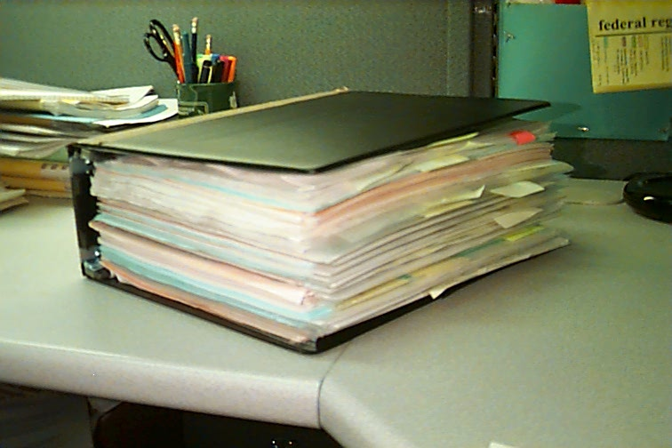
Characteristics of Credible Records
No Post-It Notes
Post-it notes are not GMP documents. Often, it’s not clear who wrote the note, or the note becomes stuck to the wrong piece of paper in a file. If a comment is important to make, use the comment section on the worksheet (if there is one), or write a memo ‘to the file” (with signature/date) stating your comment and clearly identifying the record the memo is associated with.
Alternately, a post-it note can be dated, initialed and permanently affixed to the file.
Use of post-it notes as “ticklers” “I need to come back here and review this section” is acceptable as long as the post-it notes don’t remain with the completed, final, document.

Slide 84
Characteristics of Credible Records
Sign (Or Initial) Your Work And Date It
Take responsibility for your work. Initial or sign off on your work and date it. A record is not credible if the person performing the work is not identified. Signatures are a legal and ethical responsibility

Slide 85
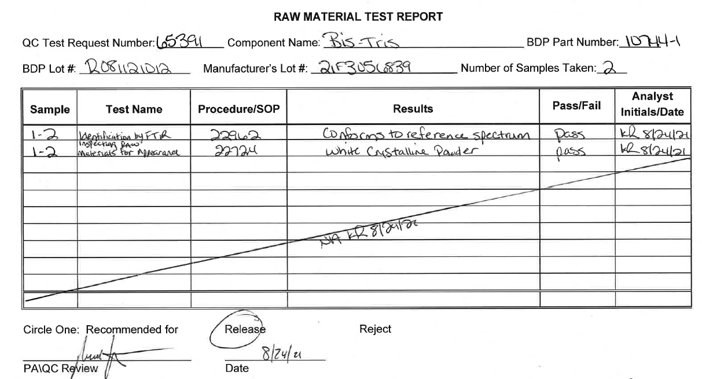
Characteristics of Credible Records
Work Is Reviewed By Another Party
The credibility of records is enhanced when work is reviewed by another party.
Checking and double-checking is an effective tool to guard against complacency. Effective checking and double-checking require discipline. Many places in our documents require a second signature. This is independent verification, not just a second signature. The second signature is the double check. The person performing the double check (independent verification) must understand the importance of their role and the consequences if they do not perform this task accurately and thoroughly.
(J of GXP Compliance, Winter 2010 – GXP Training Tips)

Slide 86
Characteristics of Credible Records
Work Is Reviewed By Another Party GMP Regs
GMP (1978) PREAMBLE
Comment: Several comments said the requirement for independent verification by a second person is unnecessary.
Response: The Commissioner finds that independent verification is a current practice and has been a GMP requirement since 1963. Independent verification has been found to be a valid means of uncovering errors which might, if left undetected adversely affect drug product quality.

Slide 87
Issues with verification of critical processes is a subject of Warning Letters
WARNING LETTER
  Each component is not adequately
  verified by a second person prior to addition
  to the batch. Specifically, there was a lack of
  assurance that verification was actually
  occurring since incorrect blends were approved
  for use in critical manufacturing steps.
  For example, although verification of the
  introduction of the correct powder blend for
  Aspirin 500 mg tablets was documented on
  the batch record, a blend for Aspirin 81 mg
  tablets was added instead.
Pharmaceutical Formulations
Edison, NJ

Slide 88
Warning Letter Example – Poor Document Practices
This firm has a history of poor documentation practices. FDA issued them a Warning Letter because similar issues brought to their attention in past inspections remain. FDA may deny entry of their products into the US. FDA gave the firm 30 days to contact them and discuss remedial plans. FDA also indicated to the firm that if any new applications are in front of the FDA, FDA would recommend disapproval until the firm can demonstrate compliance with GMPs
Complete, true and accurate records are
the foundation for good GMPs. Reliable
documentation is a control which raises
assurance of the quality of the product
manufactured. Violations concerning
inadequate documentation are serious and
should be handled as such.
Practices such as back dating and
signing for actions not performed
are serious violations.
(Wockhardt Ltd, Chickalthana)
WARNING LETTER

Slide 89
Characteristics of Credible Records
Work Is Reviewed By Another Party Verification
The credibility of records is enhanced when work is reviewed by another party.
Verified By: The information was independently
verified by another person. For example,
vial reconciliations, calculations, etc.
Witnessed By: The activity was witnessed by
another person. Usually, an activity needs to be
witnessed if there is no other documentation that
provides evidence that the activity was performed.
For example, adding materials to a formulation or
confirming a weight of a chemical when the scale
does not provide a printout.

Slide 90
Documents Aren’t Credible
If Verification Of Processes is Wrong
Auditors recheck calculations as an additional verification. So they shouldn’t find any discrepancies, right?
“The incorrect Part Number, Lot Number and Expiration Date for a solution was recorded in the BPR at least 3 times. The solution was not released, was never brought into Room 12 and was not appropriate for the project. The information recorded was signed as verified.”
VERIFIERS need to check every piece of information associated with the calculation. If the calculation uses a value from another step, the verifier needs to verify that the data was properly transcribed from the earlier step.

Slide 91
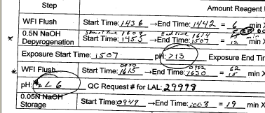
Documents Aren’t Credible
If Verification Of Processes is Wrong
Why did the auditor object to this value? The value inputted was the specification for the pH (<6) and not the actual pH value. You need to input the actual value, so it can be independently compared to the spec.

Slide 92
Documentation Is Proving
Manufacturing Requirements Are Met
You developed a plan and
You executed the plan
THE DOCUMENTS
WILL TELL THE STORY
In an FDA inspection, documentation review is a major part of their review. Yes, inspectors will listen to your explanations, but they will look to the DOCUMENTATION for proof.

Slide 93
Here are some observations from an auditor:
Auditors check that the stated quantities in the Batch Record are traceable and consistent with associated documents that also state quantities.
“Volume of Pooled Virus is recorded as 72 mL. The two runs list the estimated yield volumes as 32.5 and 42 mL. This would be 74.5. Is the 72mL an actual measured amount?”
“Starting pooled virus volume on page 26 is 72 mL. According to the record 75 mL of virus was added. Where did the additional 3 mL come from?”

Slide 94
Recorded QC Data Needs To Match
QC Test Request Documentation
Auditors check that QC results stated in Batch Record are traceable and consistent with associated QC Test Request documents
Here is an observation from an auditor:
“A260/A280, QC Request Number 028852, has results recorded as 1.2 mg/mL and a ratio of 1.90. The BPR has a recorded concentration of 1.1 mg/ml and ratio is blank. What is recorded in the BPR does not match the QC results..”

Slide 95
Recorded QC Data Needs To Match
QC Test Request Documentation Continued
Auditors look for evidence that work was documented at the time it was performed
Here is an observation from an auditor:
“The BPR states that QC#s 28847, 28846, 28843 and 28842 were all submitted by Production on 12/20/05. These QC request forms were all initialed/dated as submitted by Production and accepted by Accessioning on 12/16/05.
The date in the BPR is not the same date as the forms.”

Slide 96
Pay Attention To Significant Digits
Expectation: use the same number of significant digits as the specification or batch record. If the spec is presented in tenths of a gram, document your weight to the tenth of a gram.
Reference SOP #22012, Significant Figures and Rounding of Numbers

Slide 97
Warning Letter Example – Completing Production Records when the work is performed
WARNING LETTER
There were production records that were
completed prior to completion of the production
run. The production ticket for Lice Shampoo,
lot 4B19C, was signed off indicating
that 1440 units, or one pallet load, were filled,
when in fact the filling was still in progress
for the pallet of product.
Enter data at the time the activity is performed – not later when you need to rely on memory for the information

Slide 98
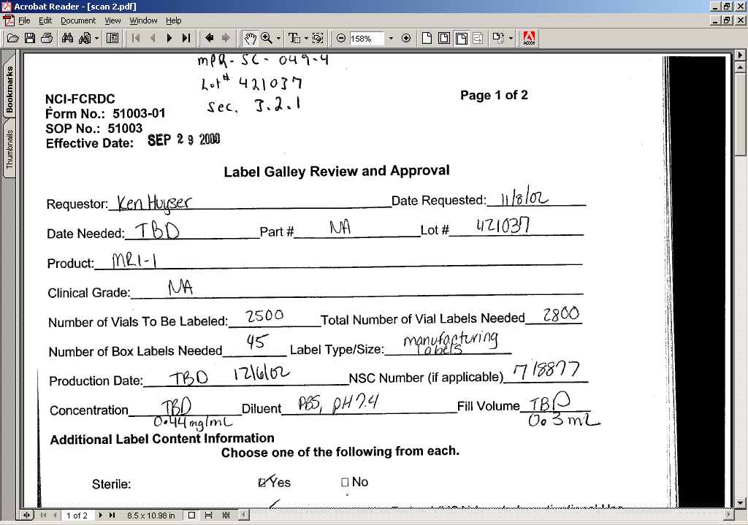
What Do You Think About This?
Entry “TBD” is unclear, especially as it relates to the entry for concentration and Fill Volume. Was the 0.44 mg/ml entry for “concentration” made after the TBD entry? Who made it? When?

Slide 99
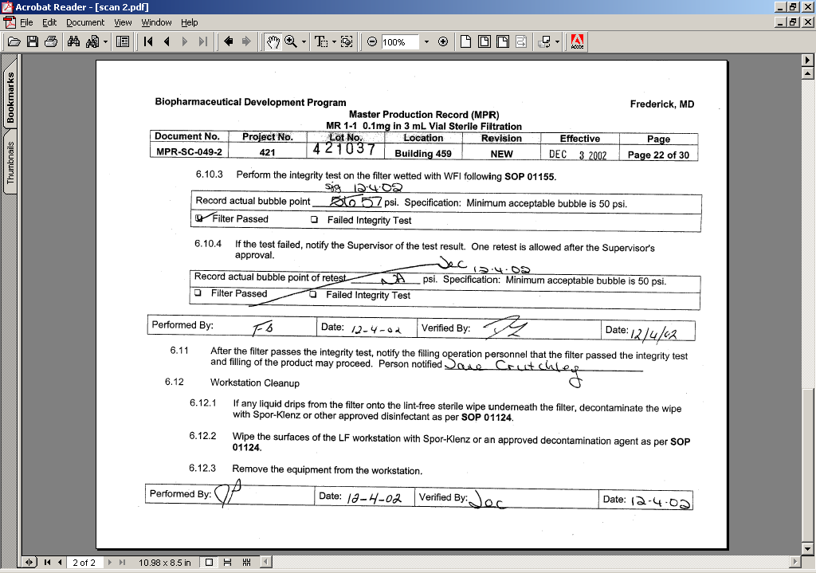
What Do You Think About This Record?
Correction to the line “Record actual bubble point” does not include an error code for the correction made.

Slide 100
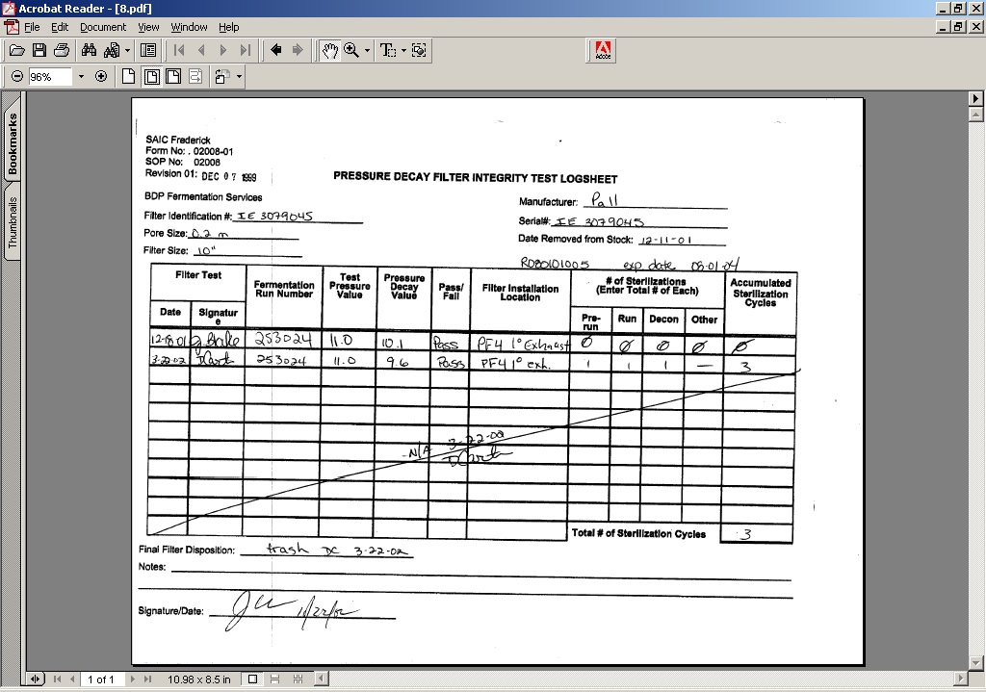
Another Example -What Do
You Think About This?
The “Notes: section (at bottom) is blank and is not NA’d. This makes it unclear whether you “forgot” to make a comment or you had nothing to say. It also allows someone to enter a comment later and it will look like your comment

Slide 101
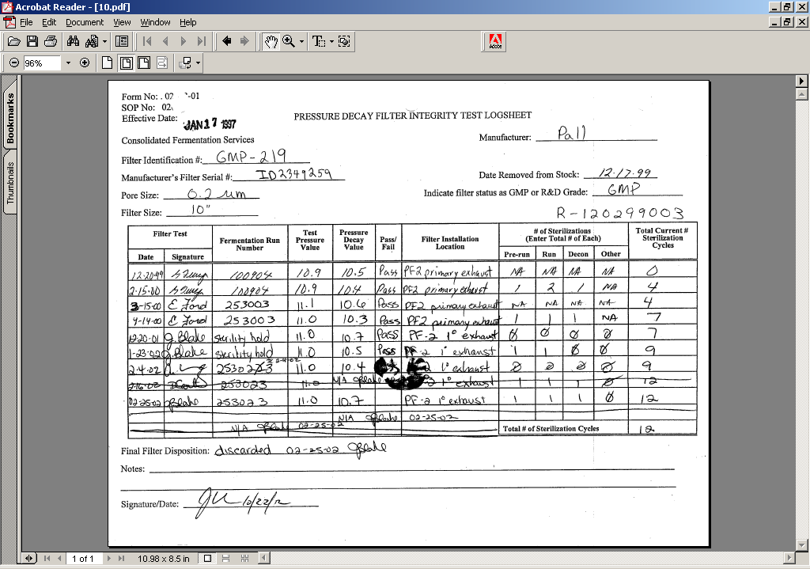
What Do You Think About This? Example 3
Blob at center is a result of a wet object bleeding the ink on the page. Need to pick pens with ink that is indelible. Over-write of date. “Notes” section at bottom should include “NA”

Slide 102
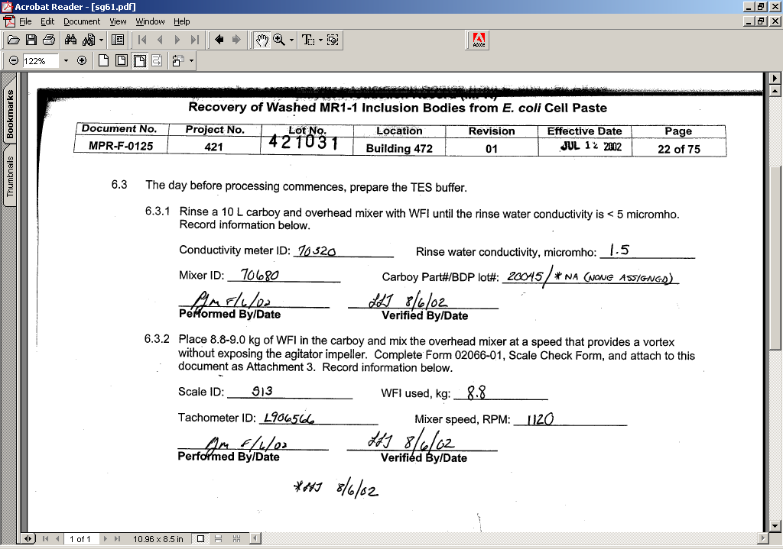
What Do You Think About This? Example 4
Note the “*NA” and the asterisk directing attention to the footnote at the bottom where the technician's initials and date are located. This is an acceptable practice to direct where additional information about the entry is located.

Slide 103
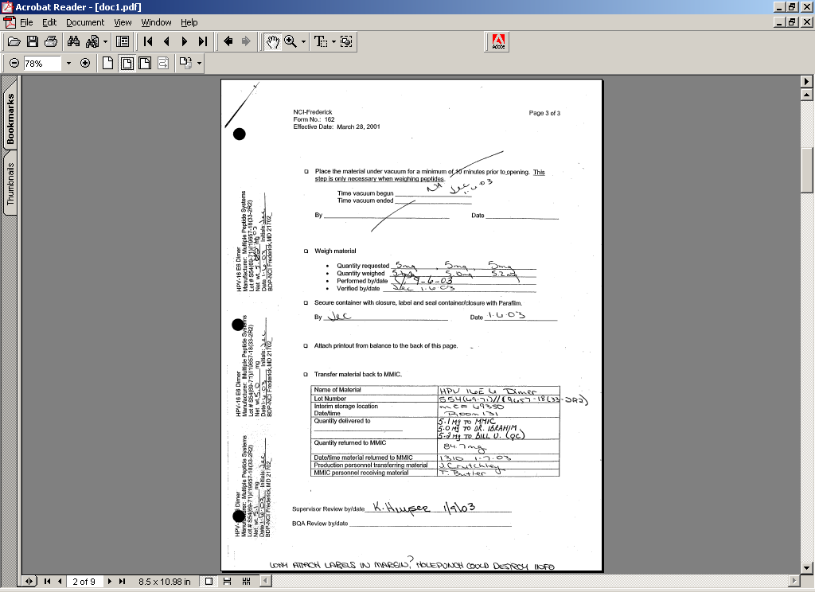
What Do You Think About This? Example 5
Obviously, this document was part of a 3-ring folder. Be careful where you affix printouts and sample labels. Punching of holes in the document to incorporate it into a file destroys some of this information.

Slide 104
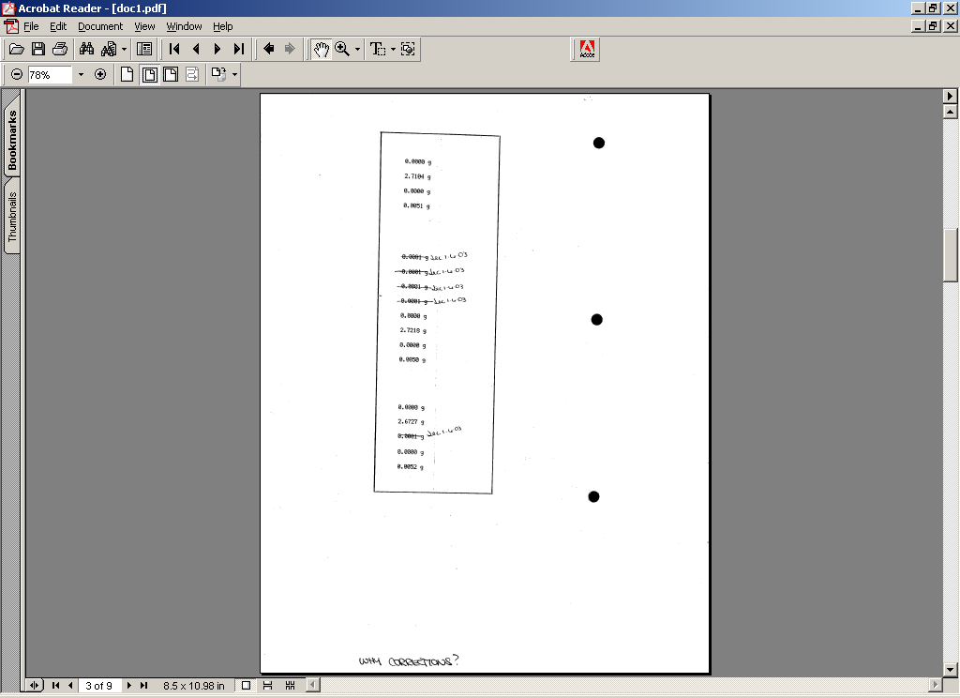
What Do You Think About This? Example 6
Printout should be identified by lot, etc. Line items should be identified. Corrections should be explained.

Slide 105
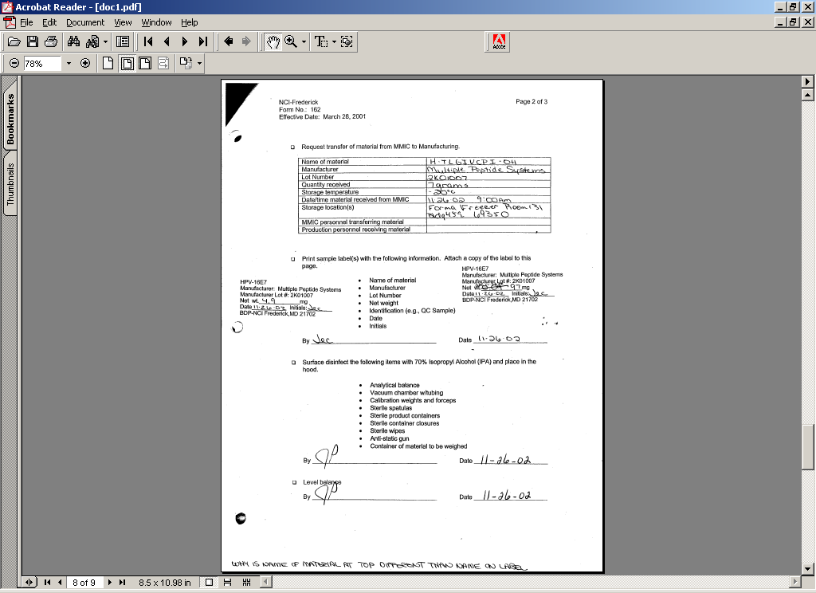
What Do You Think About This? Example 7
Why is the name on the material stated at the top different than the name on the label?

Slide 106
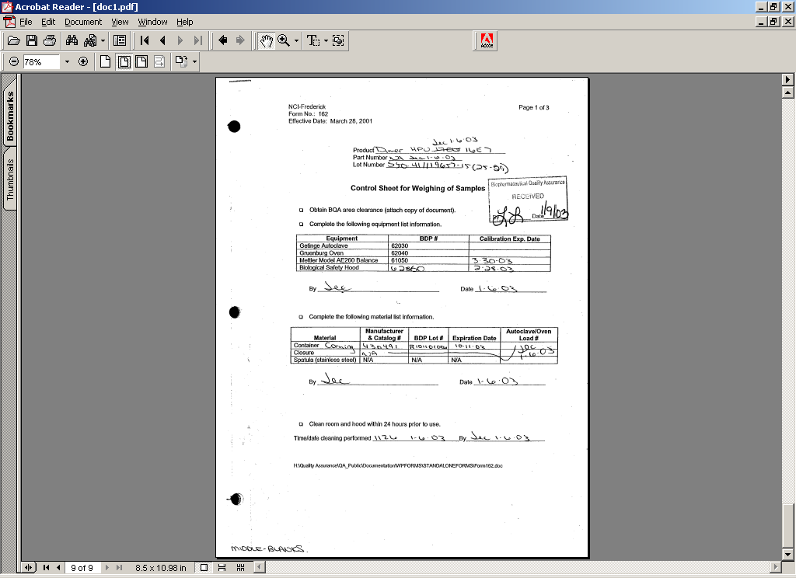
What Do You Think About This? Example 8
Middle of form contains blanks.

Slide 107
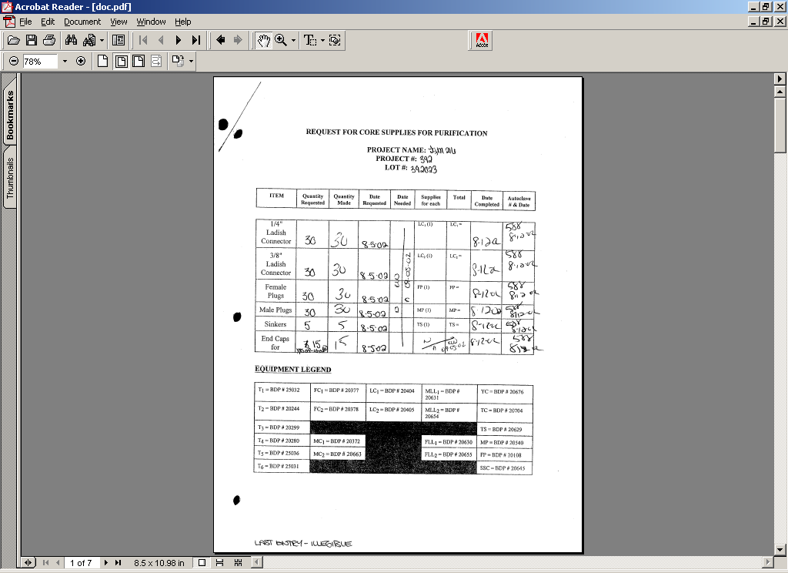
What Do You Think About This? Example 9
Last entry is illegible

Slide 108
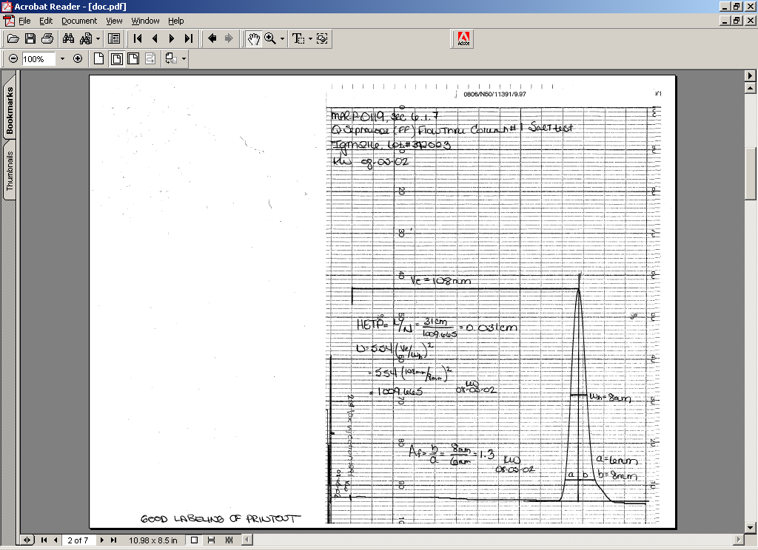
What Do You Think About This? Example 10
This is a good example of a well ID’d printout.

Slide 109
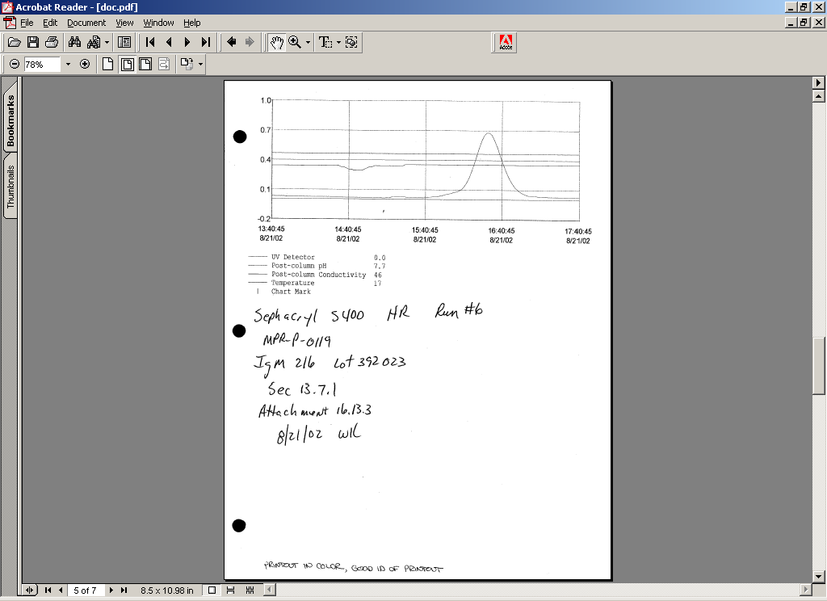
What Do You Think About This? Example 11
Another good example of a well ID’d printout.

Slide 110
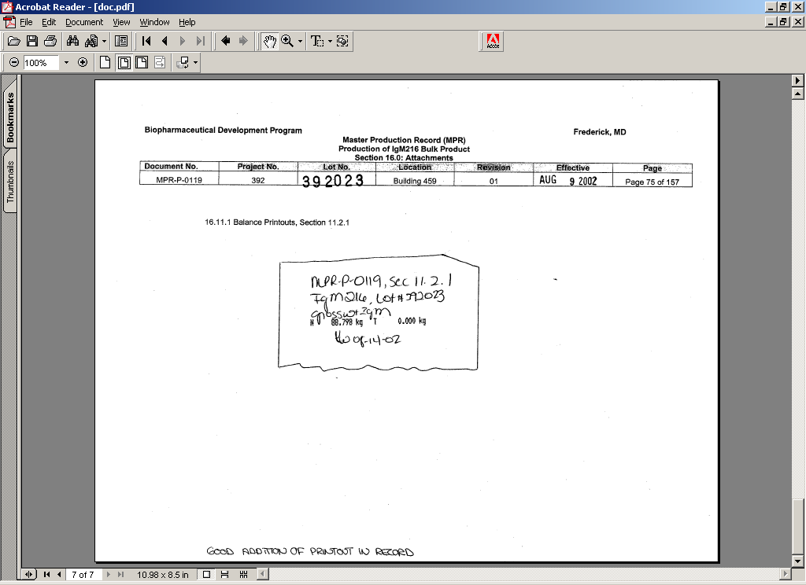
What Do You Think About This? Example 12
Good example of a well ID’d printout. However, need to sign or initial across the edge of the insert.

Slide 111
Documentation and Record Keeping Presentation
Please contact BDP BQA Management if you have any questions.

