Slide 1
cGMP Training – Laboratory Control
Biopharmaceutical Development Program

Slide 2
It’s All About SISQP
In the GMPs at least 20 times !

Slide 3
GMP SUBPARTS
A: General Provisions
B: Organization and Personnel
C: Buildings and Facilities
D: Equipment
E: Control of Components and Drug Product Containers and Closures
F: Production and Process Controls
G: Packaging and Labeling Control
H: Holding and Distribution
I: Laboratory Controls
J: Records and Reports
K: Returned and Salvaged Drug Products

Slide 4
Laboratory Controls Objectives for this module
Explore the GMP requirements for LABORATORIES
Quality Control (Process Analytics), Manufacturing, Validation, & Other Departments
Testing of raw materials, in-process & final product, utility & EM samples, etc.
Review some Warning Letter citations related to Laboratory Controls
Review application questions

Slide 5
Laboratory Controls “Suitable”
GMPs require that processes, buildings, equipment, raw materials, specifications, and testing be SUITABLE and capable of ensuring SISQP of the drug product.
Are you able to prove that your systems are SUITABLE?
The proof relies on DATA, usually LABORATORY DATA.
5

Slide 6
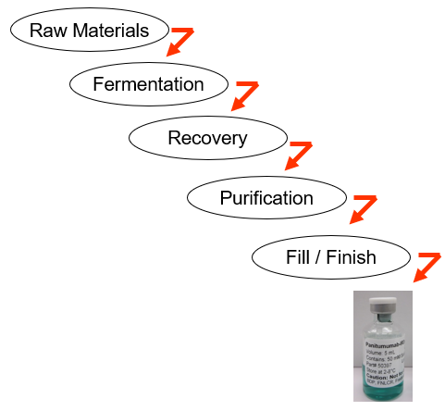
Laboratory Controls Example Manufacturing Process
This is a general process for products that we produce here. We start with raw materials and develop a fermentation process followed by a recovery process then a purification process and finally a fill/finish process to produce products for Phase I & II clinical studies.

Slide 7
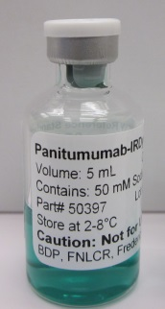
Laboratory Controls Example Manufacturing Process (cont.)
Raw Materials
When the question is asked “Does the product meet specification?” The answer to that question, yes or no, is answered with Laboratory Data.
Fermentation
Recovery
Purification
Fill / Finish

Slide 8
Laboratory Controls Reliability of the Manufacturing Process
The cascade of subprocesses that string together to produce a product is a SYSTEM. And the whole string of subprocesses is the MANUFACTURING PROCESS.
For a Phase I product, the reliability of the manufacturing process is not the primary concern. You may only use that manufacturing process a few times – enough to get material for clinical trials. If the process isn’t as reliable as it could be, if you have to “tweak” the process in different ways each time you make a batch, if 2 batches fail for every 8 you produce, . . . you can live with that – for now. And you rely on rigorous final product testing to determine that you have an acceptable product.
But for a licensed drug product – one that FDA has approved for commercialization, one that you or one of your loved ones might take, FDA is VERY CONCERNED with the question “is the MANUFACTURING PROCESS RELIABLE ?”. Of course, we still care whether the product meets specs but we also care about the reliability, the consistency of the PROCESS. If you performed the process numerous times, do you always get a product that meets specs? And the reliability of the manufacturing process depends on the reliability of the subprocesses that make up the manufacturing process.
And how do you determine the reliability of subprocesses? . . . . With laboratory data!

Slide 9
Laboratory Controls LABORATORY DATA
Used to establish whether the product meets specifications
Used to establish whether the sub-processes are reliable
“Testing lies at the heart of a drug manufacturer’s successful operation. Through testing, companies validate their processes and ensure the quality of batches for release.”
(United States vs. Barr Laboratories)

Slide 10
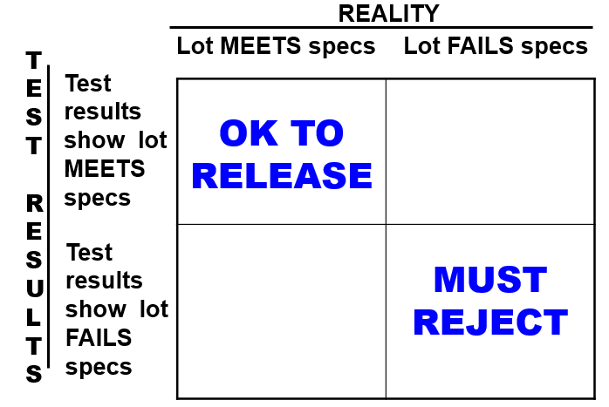
UNRELIABLE TEST METHODS HAVE CONSEQUENCES
Our goal is to have our laboratory test results reflect reality. The test results should truly reflect when a lot does or does not meet specification.

Slide 11
Manufacturer and Consumer Risk
When a lot truly does NOT meet specifications, but the test results indicate that it DOES meet specifications, then that is consumer risk. Patients could be injured.
When a lot truly DOES meet specifications, but the test results indicate that it does NOT meet specifications, then that is manufacturer risk. The lot is wrongly failed and good product, time, and materials are wasted.
Our goal is to create systems where truly good lots obtain test results that are passing specification and truly bad lots obtain test results that are out of specification. To the extent possible, we need to minimize consumer risk AND manufacturer risk.

Slide 12
How well does the USP Sterility Test detect contamination?
How contaminated is the batch? | Probability of FAILING the Sterility Test
1 per 1000 units | 2 %
5 per 1000 units | 10 %
10 per 1000 units | 18 %
50 per 1000 units | 63 %
100 per 1000 units | 86 %
500 per 1000 units | 100 %
Source “Towards an Improved Sterility Test”, Jeanne Moldenhauer and Scott VW Sutton, PDA Journal of Pharmaceutical Science and Technology, Vol 58, No 6, Nov-Dec 2004, pg 284

Slide 13
Take-Home Message
If you are manufacturing GMP products, we need to CONSISTENTLY manufacture them so that each vial represents all the vials in the lot.
If you are doing testing, we need to ensure we maximize the validity and credibility of the testing.
We already know it’s inherently imperfect, we don’t want to make it worse.
How do we know laboratory data is reliable?
The systems that are used to control the generation of laboratory data are described in the GMP requirements for LABORATORY CONTROLS and the systems that must be developed for the laboratory records are discussed in the GMP section of Records and Report, specifically the section on Laboratory records.

Slide 14
Subpart I. GMP Sections – Laboratory Controls
General
Testing and Release
Stability
Special Testing
Reserve Samples
Lab Animals
Penicillin

Slide 15
Subpart I. Laboratory Controls Sections: General
Laboratory testing occurs at many stages (raw material receipt, in-process/release/stability testing, validation efforts)
GMPs require written specifications, standards, sampling plans, procedures (including changes)
Must be scientifically sound
Include a description of sampling and testing procedures
Approved by QA
Laboratory activities must be documented at the time they are performed

Slide 16
Subpart I. Laboratory Controls Sections: General (cont.)
Deviations must be recorded and justified
Determine conformance to established
specifications
Test samples must be representative and identified
Retest raw materials if subject to deterioration
Calibrate equipment at suitable intervals per written
program
Instruments not meeting specifications may not be used
Investigation is required

Slide 17
Warning: no procedures
No established procedure for the usage of
prepared standards solutions for testing
folic acid and iron .…
Earlham College
Richmond, VA
- Must be scientifically sound
- Include a description of sampling and testing procedures
- Approved by QA
• Document activities at the time they are performed.
• Deviations must be recorded and justified.
Determine conformance to established specs
Test samples must be representative and ID’d
Retest components if subject to deterioration
Calibrate equipment at suitable intervals per written program
- Instruments not meeting specs can’t be used.
WARNING LETTER

Slide 18
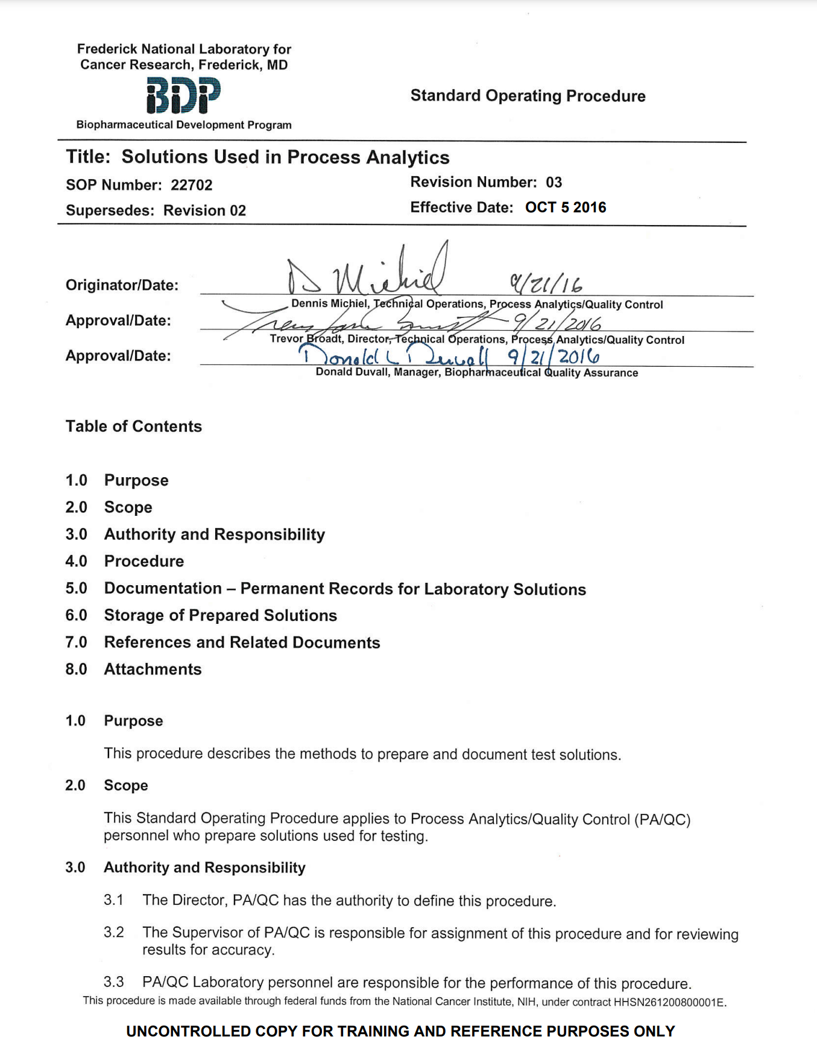
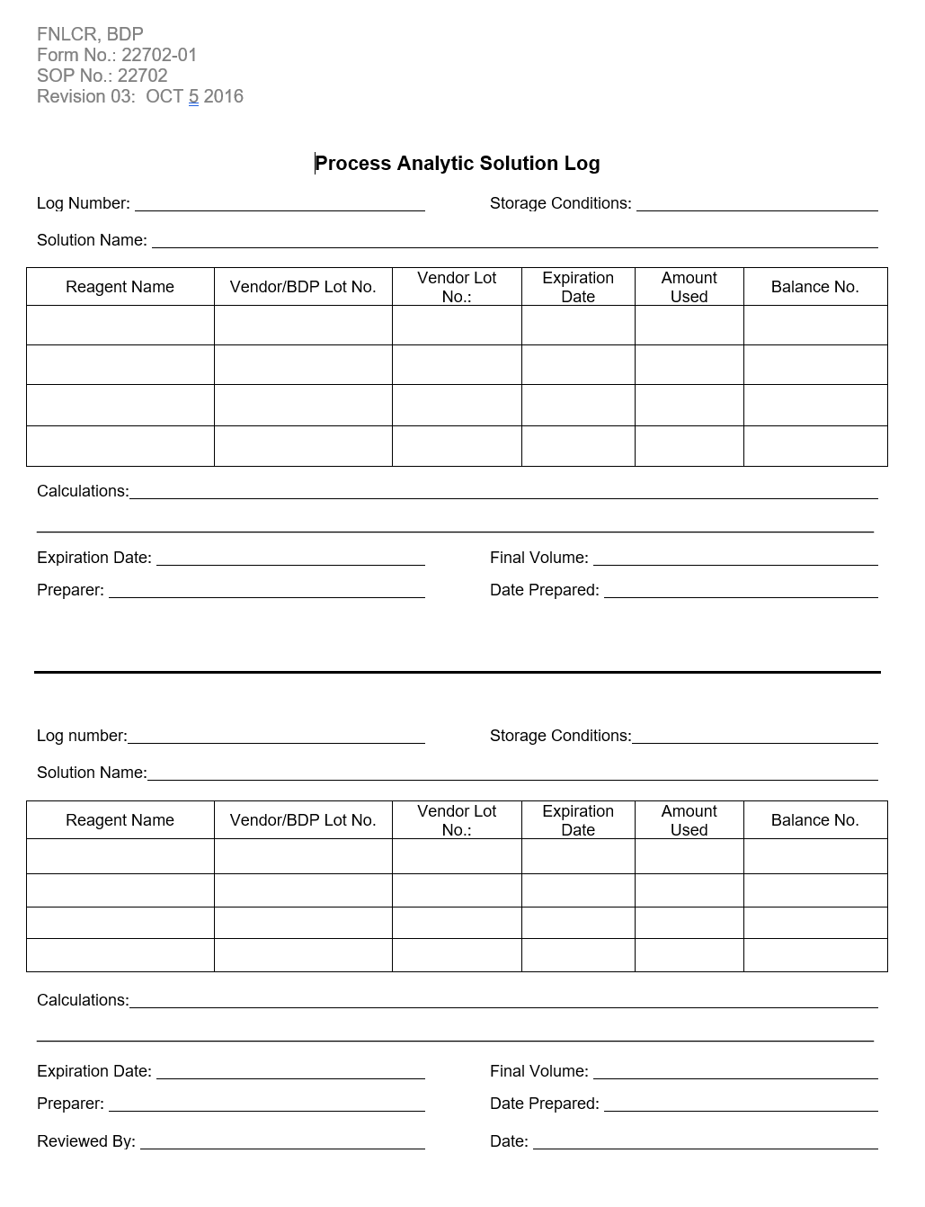
Preparation and Use of Buffers & Standard Solutions

Slide 19
Warning Letter: Sampling Thief Not Used
The sampling thief required by the sampling
procedure was not used by the operators taking
the in-process sample or even available to
them. According to the operators, they used
a small plastic spatula to sample from the
top of the drum.
Schering-Plough,
Puerto Rico
WARNING LETTER

Slide 20
Representative Sampling of Raw Materials
BDP SOP 22714 Sampling, Testing, and Review of CGMP Materials by Process Analytics\Quality Control
Number of containers sampled is determined by the ANSI/ASQC
Z1.4 Table Requirements for General Inspection Level II
A sampling thief must be used for raw material containers larger than 15 kg. A sampling thief allows you to remove samples at specified depths to ensure samples are representative of the entire container

Slide 21
Subpart I. Laboratory Controls Sections: Testing & Release
Confirm conformance to specifications using laboratory determination
Identity and strength of each active ingredient
Free of objectionable microbes (if applicable)
Prior to release
Adequate acceptance criteria for sampling and testing
Establish and document accuracy, sensitivity, specificity & reproducibility of test methods.
Limit of Detection (LOD) & Limit of Quantitation (LOQ)
Reject for failure to meet specs, standards, etc.
Must investigate OOS, failures, etc.
Can reprocess
Reprocessed product must pass specifications

Slide 22
Warning Letter: Failure to use Validated Test Method
Failure to use a validated test method for
release testing. The assay method for
guaifenesin in Spec-Tuss TM Palatable
Expectorant Powder has not been validated
for accuracy, sensitivity, specificity,
and reproducibility.
Neogen Corporation,
Lansing, MI
WARNING LETTER

Slide 23
Warning Letter: Validation Data Unavailable
Written descriptions and validation data for
finished product testing methods were
unavailable.
Cardinal Enterprises, Inc.
Middletown, RI, 2001
WARNING LETTER

Slide 24
Warning Letter: Released Products Out of Specification
Two lots of GOJO Hand Medic III were
released that had final product
test results that were out of specification.
A complete investigation into the root cause
of the problem was not completed
before product release
GOJO Industries, Inc.
Akron, OH
WARNING LETTER

Slide 25
Warning Letters: Failure to Meet Required Specifications
Failure to reject drug products that
fail to meet established
specifications. For example,
several drug products
manufactured by your firm
containing
octyl methoxycinnamate
failed specifications and were
released.
2-2-0 Laboratories
Riverside, CA., 2001
Failure to ensure satisfactory
conformance to final specifications
prior to release. For example,
you failed to conduct
finished product testing
on at least 6 batches of product
2-2-0 Laboratories
Riverside, CA., 2001
WARNING LETTER
WARNING LETTER

Slide 26
Laboratory Controls IS THERE ANYTHING ELSE . . .?
Once you have a validated procedure, how do you know the analyst is capable?
Education
Experience
Training
Proof of Competency

Slide 27
Laboratory Controls How Do I Know That …
TEST IS PERFORMED PROPERLY?
Written, approved procedures
Appropriate Controls and Standards
Analyst properly trained
Procedures followed & documented
TEST MEASURES WHAT IT IS SUPPOSED TO MEASURE?
Qualification & Validation
SPECIFICATION IS CORRECTLY SET?
Based on data and scientific analysis
Written and approved
RESULT IS ACCEPTABLE?
Compared to specification

Slide 28
Analytical Method Qualification and Validation
FDA Guidance – Analytical Procedures and Methods Validation for Drugs & Biologics July 2015
FDA Guidance – Bioanalytical Method Validation May 2018
ICH M10 – Bioanalytical Method Validation Draft
28

Slide 29
Subpart I. Laboratory Controls Sections: Stability
Written testing program to assess stability of the drug product
Drug products degrade over time
We need to know when they are going to fall out of specification
Test data is used to determine an appropriate shelf-life and expiration date
Real time stability studies are required
Accelerated stability studies are recommended

Slide 30
Warning Letter: Stability Data
Failure to establish stability data to support
the 2 year expiry period for Spec-Tuss TM
Expectorant powder.
Neogen Corp,
Lansing, MI
WARNING LETTER

Slide 31
Warning Letter: Lack of Written Testing Program
Failure to have a written testing program
designed to assess the stability
characteristics of drug products.
Wayzata Bay Products, Inc.,
St. Bonifacius, MN
WARNING LETTER

Slide 32
Subpart I. Laboratory Controls Stability
The GMPs require a written testing program to assess stability of drug product to include:
Sample size and test intervals to properly evaluate each attribute (based on statistical criteria)
Storage conditions for samples
Reliable, meaningful, and specific test methods
Reliably measure SISQP
Same container-closure system as the drug product
Testing of reconstituted product at time of dispensing and after reconstitution
Notes:
This isn’t correct.

Slide 33
Stability Determination of Appropriate Shelf-life
Establishment of expiration data must be based on testing and results must be documented.
Accelerated studies with other data may be acceptable for tentative dating.
Validate with real-time studies
Statistically sound
Full real-time shelf-life studies must be conducted until the actual shelf-life has been determined.
At least 3 lots and whenever a change is made to manufacturing or storage procedures, container/closure, etc.

Slide 34
Stability Guidelines
ICH Q1A(R2), Stability Testing of New Drug Substances & Products
ICH Q1E, Evaluation of Stability Data
ICH Q5C, Stability Testing of Biotechnological & Biological Products
34

Slide 35
Subpart I. Laboratory Controls Special Testing
If claimed to be sterile, or pyrogen-free, laboratory testing must confirm
Procedures must be in writing
Written procedures must be followed and documented
For controlled-release dosage forms, must test for conformance to specs for rate of release of each active ingredient
Procedures must be in writing
Written procedures must be followed and documented

Slide 36
Subpart I. Laboratory Controls Retain Samples
ACTIVE INGREDIENTS
Retain a sample of each lot in each shipment (identify properly)
Retain quantity = 2X needed for testing to specs
(except for sterility and pyrogen testing)
Retain period = 1 year after expiration of last lot that used the ingredient
For Phase 1 products, FDA recommends that samples be retained for at least two years following clinical trial termination or IND withdrawal

Slide 37
Subpart I. Laboratory Controls Reserve Samples Question
We received active ingredient, vendor lot XYZ, in 3 different shipments. Do we need to maintain a reserve sample for each shipment? They are the same lot from the manufacturer.

Slide 38
Subpart I. Laboratory Controls Reserve Samples Answer
YES. Each lot in each shipment must have a reserve sample.
Reserve samples from each shipment must be identifiable. BDP assigns a different lot number for each lot in each shipment (the same vendor lot received in different shipments will be assigned different BDP lot numbers).

Slide 39
Reserve Samples Final Drug Product Retains
Store consistent with product labeling
Store in same container/closure system (or with same materials & characteristics)
2X quantity required for retesting
(except for sterility and pyrogen testing)
Retain for 1 year after expiration of drug product
For Phase 1 products, FDA recommends that samples be retained for at least two years following clinical trial termination or IND withdrawal
Yearly, examine a statistical sampling to detect deterioration (waived if it would cause product damage)
Document the examination. Maintain with data from other lots.
Investigate any detected deterioration

Slide 40
Subpart I. Laboratory Controls Sections: Laboratory Animals
Animals may be used for testing components, in-process materials or final products. In order to ensure quality and traceability:
Animals must be maintained in a manner to assure their suitability for use.
Records should identify animals used.
A history of the animal’s use must be maintained, particularly for animals used more than once.

Slide 41
Subpart I. Laboratory Controls Sections: Penicillin
Minute quantities of penicillin can cause life threatening allergic reactions.
Requirements for manufacturing operations covered in Buildings and Facilities Module
If there could be potential cross- contamination with penicillin, must test for penicillin
Cannot market the product if detectable levels are found
Applies to all beta-lactam antibiotics

Slide 42
Warning Letter: Penicillin
Failure to test non-penicillin drug product
for the presence of penicillin when
a reasonable possibility exists that
non-penicillin drug products
could have been exposed to
cross-contamination with penicillin.
Pharmaceutical Distribution Systems
Montclair, VA
WARNING LETTER

Slide 43
Subpart I. Laboratory Controls Out of Specification (OOS) Case
United States of America, Plaintiff
v.
Barr Laboratories, Inc., Defendants
1993

Slide 44
Subpart I. Laboratory Controls Out of Specification (OOS)
The court case United States of America versus Barr Laboratories, tried in 1992 in New Jersey, sent FDA regulated industries a wake-up call.
Barr was inspected numerous times from 1989 – 1992. In 1992, FDA inspected the Northvale Facility giving them a 483 containing 75 items and the Pomona Facility, giving them a 483 containing 47 items. Many of these issues had been recorded during prior visits to Barr in the areas of process validation, failure investigation and laboratory practices.

Slide 45
Subpart I. Laboratory Controls Out of Specification (OOS) Discovery
FDA discovered that Barr was:
Averaging out of specification results with in-spec results to get a passing result
Maintaining an ineffective program for process validation
Discarding raw data
Conducting multiple retests with no defined end point
Performing inadequate failure investigations
Lacking method validation
Eventually, FDA took regulatory action against the firm, and brought a preliminary injunction against Barr directing them to suspend, recall or revamp numerous products in the Barr product line. Barr subsequently filed against the FDA seeking relief from allegedly ad hoc drug regulation. The case ended up at trial and generated 2300 pages of testimony and 400 exhibits and declarations.
Notice that some of these issues are not well addressed in the GMP regulations. GMPs don’t discuss any controls over the management of out of specification results. Process validation, multiple retests, method validation are all issues that had, at the time, no specific GMP references. So how does FDA have grounds for any regulatory actions?

Slide 46
Out of Specification (OOS) The Barr Decision
The grounds come from the flexibility of the GMPs. A GMP requirement like this one can be interpreted to require whatever measure is necessary to assure that drug products conform to appropriate standards of identity, strength, quality, and purity. 21 CFR 211.160 (b) “Laboratory controls shall include the establishment of scientifically sound and appropriate specifications, standards, sampling plans, and test procedures designed to assure that components, drug product containers, closures, in-process materials, labeling, and drug products conform to appropriate standards of identity, strength, quality, and purity.”

Slide 47
(OOS) Decision
Judge Wolin, Barr Court Decision
“Ironically, the regulations themselves, whose broad and sometimes vague instructions allow conflicting, but plausible, views of the precise requirements, transform what might be a routine evaluation into an arduous task.”
This issue was addressed at the trial by the FDA Out of Specification ( witness and accepted by Judge Wolin. Industry practice, whatever it is, must meet the intent of the GMP regulations.
“The Court, however, cannot rely on industry practice alone to determine whether an individual firm meets the statutory requirement, since industry standards themselves must be reasonable and consistent with the spirit and intent of the CGMP regulations.”
(Judge Wolin, Barr Decision)

Slide 48
Barr Decision Resulted In:
Revised FDA Procedures and Policies
Proposed changes to cGMPs
Guidance for Investigating Out-of-Specification (OOS) Test Results for Pharmaceutical Production – May 2022
Increased FDA inspections and emphasis on laboratory operations

Slide 49
Out of Specification (OOS)
FDA expects:
An immediate and thorough investigation of an OOS result
The existence of an OOS SOP – the basic document to assist in assessing and investigating an OOS result
An effective Corrective and Preventative Actions (CAPA) system
Guidance for Industry: Investigating Out-of-Specification (OOS) Test Results for Pharmaceutical Production, May 2022

Slide 50
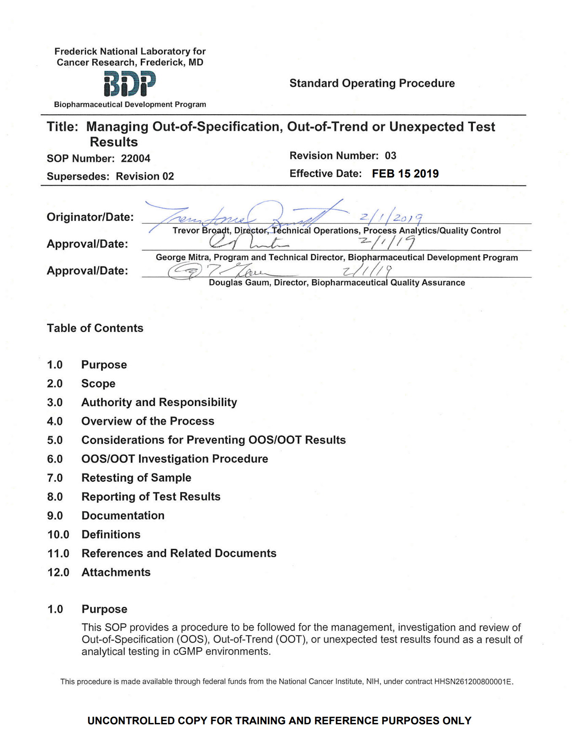
SOP 22004 Managing OOS, OOT, or Unexpected Test Results

Slide 51
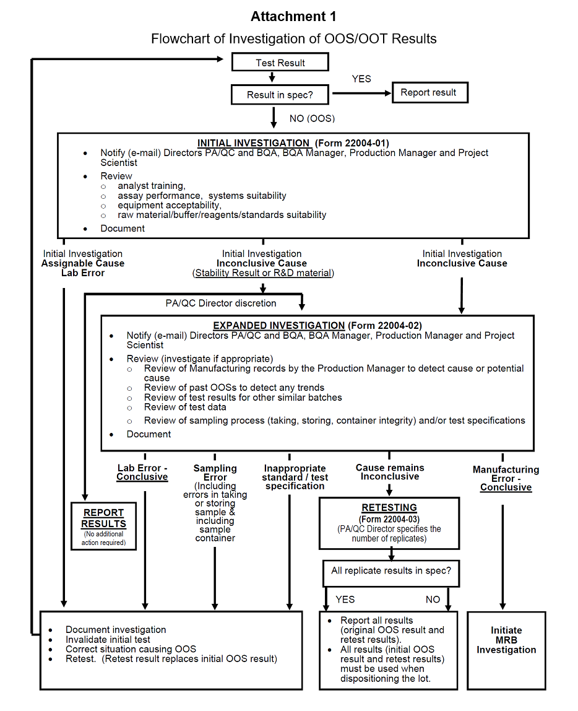
Investigations
OOS investigations are conducted in phases
If the initial investigation does not determine conclusive cause, an expanded investigation is conducted

Slide 52
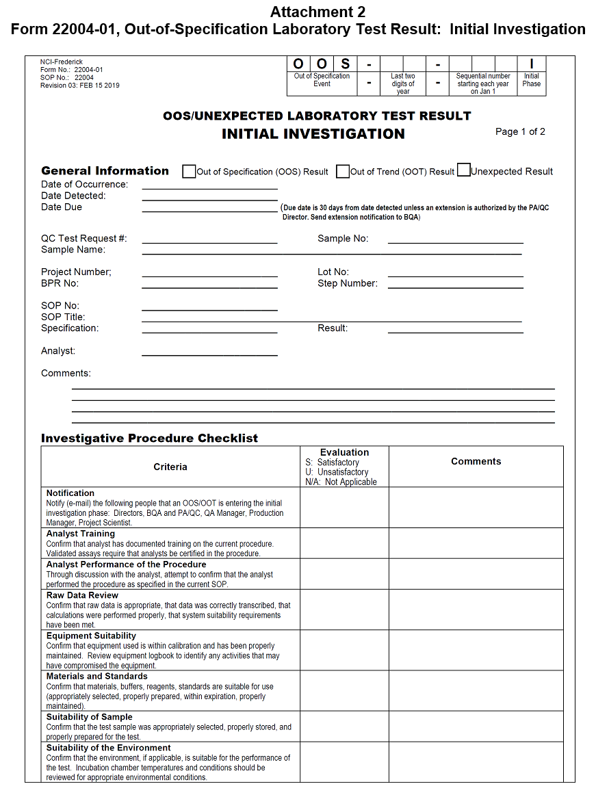
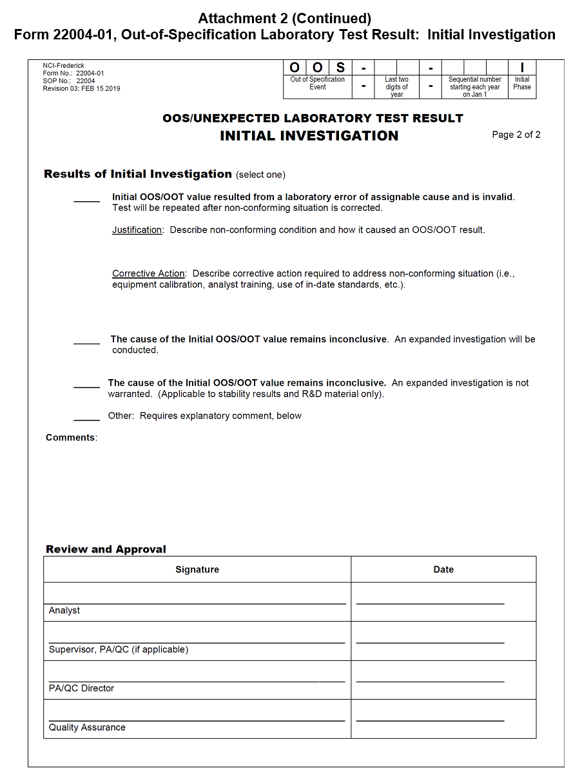
SOP 22004 - Managing OOS, OOT, or Unexpected Test Results Initial Investigation Form

Slide 53
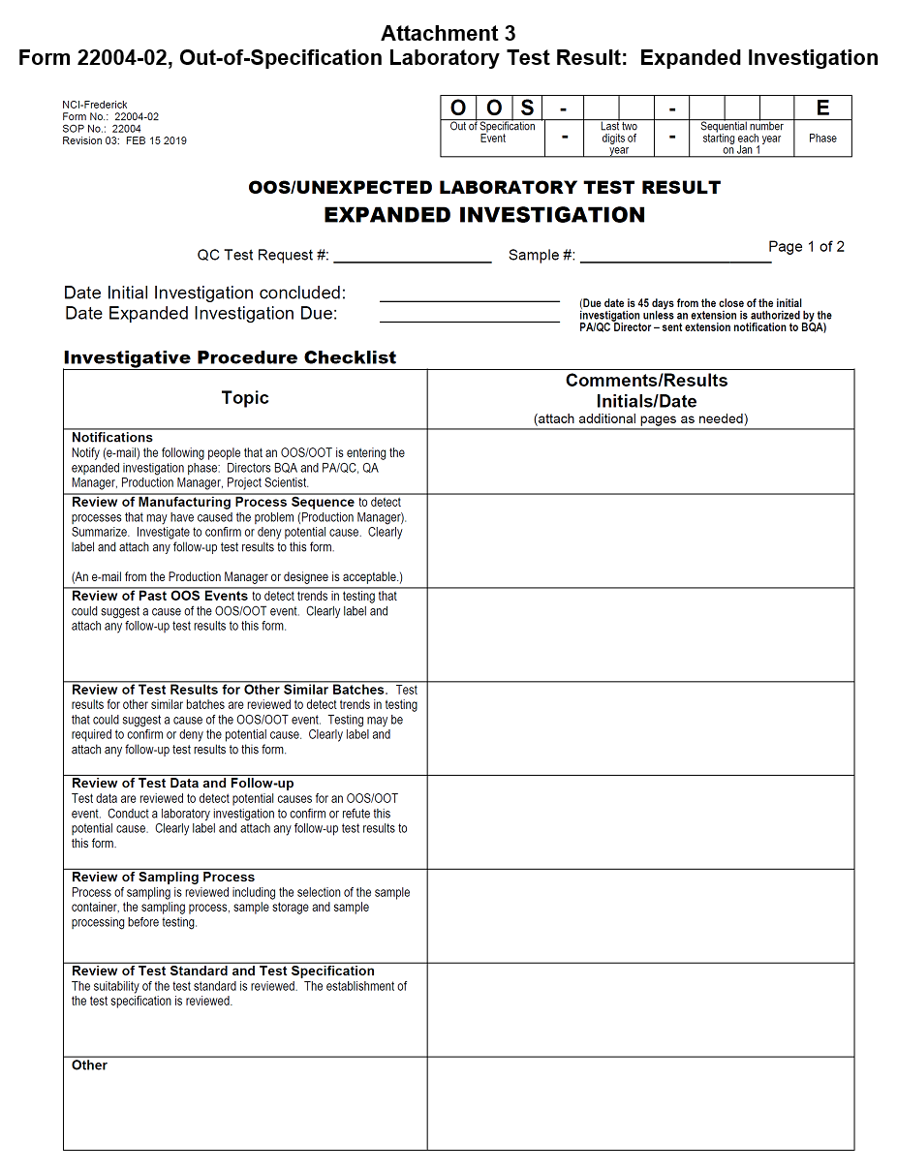
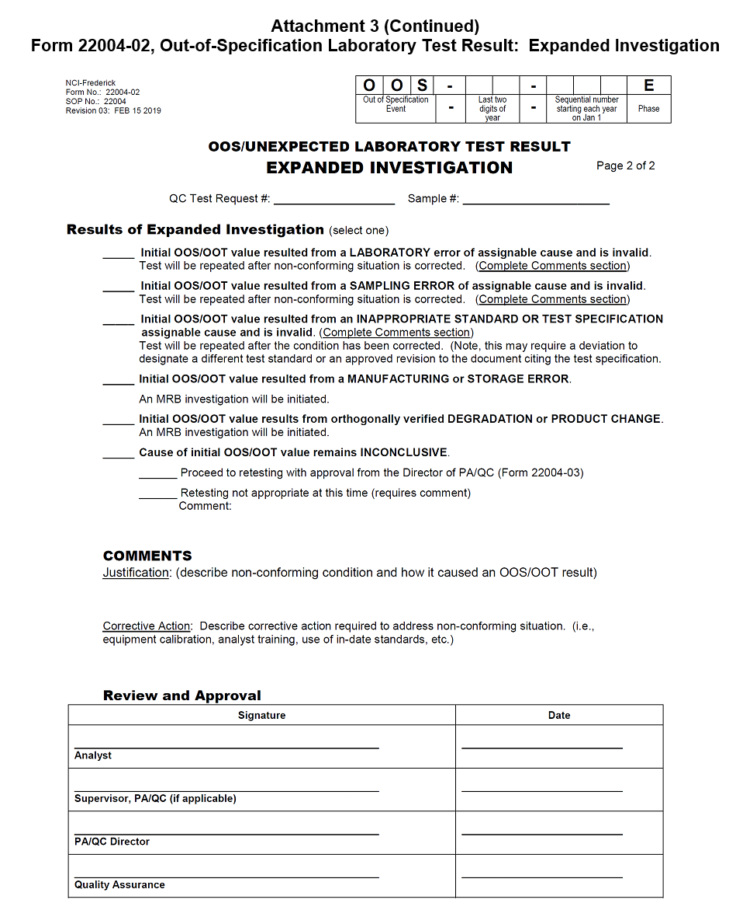
SOP 22004 - Managing OOS, OOT, or Unexpected Test Results Expanded Investigation Form

Slide 54
Prevent / Minimize OOS Results?
BEFORE YOU START THE ASSAY
PERFORMING THE ASSAY
REPORTING OF THE ASSAY RESULT

Slide 55
How Do You Prevent / Minimize OOS Results?
BEFORE YOU START THE ASSAY
Must have an approved testing procedure
Analyst must be properly trained
Must have appropriate materials, supplies, standards
Instrumentation must be calibrated and properly maintained
Sample to be tested must be stored properly and correctly identified
2. PERFORMING THE ASSAY
Perform the assay according to written approved procedures
Document work as it is performed
Document any deviations and unexpected results
STOP THE TEST if you have made an error that could affect the results – document this.
3. REPORTING OF THE ASSAY RESULT
Check assay’s system suitability requirements BEFORE reporting results
Check result against specifications BEFORE DISCARDING TEST SOLUTIONS, STANDARDS, DILUTIONS, ETC. (Save if OOS)
Notify your Supervisor immediately if OOS

Slide 56
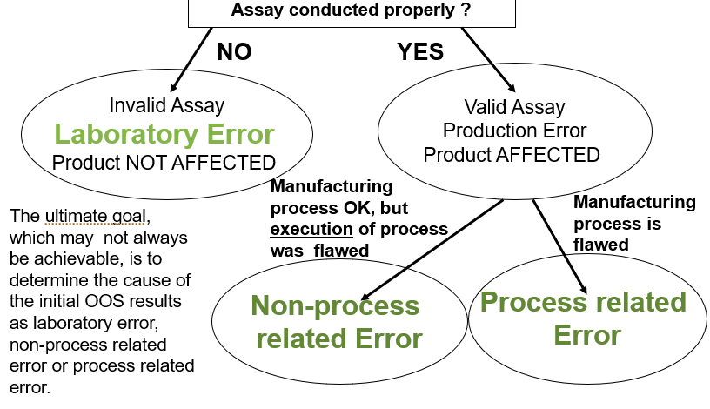
OOS Result

Slide 57
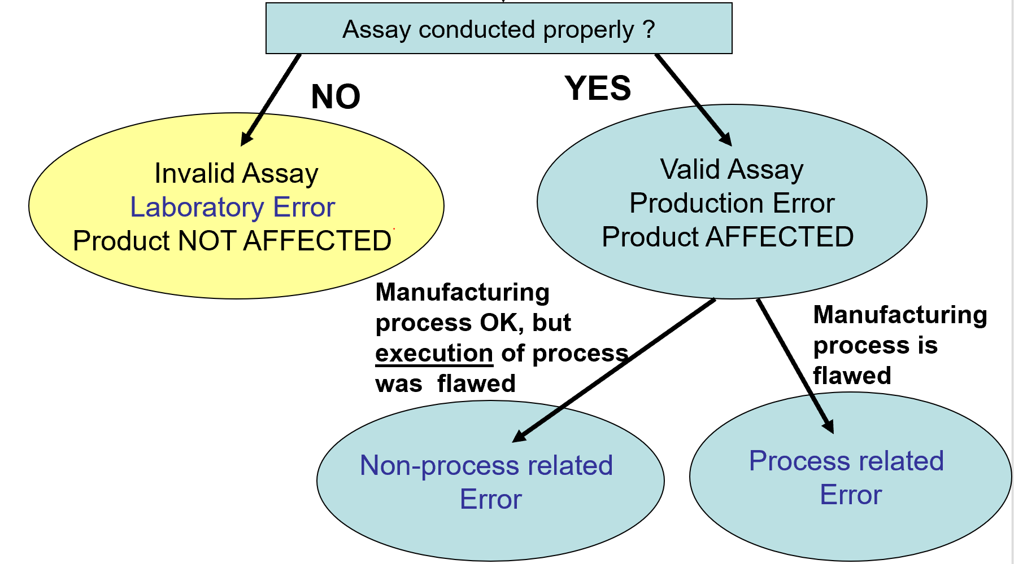
OOS Result Example #1 TEST READ AT THE INCORRECT WAVELENGTH

Slide 58
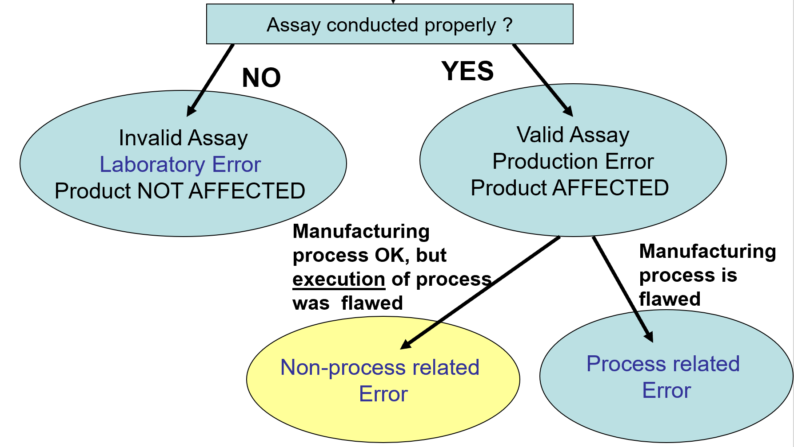
OOS Result Example #2 MANUFACTURING TECH FORGOT THE INCUBATION STEP BEFORE FILTRATION

Slide 59
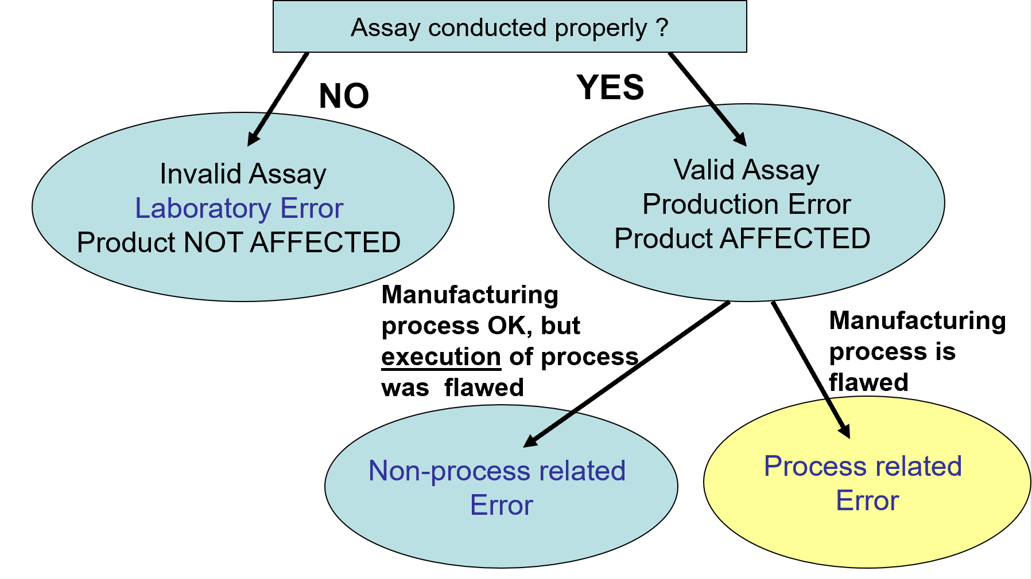
Out-Of-Specification Result Example #3 MANUFACTURING PROCEDURE SPECIFIED THE USE OF A VIAL/STOPPER COMBINATION THAT LEAKS AND THEREFORE PERMITS CONTAMINATION

Slide 60
Warning Letter: Out of Specification
During my review, I found that on April 29, 2001
your laboratory obtained an OOS and a retest was
authorized without an explanation.
I requested the justification for the re-testing and your Laboratory
personnel explained to me that they have observed this
OOS result in other lots from the same product.
In the previous investigations, the original OOS value was
invalidated because of “interference in the dissolution vessel”
and the lot was retested. These investigations do not have
analytical data to demonstrate the validity of this
assignable cause.
During the inspection, your laboratory performed a study to
prove this assignable cause and found that this assignable
cause, previously used to invalidate data,
is not valid.
Schering Plough, Puerto Rico
WARNING LETTER

Slide 61
OOS FDA Expects:
An immediate and thorough investigation following an OOS result prior to any retesting
The existence of an SOP – the basic document to assist in assessing and investigating an OOS result.
What to do when an OOS is detected?
What to document?
How to investigate?
Time Limits?
When does QA get involved?
Corrective & Preventative Action (CAPA)
To correct the testing process
To correct the manufacturing process
To correct the EXECUTION of the manufacturing process

Slide 62
Subpart I. Laboratory Controls FDA Expects
483 Citation: (OOS investigation time limits)
Following an out-of-specification result for Test A in the 6-month stability sample of Lot [ABC], the analyst reported that the “Test FAILED” on the report sheet and forwarded this to the group leader, however, no action was taken.
According to the laboratory manager, the sheet must have been missed and was not discovered for more than two months.
Source: “FDA API Inspections” by Robert C. Horan, PhD, FDA Pharmaceutical Inspectorate, New York District.

Slide 63
Subpart I. Laboratory Controls
If a process is validated, do you expect process-related failures ?
. . .
NO !

Slide 64
WHAT DO YOU THINK OF THIS? OOS Example
On review of a number of OOSs for potency issues in API XYZ, it was found that this was attributed to failure of temperature sensors on manufacturing equipment XXX and that the temperature had been out of the critical control range.
In reviewing other deviation reports, it was found that following earlier episodes of ‘OOS” potency values, there were corrective actions recommended including one to increase the frequency of calibrations of the sensing devices.
Examination of the applicable SOPs found these recommendations have not been implemented and no other corrective action taken.
Source: “FDA API Inspections” by Robert C. Horan, PhD,
FDA Pharmaceutical Inspectorate, New York District.

Slide 65
WHAT DO YOU THINK OF THIS? pH Example
Calibration of pH meter ABC is performed using buffers at pH 4.0, 7.0, and 9.0 before testing the pH of product XYZ that has an expected pH around 12.
Source: “FDA API Inspections” by Robert C. Horan, PhD,
FDA Pharmaceutical Inspectorate, New York District.

Slide 66
pH Example Outcome
Since February 1999 all stability batches of Gentocin otic solution have revealed a contamination of the product in the form of an unknown peak in the Betamethasone Valerate assay.
The investigation conducted by the firm concluded that the product was contaminated with DCHP. They also concluded that the DCHP was leaching from the adhesive used to adhere the label through the product container.
483 citation, Feb 2001 (edited), Schering-Plough, Puerto Rico

Slide 67
pH Example Outcome (Continued)
Even though the company investigated the issue and determined the cause, FDA still issued a 483.
“There is no evidence the firm has determined the effect the leaching may have on all other products which use the same container and label adhesive combination.”
483 citation, Feb 2001 (edited), Schering-Plough, Puerto Rico

Slide 68
WHAT DO YOU THINK OF THIS? Procedure vs Data Example
The testing procedure states to run the chromatogram for not less than 2.5 times the retention time of the drug.
Review of earlier test data shows that a significant recurring impurity elutes at approximately 5 times the retention time of the bulk drug.
The laboratory staff is performing the procedure according to their SOP.
Source: “FDA API Inspections” by Robert C. Horan, PhD,
FDA Pharmaceutical Inspectorate, New York District.

Slide 69
Procedure vs Data Example Outcome
This became a 483 citation. Testing procedures are required to be scientifically sound. If the chromatogram is not specified to run at least 5 times the retention time of the bulk drug, the impurity that could be present in the drug would go undetected.
Source: “FDA API Inspections” by Robert C. Horan, PhD,
FDA Pharmaceutical Inspectorate, New York District.

Slide 70
WHAT DO YOU THINK OF THIS? Procedure for OOS Example
Manufacturer’s procedure for handling OOS results:
If an identified cause for the OOS is not determined or not confirmed, than a second analyst will test a new sample.
If the second sample meets specification, the conclusion is made that the original sampling was flawed.
If the new sample fails also, the Lab Supervisor starts an OOS Report Form.
Source: “FDA API Inspections” by Robert C. Horan, PhD,
FDA Pharmaceutical Inspectorate, New York District.

Slide 71
Procedure for OOS Example Outcome
Just because the second sample meets specs is not enough evidence to conclude that the original sampling was flawed.
(What could you do to confirm or refute that the original sample was flawed? – test the old and new sample in parallel).
An OOS report must start before retesting occurs.
Source: “FDA API Inspections” by Robert C. Horan, PhD,
FDA Pharmaceutical Inspectorate, New York District.

Slide 72
Subpart J Records & Reports - Laboratory Records
Laboratory records shall include complete data from all tests necessary to assure compliance with established specifications, standards
Records shall be maintained for modifications of established testing methods.
Reason for modification
Data to verify that change is at least as accurate and reliable as the previous method
Maintain records of testing and standardization of reference standards, reagents, standard solutions.
Maintain records of calibration of lab instruments, etc.
Maintain records of all stability testing

Slide 73
Records & Reports - Laboratory Records continued
Laboratory records shall include complete data from all tests necessary to assure compliance with established specifications, standards. Complete date includes:
Description of sample
Method used for testing
Location of data to show that the method is accurate and reliable under actual conditions of use.
Weight or measure of sample used for testing, where appropriate.
All data obtained for each test (graphs, charts, spectra - properly identified)
Calculations (units, conversion factors, and equivalency factors)
Actual results of tests and whether they meet specifications
Initials or signatures of analyst and the date.
Initials or signature of verifier (signifying that records have been reviewed for accuracy, completeness, and compliance with established standards) and the date.

Slide 74
Warning Letter: Lab Records
Failure to maintain laboratory records that
include complete data from all tests necessary
to assure compliance with established
specifications and standards.
Opti-Med CR Labs, Inc.,
Seymour, IN
WARNING LETTER

Slide 75
Warning Letter: Review of Test Data
There is no provision for review of test data
and results prior to final release to the
customer as a Certificate of Analysis.
Earlham College,
Richmond, VA
WARNING LETTER

Slide 76
Subpart I. Laboratory Controls APPLICATION
…technician notices that the equipment he plans to use for the testing of raw material A is outside of its calibration period. He decides that he will perform the testing anyway and if the result is out of specification, he will invalidate the result based on the out of calibration equipment. If the result is in-spec, he will have saved some time.
…..Is this OK?
ANSWER:
No. You can not continue a testing processes knowing that you have an assignable cause for an out-of-spec result.

Slide 77
Subpart I. Laboratory Controls Another Scenario
Analyst Bob obtained an OOS result. He knows that he needs to perform an investigation with his supervisor to determine if any laboratory error has occurred. In the meantime, to save time, Bob decides to perform retests. If there is lab error, he’ll already have results to report, and he will have saved time.
If they can’t find lab error, he didn’t do any harm.
Is this OK?
ANSWER:
No. The first step in dealing with an OOS event is to determine if you have conducted the laboratory testing properly. Retesting cannot be performed until an investigation has been conducted to at least identify obvious sources of laboratory error. Since retesting in this example started before any investigation was conducted, a violation of GMPs exists.

Slide 78
Laboratory Controls Application
A Company obtained an OOS result for Drug Z at its 6-month stability test point.
Additional samples of Drug Z were pulled from inventory for testing.
Some of these also generated OOS results.
From ALL of the results of ALL of the samples tested, an average was calculated, and the average was within specification.
Was this event handled appropriately?
ANSWER:
No. At the first OOS event, an investigation MUST be conducted to determine the cause of the problem. Averaging is a problem. Unless your test method would direct you to average results, averaging results to attempt to obtain a conforming value is NOT APPROPRIATE.
(Bristol-Myers Squibb, Warning Letter Oct 2002.)

Slide 79
This is the end of the presentation
Please contact BQA Management if you have any questions.

