Slide 1
cGMP Training Investigation of Non-Conformances

Slide 2
Titanic
When the Titanic struck an iceberg on April 14 1912, it was not a foregone conclusion that the ship would sink. The liner was designed to stay afloat if up to four of its sealed compartments were flooded.
But so many of the rivets popped along the starboard side of the ship that a fifth compartment flooded, condemning the vessel to the depths and sending more than 1,500 people to their deaths. (from http://www.guardian.co.uk/uk/2008/apr/16/usa)
Studies show that Titanic’s damage was more extensive because of poor quality rivets and difficulty in obtaining enough experienced riveters. See also slide show that is available at this location.
Titanic: 1500 people died. The quality of the rivets was first questioned 10 years ago and still is a controversial theory.

Slide 3
What went wrong?
The titanic required over 3 million rivets. There were shortages in iron during construction and the company had to resort to lower-grade iron for the production of rivets. However, from rivets recovered from the Titanic, more than 2 miles under water, they found rivets riddled with slag (a glassy residue that can make rivets brittle).
Steel rivets were stronger and were in some use. For example, the Lusitania used steel rivets. There were some steel rivets used on the Titanic also but only on the central hull where stresses were expected to be the greatest. Iron rivets were used on the stern and bow which is where the iceberg struck.
Better rivets may have kept the vessel floating longer allowing for more survivors.

Slide 4
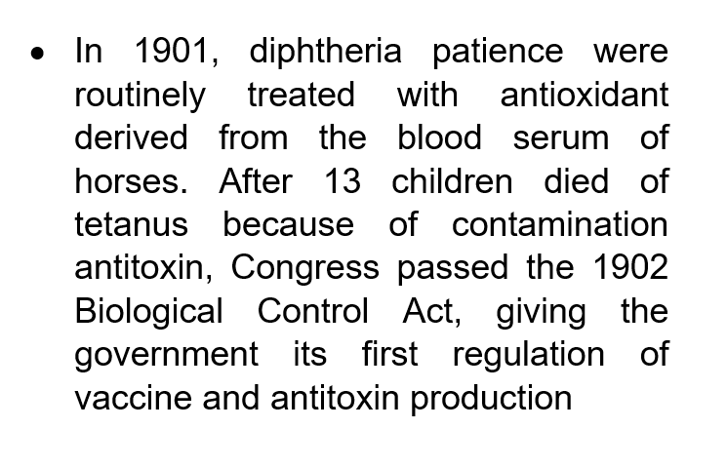
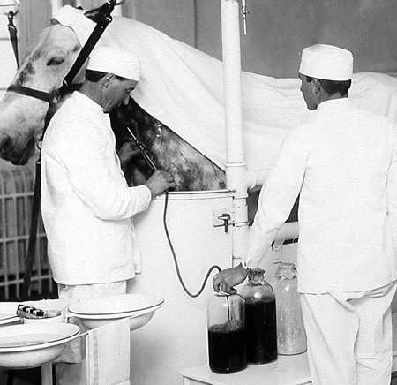
We Know What We’re Doing, What Could Possibly Go Wrong?
1902 Diphtheria anti-toxin contaminated with tetanus
13 children died
Resulted in the Biologics Control Act of 1902
“The purity of these substances is of far more importance than that of ordinary drugs. A dose of an antitoxin for instance, once administered directly into the bloodstream, is beyond recall.”
https://commons.wikimedia.org/wiki/File:Diphtheria_antitoxin_horse.jpeg

Slide 5
Vaccinations
Forms of vaccination had been practiced since at least the 1100s in various parts of the world when dried scabs from smallpox patients were inoculated into children and adults. This process probably involved “sniffing’” smallpox crust powder or scratching material into the skin. Intravenous infusions started to be used in the 1830s, originally developed as a treatment for cholera. In 1888 the diphtheria toxin was discovered and the treatment of diphtheria using therapeutic antibodies (against the toxin) was developed by an Emil von Behring (who won the first Nobel prize for Physiology and Medicine for this work).
Diphtheria is a bacterial infection that causes throat swelling often to the point of strangulation. Today, we have vaccines to protect children from diphtheria, but in the early 1900’s the treatment was to treat children who already had the disease with antiserum made from the blood of diphtheria-immunized horses. Public Health Labs had been producing diphtheria antitoxin since 1894.

Slide 6
Diphtheria Antitoxin Investigation
In 1902 diphtheria antitoxin was found to be responsible for the deaths of 13 St. Louis children.
The investigation into these 13 deaths revealed that these children had all received diphtheria antitoxin derived from the serum of one specific horse, named Jim. This horse was a retired milk cart horse and had provided serum before without problem. It is estimated that over the course of his “career”, he had produced 30 quarts of antiserum that was responsible for saving many lives. However, the investigation into this incident revealed that the horse had contracted tetanus in October and was destroyed. This was before any deaths had been reported. After his death, his “blood harvests” from immediately before his diagnosis of tetanus were not checked for the presence of tetanus and were subsequently processed and made available for use. The first death occurred after that and was determined to be from an antiserum harvest from September 30 that was contained tetanus in its incubation phase. Before officials got a grip on the situation, twelve more children died. It’s possible that these deaths could have been prevented if there was an appropriate recall of previous lots because of Jim’s tetanus infection and would certainly have been prevented if the lots had been tested before being released for use.
Around this same time, children were dying in Camden, NJ as a result of a similar situation with a smallpox vaccine.

Slide 7
Additional Information
See also:
http://www.historyofvaccines.org/content/blog/early-uses-diphtheria-antitoxin-united-states
The Road to the Biotech Revolution: Highlights of 100 Years of Biologics Regulation; FDA Consumer magazine, The Centennial Edition / January-February 2006

Slide 8
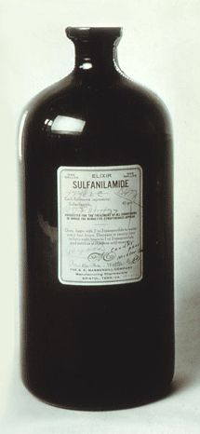
Investigation
Another incident that increased public awareness about the risks in available drugs was Elixir Sulfanilamide.
A development chemist for the Massengil Company prepared an “elixir sulfanilamide”.
Sulfanilamide, a sulfa drug, was introduced in 1935 and was extremely effective in fighting bacterial infections. But sulfanilamimde was only available as a powder or as pills and was bitter-tasting. This made it hard to take – especially for a child. This chemist was asked to find a liquid solution for the drug that would be more suited for children.
The solvent, used to prepare the elixir, was diethylene glycol. With a little pink coloring and some cherry flavoring, it tasted great.
As an aside, the word “elixir” mean that the substance was dissolved in alcohol. Since it was not dissolved in alcohol, but in diethylene glycol, we have a misbranded drug.
Diethylene glycol was tested for qualities such as flavor and fragrance, but never tested for safety. More than 100 people died, including many children and the FDA instituted a nationwide recall. Amazingly, the FDA eventually tracked down 234 gallons and 1 pint of the 240 gallons manufactured.
https://commons.wikimedia.org/wiki/File:Sulfanilamide_FDA.jpg

Slide 9
Further Investigation
The cause of this tragedy was not readily apparent. FDA was diligent about investigating the cause and had asked for help from the University of Chicago. Frances Kelsey, a graduate student at the University of Chicago was instrumental in determining that the solvent used in the formulation, diethylene glycol, was toxic.
But remember this individual - - she has another part to play at FDA in future years.
The immediate outcome of Elixir Sulfanilamide was tragic. It caused 107 deaths, many of them children.
Samuel Massengil (company owner) denied any responsibility for this event because they could not have foreseen these consequences. (compare this to the suicide of Harold Watkins the chemist who created the formulation).
But Samuel Massengil was charged with distributing an adulterated product because it “fell below the professed standard under which it was sold (not being equivalent to the earlier power formulation). Massengil pled guilty and was fined $150 for 164 counts ($24,600) which was the largest fine levied under the 1906 Act. However, justice may have prevaiiled. There are reports that Massengil paid ½ million dollars in wrongful death suits as a result of this incident.

Slide 10
Also see
See also:
http://www.nlm.nih.gov/changingthefaceofmedicine/physicians/biography_182.html
http://www.faqs.org/health/bios/6/Frances-Oldham-Kelsey.html
FDA Consumer magazine - June 1981 Issue, Taste of Raspberries, Taste of Death: The 1937 Elixir Sulfanilamide Incident

Slide 11
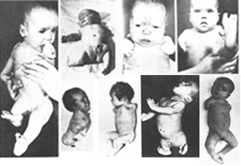
Early 1960’s - THALIDOMIDE
We Know What We’re Doing, What Could Possibly Go Wrong?
Early 1960’s - THALIDOMIDE
Available in Europe
Promoted as non-toxic, no side effects, completely safe
Interferes with development of limb buds in first 3 months of gestation
Not approved by FDA
~12,000 cases in Europe
17 cases in USA
https://commons.wikimedia.org/wiki/File:Thalidomide_effects.jpg

Slide 12
Thalidomide Investigation
In the 1960’s, the tragic effects of thalidomide became evident.
Thalidomide was not available in the US; it was however available in Europe. It was found to be responsible for birth defects in more than 12,000 infants, mostly in Europe.
Thalidomide’s German manufacturer claimed that the drug was non-toxic, with no side effects, and completely safe for pregnant women. Obviously, these statements aren’t true.
We know NOW, that Thalidomide interferes with the development of the limb buds in a fetus exposed to thalidomide in the first three months. The US had 17 thalidomide victims (children) but the incidence was low because the drug was not yet approved in the US. (Patients obtained the drug from connections in Europe or through product samples distributed to US physicians (which was legal).
Also see:
Frances Oldham Kelsey: FDA Medical Reviewer Leaves Her Mark on History: http://web.archive.org/web/20061020043712/http://www.fda.gov/fdac/features/2001/201_kelsey.html

Slide 13
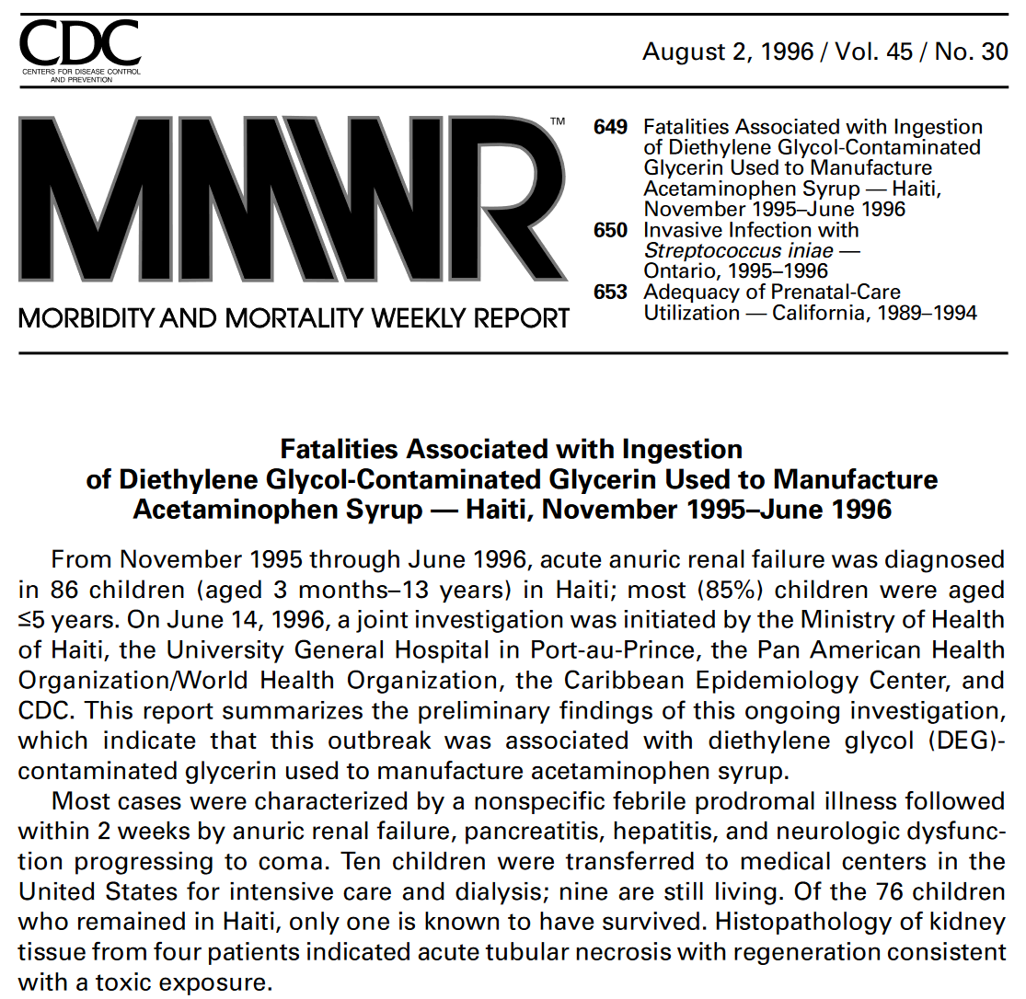
We Know What We’re Doing, What Could Possibly Go Wrong?

Slide 14
What Went Wrong
This adulterated product PASSED testing requirements.
This incident resulted in the deaths of 75 deaths mostly in children 5 years old and younger. FDA participated in the investigation into this tragedy. The cause was determined to be diethylene glycol contamination of the glycerin syrup used for the formulation of acetaminophen syrup.
Glycerin is used as a sweetener in formulations of many pharmaceutical syrups ingested orally.
The glycerin material was manufactured in China as “synthetic glycerin”. A middleman in the Netherlands relabeled the material as USP Glycerin. This is what was used by the manufacturer in Haiti to formulate acetominophen syrup. (“Afebril” and Valodon” ).
This is a very prominent example of the need for control over the raw materials used in the formulation of drug products.
Interestingly and ominously, the infrared spectroscopy tests required by the USP would not have detected this DEG-contaminated glycerin syrup. Another example where TESTING is not the assurance that things are what you think they are.

Slide 15
The GMPs
15
The GMP regulations are a result of tragedies that resulted from a lack of control by drug manufacturers
Failure to produce drug products within a system compliant with GMPs causes the products produced from the system to be ADULTERATED and subject to regulatory action.
Reading the GMPs is easy. APPLYING them appropriately to your operation takes knowledge of GMP requirements, knowledge of the specific needs of your products and processes, knowledge of current industry practice, and knowledge of how FDA is currently interpreting this issue.
And because compliance is affected by current industry practice, and because current practice can CHANGE, we all need to be on our toes.

Slide 16
Drugs Are Different Than Most Other Consumer Products
There’s no way for a consumer to judge the quality:
You can’t tell by looking at it
You can’t play with it in the store
You can’t test drive it
You can’t try a little and see if you like it
You, as a consumer, are forced to trust the manufacturer that the drug was made properly (and the drug product has the appropriate SISQP).
We all need to trust the quality of the medicines that we take or that our loved ones take. Buying medicine is different than buying a car that you can test drive. Most of us don’t have the specific training or laboratory facilities to test a drug product before we take it.

Slide 17
What’s in the GMPs about Quality? SISQP
Safety: Does no harm
Identity: Is what it’s supposed to be
Strength: Sufficiently potent
Quality: Meets requirements
Purity: Free of contamination
In the GMPs at least 20 times!
In fact, the phase “safety, identity, strength, quality, and purity” or some combination thereof appears in the GMPs at least 20 times, and in almost all of the 11 subparts in the regulation. It’s hard to miss the theme that the GMPs have been written to assure the SISQP of the product.

Slide 18
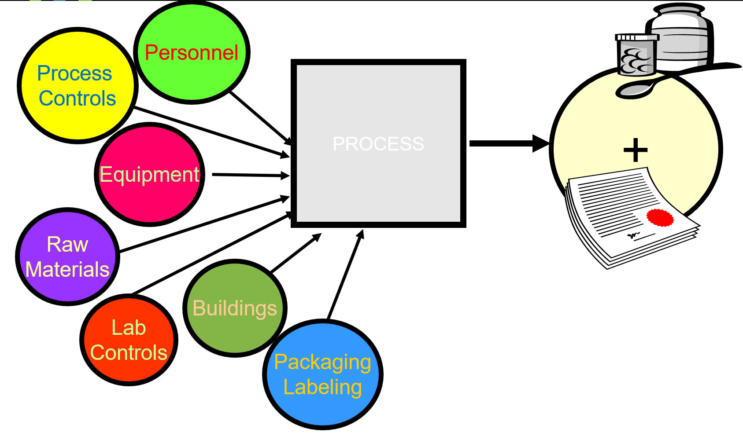
Input –Process-Output (IPO) Model Making a Drug
18

Slide 19
What are the Products of a Process?
In the GMP Orientation, we look at the GMPs as an IPO Model (Input – Process – Output). The quality and attributes of the product that is produced is affected by the inputs to the process. A bad input affects the quality of the product that comes out the other end.
Why is it significant that the production of a drug product generates TWO products?
The drug product and the documentation. The documentation is important because the production records are reviewed and help to determine if the drug product is good. Therefore, there will be documentation to demonstrate that the buildings used to produce the drug product were acceptable during the manufacture.

Slide 20
Non-Conformance Related Regulations
21 CFR 211.22 Responsibilities of Quality Control Unit
(a) There shall be a quality control unit that shall have the responsibility and authority to … review production records to assure that no errors have occurred or, if errors have occurred, that they have been fully investigated. …
21 CFR 211.100 Written Procedures; Deviations
(b) … Any deviation from the written procedures shall be recorded and justified.
21 CFR 211.160 Laboratory Controls, General Requirements
… Any deviation from the written specifications, standards, sampling plans, test procedures, or other laboratory control mechanisms shall be recorded and justified.
21 CFR 211.180 Records and Reports, General Requirements
(e) … Written records required by this part shall be maintained so that data therein can be used for evaluating … quality standards … Written procedures shall be established and followed for such evaluations and shall include provisions for: (2) A review of … and investigations conducted … .

Slide 21
Non-conformance Regulations
21 CFR 211.192 Production Record Review
… Any unexplained discrepancy … or the failure of a batch or any of its components to met any of its specification shall be thoroughly investigated, … . The investigation shall extend to other batches of the same drug product and other drug products that may have been associated with the specific failure or discrepancy. A written record of the investigation shall be made and shall include the conclusions and follow-up.
21 CFR 211.198 Complaint files
(a) … Such procedures shall include provisions for review by the quality control unit, of any complaint involving the possible failure of a drug product to meet any of its specifications and, for such drug products, and determination as to the need for an investigation … (b)(2) Where an investigation under §211.192 is conducted, the written record shall include the findings of the investigation and follow-up. … (3) Where an investigation under §211.192 is not conducted, the written record shall include the reason that an investigation was found not to be necessary and the name of the responsible person making such a determination.
21 CFR 606.100 SOPs
(c) … A thorough investigation, including the conclusions and follow-up, of any unexplained discrepancy or the failure of a lot or unit to meet any of its specifications shall be made and recorded.

Slide 22
What Could Possibly Go Wrong?
Examples of various production processes. Some of these processes are actually a set of subprocesses.
Cleaning of equipment
Sterilization of equipment
Cleaning of production areas
Securing raw materials
Accepting raw materials
Weighing
Sampling
Purification processes
Sterilizing filtration
Virus removal
Fermentation
Vialing
Labeling
Storing
Laboratory testing
Distributing

Slide 23
Purification
Cleaning of equipment
Sterilization of equipment
Cleaning of production areas
Securing raw materials
Accepting raw materials
Weighing
Sampling
Purification processes
Sterilizing filtration
Virus removal
Fermentation
Vialing
Labeling
Storing
Laboratory testing
distributing
Subprocesses of Purification
Column cleaning
Column packing
Column depyrogenation
Instructions on how to run the column
Sampling and testing

Slide 24
Sterilization
Cleaning of equipment
Sterilization of equipment
Cleaning of production areas
Securing raw materials
Accepting raw materials
Weighing
Sampling
Purification processes
Sterilizing filtration
Virus removal
Fermentation
Vialing
Labeling
Storing
Laboratory testing
distributing
Subprocesses of Sterilization of Equipment
Preparing equipment for sterilization
Loading the autoclave
Setting the autoclave cycles
Removing and storing the sterilized material
Sampling and testing

Slide 25
What Is Your Comfort Zone?
If you know something went wrong with a production process, would you have concerns about the quality of the final drug product?
?

Slide 26
Answer
YES
When things go wrong, we don’t have the assurance in the final product.

Slide 27
Quality of Drug Prodcut
If you don’t know that the process went right, would you have concerns about the quality of the final drug product?
?

Slide 28
Answer?
YES
If you can’t tell if the process WENT RIGHT, you would be concerned about the quality of the final drug product

Slide 29
Which do you feel more comfortable with?
Which Do You Feel More Comfortable With?
“The Manufacturer DOESN’T KNOW of anything that went wrong with the process”
or
“The Manufacturer KNOWS that the process was performed properly”

Slide 30
What Makes You More Assured of the Quality of the Product?
You probably have a definite opinion about these responses, and so does the FDA.
The FDA wants you to detect and evaluate things that go wrong in the process, and they also want you to know and provide evidence that the process was performed properly.

Slide 31
What Does The FDA Expect?
The FDA wants verifiable evidence that the process was performed properly.
According to FDA, the definition of “properly” is “in compliance with Good Manufacturing Practices”
This includes the requirement that any non-conformances are properly investigated.
Investigations of non-conformances need to be thorough, complete, and timely.

Slide 32
The State of Being In-Control vs Out-of-Control
[FDA investigations] “… provide CGMP assessment which may be used in efficient determination of acceptability of the firm …”
In-Control
“operating in compliance with applicable CGMP requirements”
Out-of-Control
“determine whether inspected firms are operating in compliance with applicable CGMP requirements, and if not, to provide the evidence for actions to prevent adulterated products from entering the market and as appropriate to remove adulterated products from the market, and to take action against persons responsible as appropriate”
REFERENCE: FDA’s COMPLIANCE PROGRAM GUIDANCE MANUAL 7356.002 SUBJECT: DRUG MANUFACTURING INSPECTIONS

Slide 33
Quality
“Quality needs to be constantly improved, but it is just as necessary to make sure that quality never deteriorates.” – Shigeru Mizuno
“What happens is not as important as how you react to what happens” – Epictetus, Greek philosopher

Slide 34
Corporate Culture / Institutional Culture / Group Culture / Team Dynamics
The “Culture” of Quality

Slide 35
It’s All About Attitude Being Cavalier
Synonyms: Indifferent / Offhand / Heedless / Neglectful
We’ve all heard remarks like this:
“Don’t worry, we’ve never had a problem with that before!”
“I’m sure it’ll be fine. Let’s just go ahead with it.”
“We’re not spending a dime/time on this unless we know it’s a real problem.”
“Let’s just go ahead. If there’s a problem, we’ll fix it then.”
This type of attitude drives the FDA (and other quality professionals) to despair. It guarantees eventual pain and suffering.

Slide 36
Non-Conformances
Non-Conformances

Slide 37
Documentation and Investigation of Non-Conformances What’s a Non-Conformance?
Deviations
Failures
Out of Specifications (OOS)
Out of Tolerance (OOT)
Stability OOS
Validation Failures and OOS
Exception Reports
Environmental & Utility Monitoring OOS
Customer Complaints
Unexpected Results
Audit Observations
Employee Observations
Variances
Quality Events
Others

Slide 38
Do I Really Need To Report A Non-conformance?
“I don’t want to report it because . . .”
I don’t like it
It’s going to make me look bad
I don’t want to inform on my colleagues
I wasn’t expecting it
My boss will be mad
We really need that product, utility, equip. …
It’ll probably never happen again
It’ll be a hassle to deal with
Etc.

Slide 39
Out of Specification (OOS)
The court case United States of America versus Barr Laboratories, tried in 1992 in New Jersey, sent FDA regulated industries a wake-up call.
Barr was inspected numerous times from 1989 – 1992. In 1992, FDA inspected the Northvale Facility giving them a 483 containing 75 items and the Pomona Facility, giving them a 483 containing 47 items. Many of these issues had been recorded during prior visits to Barr in the areas of process validation, failure investigation and laboratory practices.

Slide 40
Out of Specification (OOS)
FDA discovered that Barr was:
Averaging out of specification results with in-spec results to get a passing result
Maintaining an ineffective program for process validation
Discarding raw data
Conducting multiple retests with no defined end point
Performing inadequate failure investigations
Lacking method validation

Slide 41
Human Nature – Question Unexpected Results
It might be human nature to immediately conclude that if you didn’t get the answer you expected, then the answer that you got is somehow wrong. So, you repeat the testing. And maybe to be on the safe side, you repeat the testing several times. But when you get an expected result from a test, do you question the validity of that result? Would you perform repeat testing? And ultimately, retesting of a sample boils down to how much you “like” the result. If you like the result, if it’s in-spec, you report it. If you don’t like the result, if it’s out of spec, you repeat it.
When you step on a scale to monitor the weekly weight loss from your diet, and you don’t like the result, don’t you step on the scale again? If you don’t like the numbers, you get balancing your checkbook, don’t you run the numbers again?
This is what Barr Labs was doing with their QC test results that didn’t turn out the way they expected. And FDA had a problem with that. The reason that you give for a test result being invalid must be based on science – not on emotions or how well you “like” the answer.

Slide 42
Warning Letter Whitney Labs, Orlando, FL
[Observation] 4. Failure to thoroughly investigate any unexplained discrepancies or failures of a batch or any of its components to meet any of its specifications [21 CFR § 211.192]. For example, the mislabeling of 300 unit-doses … and reports of leaking containers and missing labels received by your firm were not investigated to determine root causes and no corrective or preventive action was implemented.
Your FDA 483 response is inadequate because it does not address the need to investigate unexplained discrepancies or failures of a drug product or component to meet specifications even when there is no complaint involved.

Slide 43
Warning Letter Pharmalucence, Inc., Bedford, MA
2. a. Your investigations into environmental and personnel monitoring excursions do not address potential links between identified microorganisms and the root cause or indicate whether these microbes had been observed in past monitoring. Five investigations were conducted when the action level was exceeded for personnel monitoring. ... Each investigation lacked the identification of potential sources or previous occurrence of the identified microorganisms. Additionally, three of the above-mentioned investigations conducted … were not initiated until 7-9 months after the excursion had occurred. Your response to the Form FDA-483 was inadequate in that the written records of the investigations were not included and the rationale to support release of associated product was not provided.

Slide 44
Obligation to Report Problems and Near Misses
Failure to report non-conformances or other problems can result in:
Patients can be harmed
Drug product may not be effective
Drug product may not represent its true characteristics
Missed opportunity to correct a pervasive problem that will continue to cause headaches, failures, etc.
It will come back to haunt us – Murphy's Law
It will reduce your credibility, the BDP’s credibility, and potentially the credibility of biopharmaceutical medicine.

Slide 45
FDA Expectations
A primary FDA concern and GMP requirement is the ability of a GMP organization to properly document deviations, failures, deficiencies, etc. and to subsequently perform thorough and effective investigations to determine root cause, possible product impact, corrective and preventative actions (CAPA), and to document such actions.
These investigations are expected to be completed within a reasonable time period (example 30 days)
The inability to complete an investigation in a timely fashion must be justified, approved, and documented in writing.

Slide 46
SOP 21301
SOP – Deviations

Slide 47
SOP 21301 Deviations
This procedure defines the process for reporting, evaluating, dispositioning, and documenting deviations from approved written procedures, such as SOPs, BPRs, and GMP regulations.
Is it a deviation?
If an official document states to do “X” and “Y” is done instead, it’s a deviation.
If an official document states to do “X” and “X” is not done, it’s a deviation.
This is also called a deficiency.
If something new is done that is not a part of the stated procedure, it’s a deviation.
This procedure also applies to deviations that occur during the execution of validation protocols.
Unexpected events are best handled as deviations.

Slide 48
SOP 21301 Deviations
Planned vs Unplanned Deviations – Planned is much better
The FDA and auditors expect to see planned deviations, they’re normal. The time and effort has been expended to optimize the probability that the right thing is being done. They are considered a temporary change to a procedure.
Unplanned deviations are a problem. The potential impact to product & patient may be unknown. There has been no opportunity to ensure that the right immediate response has been made. “Shooting from the hip”
Need to identify and investigate the Who, What, Why, Where, When, & How, and the Scope or Weight of the deviation.
Investigate the deviation, identify and document root causes, determine possible product impact (SISQP), and perform actions to contain, correct and prevent the problem from happening again.

Slide 49
SOP 21301 – Deviations Classifications of Criticality & Risk
Critical Deviations
An event that is likely to cause a product to fail established final product test specifications or general expectations and that makes the product unfit for its intended use. The deviation results in a substantial impact on a quality attribute, process parameter, equipment or instrument used for process or control for which impact to patients, personnel, or environment is highly likely.
Major Deviations
An event that could possibly cause a product to fail established final product test specifications or general expectations but that may still allow the product to be used as intended with an approved corrective action. The deviation results in a moderate impact on a quality attribute, process parameter, equipment or instrument used for process or control.
Minor Deviations
An event that will not obviously cause a product to fail established final product test specifications or general product expectation. The deviation does not affect the safety, identity, strength, quality, or purity of the product. The deviation has a minimal impact on a process parameter, equipment or instrument used for process or control.
Classifications can change with additional data & investigation results.

Slide 50
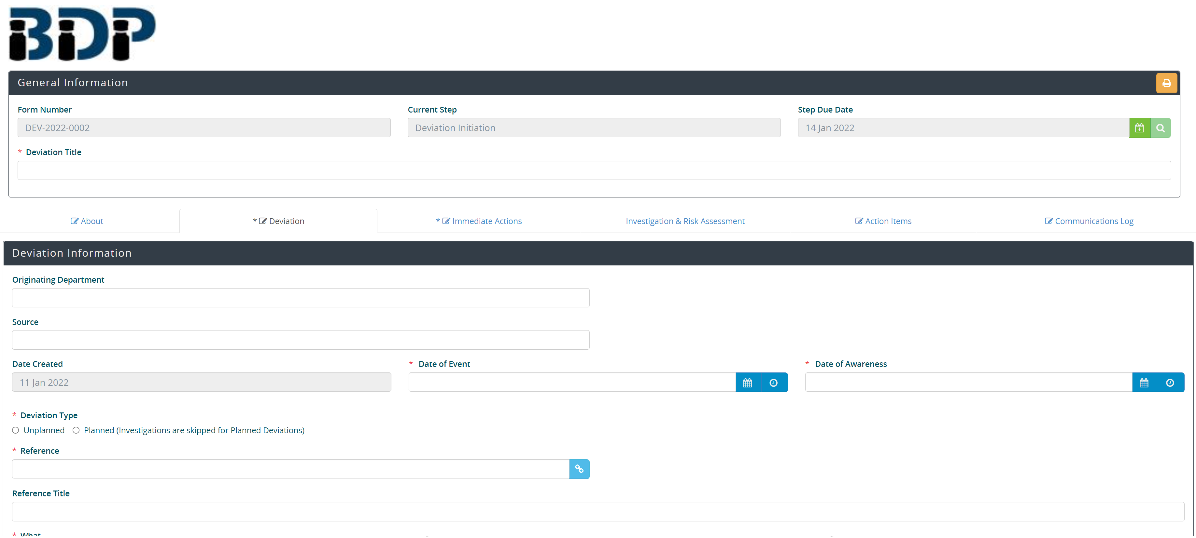
SOP 21301, Deviations Deviation Request - In the eQMS

Slide 51
Warning Letter Hospira, Inc., Clayton, NC
“Your failure to follow written procedures, assure prompt investigation, determine root cause, and implement appropriate corrective action resulted in exposure of patients to objectionably contaminated drugs. …
... it is unclear if your firm has determined the root cause of the problem and resolved it. In addition, you have not provided an interim plan to ensure the quality of drug products that you continue to manufacture and distribute, prior to the completion of your corrective action and validation activities.
…your Quality Control Unit (QCD) failed to: … (2) implement adequate corrective and preventive actions related to objectionable … contamination in … drug products; and (3) complete and approve 178 manufacturing investigations within 30 days … .
… you failed to conduct adequate investigations that [would] result in your implementation of corrective actions to prevent recurrence of the problems and evaluate other potentially affected lots.”

Slide 52
Deviations
Planned Verses Unplanned Deviations

Slide 53
Planned Vs Unplanned Deviations
Planned Deviation
Controlled
Forethought – input from PS, SME, QA, RA, Manuf. & others
Allows prior consideration of possible choices to minimize negative product & patient impact
Can track how well plan was executed
Unplanned Deviation
Uncontrolled
Unexpected
Not enough time to get pre-approval
A significant problem due to unknown impact to product & patient
Not to be used to avoid obtaining a planned deviation

Slide 54
Planned Vs Unplanned Deviations Asking for Forgiveness, Not Permission*
“I can do anything I want and if something goes wrong or if I get caught, I’ll just say I’m sorry.”
Actions have consequences!
The trust between you and your supervisor, your department and QA, and the BDP and our customer is compromised.
You are creating liability for yourself, the BDP, Leidos, and FNLCR!
* Paraphrased from: “Asking for Forgiveness, Not Permission, The Importance of Judgment and Responsibility,” Walt Grassl

Slide 55
Asking for Forgiveness, Not Permission*
Ask yourself:
Is what I am going to do illegal?
Is what I am going to do a violation of policy?
Do I have enough information to make a reasonable decision?
If what I choose to do does not work out, what is the worst possible outcome?
Am I willing to accept responsibility for making the decision and not look to blame others for the unexpected outcome?

Slide 56
Planned Vs Unplanned Deviations
Remember that Planned Deviations (asking for permission) are greatly preferable to Un-planned Deviations
Forethought
Opportunity for additional input
Approval to proceed
Planned deviations must be approved prior to the action being taken.
Otherwise, it becomes an unplanned deviation

Slide 57
SOP 22004
SOP – Managing Out-of-Specification Test Results or Unexpected Test Results

Slide 58
Unexpected Test Results
PA/QC test results that are OOS or unexpected must be investigated by the analyst and their supervisor to confirm that they accurately represent the quality attributes of the sample being tested.
OOS investigations occur in two phases.
The first phase of investigation attempts to identify “obvious” lab related (not sample related) causes for the OOS result such as out of calibration equipment, use of outdated reagents, calculation errors, dilution errors, etc.
If no obvious causes of lab error are identified, the investigation is expanded to a second phase, often utilizing laboratory experiments, to identify a cause of the initial OOS result. Initial OOS results that are determined to be due to laboratory error are invalidated and after implementing corrective action to prevent a future occurrence, the sample may be retested.
In cases of documented lab error, the retest result replaces the initial OOS result.

Slide 59
SOP 22004 – Managing Out-of-Specification Test Results or Unexpected Test Results
Investigations that indicate that the OOS result accurately represents the attributes of the sample are valid results.
Expand the Investigation – Review:
Manufacturing Process Sequences
Past OOS Events
Test Results for Other Similar Batches
Test Data and Follow-up Testing Results
Sampling Process
Test Standards and Test Specifications
Assignable Cause
Laboratory Error
Sampling Error
Inappropriate Standard or Test Specification
Manufacturing Error
Inconclusive

Slide 60
Warning Letter Centaur, Inc., Olathe, KS
Observation “1. Failure to make written records of investigations into unexplained discrepancies as required by 21 CFR 211.192. For example, a specific gravity analysis for isopropyl alcohol did not meet specifications. There was, however, no documented record regarding this failure to meet specifications. There was also no written record of any related investigation, including documentation of conclusions and follow-up, as required by 21 CFR 211.192.”
Investigations must be properly documented.

Slide 61
Warning Letter Akorn, Inc., Decatur, IL
II. Failure to conduct and document a thorough investigation of any unexplained discrepancy or failure of a drug product …
a. The investigations conducted by your firm … into the origin and nature of visible precipitate, which you now have identified … in … products and into numerous illness/injury complaints for the products are inadequate … Although the corrective action outlined in your firm's … response … , the addition of instructions that the products be administered through a sterile syringe filter, is … not an acceptable permanent solution … and does not address the root causes …
→

Slide 62
Warning Letter – Akorn, Inc. (Continued)
c. Timeframes for investigations are not met and investigation extension requests are not approved as required by your firm's written procedures.
(1) SOP … requires that OOS investigations are completed within 30 days or an Investigation Extension Request approval be obtained. …OOS investigations … were not completed within 30 days and did not obtain Investigation Extension Request approval.
(2) SOP … requires that deviation from a standard procedure be documented. … OOS investigations that did not meet the timeframes established in … did not have a deviation report initiated and completed per the timeframes established in …

Slide 63
Other Non-Conformance Related BDP SOPs
SOP 21508, Equipment Calibration Program
SOP 21526, Engineering Event Management
SOP 21525, Responding to Power Outages in Building A & B of the ATRF
SOP 21101, Internal CGMP Compliance Auditing
SOP 21008, Material Review Board

Slide 64
Other Non-Conformance Related BDP SOPs (continued)
SOP 21704, Biopharmaceutical Quality Assurance Hold/Quarantine Policy for Materials and Product
SOP 21705, Request for Additional Processing of Drug Substance or Final Drug Product
SOP 22313, Environmental and Utility Monitoring – Excursions Event Notification and Evaluation
SOP 24101, Field Withdrawal or Correction of Investigational Products

Slide 65
Documentation and Investigation of Non-Conformances
Usually need an investigation team
The person who caused it or discovered it
QA
Project Scientist
Subject Matter Expert (SME)
Impacted party
QC/Analytical (for OOSs and related)
Others, as appropriate
Need to investigate other lots of the same product and/or similar products to see whether the same non-conformance & actions applies to them as well. May require a CAPA.

Slide 66
Warning Letter Fenwal, a Fresenius-Kabi Company
“Observation 1. You failed to thoroughly investigate any unexplained discrepancy or the failure of a batch or any of its components to meet any of its specifications whether or not the batch has already been distributed. In addition, you failed to extend the investigation to other batches of the same product and other products that might have been associated with the discrepancy ... Our inspection … found that you have received multiple consumer complaints related to … product mix-ups ... You have confirmed most of these quality issues. Your investigations have failed to identify the deficiencies in need of correction to avoid the distribution of … products which are not in full compliance with regulatory specifications. In addition, the scope of your investigations was not expanded to other lots and products potentially affected by these deviations.”

Slide 67
Determination
Root Cause Determination

Slide 68
Definition
A root cause is defined as a factor that caused a nonconformance and should be permanently eliminated through process improvement. The root cause is the core issue—the highest-level cause—that sets in motion the entire cause-and-effect reaction that ultimately leads to the problem(s).
Root cause analysis (RCA) is defined as a collective term that describes a wide range of approaches, tools, and techniques used to uncover causes of problems. Some RCA approaches are geared more toward identifying true root causes than others, some are more general problem-solving techniques, and others simply offer support for the core activity of root cause analysis.

Slide 69
Root Cause Determination
Need to determine the causes and the root causes at all the affected levels
Usually, there is more than one root cause
Ask:
What caused the non-conformance (This is the immediate cause)
What caused that problem (This is a secondary cause)
What caused that problem (This is a tertiary cause)
What caused that problem (These are additional sublevel causes)
What caused that problem (These are the true Root Causes)
Dig deep. Can usually drill down 5 levels!
Correcting a true root cause solves many problems and is worth the effort.
True root cause may not be what you first thought and can only be determined by deeper investigation.
Notes:
Need examples

Slide 70
Root Cause- Determination
There is usually more than one root cause
Ask:
Who? – Use employee identification numbers or titles rather than names. Must identify the who.
What? – What was affected? What product, utility, etc? Description must be sufficient to allow someone (FDA investigator) to know all the pertinent information of what happened.
When? – Dates & times, durations
Where? – Building, Room, Equipment, Etc.
Why? – What were the mitigating factors? What went wrong? What allowed it to happen? What were the true root causes?
How? – How did it happen step by step. What was the timeline of the event? Description must be sufficient to allow others (Supervisors, QA, Management, FDA investigator) to know all the pertinent information of how it happened and to be able to reconstruct what happened.

Slide 71
Warning Letter – “Who” CorePharma, LLC, Middlesex, NJ
Observation “2, a) Your investigation is inadequate ... Despite your inability to determine a definitive root cause, you released the batch …, you failed to extend the investigation to other batches manufactured by the same operator even though you determined the probable root cause was due to operator error … Your response is inadequate because you do not describe the steps you have taken to ensure thorough investigations of discrepancies in the future.
b) … The investigation did not determine a root cause or evaluate the impact on product quality. … you fail to address the possible cause …, the potential impact on product quality, or the implementation of adequate corrective actions to prevent recurrence...
c). Your … investigation did not extend to other batches of product using the same … process even though your root cause analysis noted the need for numerous improvements to the … process. …
d) You failed to implement timely corrective actions after identifying increasing trends of … the defect. 3. … your QCU failed to follow your … SOP …, for ensuring Problem Analysis and Corrective Action Reports … Sixty percent (33 of 55) PACARS (documenting corrective and preventive actions) …, were incomplete at the time of our inspection. …”

Slide 72
Warning Letter – “What” Jubilant HollisterStier, LLC, Spokane, WA
“… your firm acknowledges the lack of an adequate, documented evaluation of the effect of major equipment and facility modifications. You also provide a retrospective impact assessment that you performed. Furthermore, you state that SOP 1608.9, “Quality Control of Hollister Stier Facility During and After Shutdown” has been revised to include an improved impact assessment process. Your response is inadequate because you do not commit to conducting media fill process simulations to assure the aseptic processing operations are acceptable after major shutdown activities.”

Slide 73
Warning Letter – “Why” & “How” Ranbaxy Laboratories
Observation “3. Your procedures do not provide for a thorough review of unexplained discrepancies or failure of a batch or any of its components to meet its specifications …
A. 3. The investigation failed to confirm the root cause conclusion that microbes found in [redacted] water samples were the cause of the contamination, in that these isolates were not shown (characterized to their genus and species level) to be related to the batch sterility failure isolate [redacted].
Your response to the FDA 483 observation concerning the root cause conclusion in the investigation commits to implementing procedural changes that will address future sterility failures to ensure full characterization of investigational isolates. However, your response does not address how you intend to complete the failure investigation …, to ensure the root cause for the failures is identified and appropriate corrective and preventive measures are implemented.”

Slide 74
Assessment
Impact Assessment

Slide 75
Impact Assessment – Product
Product Impact – could the event have had any effect on the SISQP of the product?
Safety – could the patient be adversely affected?
Identity – could the chemistry, quaternary structure, glycosylation, etc. have been affected?
Strength/Potency – could the specific activity have changed?
Purity – could the impurity profile have changed?
Stability – could the stability of the molecule have changed? This is often hard to determine. May need to put the lot on stability.
Quality – have any other characteristics of the molecule, DS, or DP changed? Does the product still represent the original construct?

Slide 76
Impact Assessment – Patient
Patient Impact – could the event have any effect on the safety, health, or well being of the patient that receives the drug?
Infection by Bacteria, Fungi, Viruses, Mycoplasma, Etc.
Bacterial & fungal metabolites, toxins, etc. (Endotoxin, Botulinum toxin, Shigella toxin, aflatoxin, and many more)
Degraded product no longer active (loss of stability)
Degraded product becomes immunogenic, toxic, etc.
If the product is similar to a natural human biomolecule, an immune response to the agent can be catastrophic.
Particulates in injectable products can cause many adverse outcomes
Others due to labeling & packaging errors, formulation errors (superpotent or subpotent), biological unavailability, etc.

Slide 77
Product & Patient Impact Assessment of Possible Impact
Brainstorm: List all the possible product and patient impacts the investigation team can think of
Then, consider them and determine why or why not they are likely. For those that are possible, investigate further
For each, document the possible cause-effect relationships as to why or why not it’s likely to pertain to the event. Use data and evaluation to show/prove the possibility of the relationship.
Document the justifications as to why each possible cause will or will not be investigated further.
Investigate the probable product and patient impact
Document the reasoning, justifications, & CAPA actions

Slide 78
CAPA
Corrective and Preventative Actions (CAPA)

Slide 79
CAPA – Corrective Actions
Containment actions are Immediate actions taken to mitigate a problem to prevent loss of the lot
Notify your supervisor, project scientist, and QA immediately of any non-conformance
Fully document what was done
Initiate a deviation (or other non-conformance system)
A planned deviation is much better than an unplanned deviation
Investigate
Implement the appropriate preventative actions (CAPA) and follow-up to ensure effectiveness
Companies and institutions often define CAPA in different ways.

Slide 80
FDA Warning Letter to Zhejiang Hisun Pharmaceutical Co., Ltd.
“In your response to this letter, provide the following:
A comprehensive investigation and evaluation. Describe your methodology. Results should include conclusions about the extent of … deficiencies and their root causes, which may involve … .
A risk assessment of how the observed deficiencies may affect the reliability and completeness of quality information available for your drugs. Also determine the consequences of your deficient … practices on the quality of drugs released for distribution.
A management strategy that includes a detailed global corrective action and preventive action plan.
Describe the actions you will take, such as contacting your customers, recalling drugs, conducting additional testing and/or adding lots to your stability programs, or other steps to assure the quality of your drugs manufactured under the deficient conditions discussed above.
Describe the actions you will take, such as revising procedures, implementing new controls, training or re-training personnel, or other steps to prevent the recurrence of CGMP deviations, including … .”

Slide 81
CAPA – Preventative Actions
“An once of prevention is worth more than a pound of cure.”
What needs to be done to prevent the problem from happening again? Assign, document, and follow-up on responsibilities to fix or upgrade:
All these need to be considered.
Facility, utilities, and equipment
Personnel and training
Raw materials
Procedures
Testing/analytical
Computer systems and software
Etc.

Slide 82
Risk Assessment
Risk Assessment

Slide 83
Warning Letter AMRI Burlington, Inc., Burlington, MA
“Your firm has not thoroughly investigated the failure of a batch or any of its components to meet its specifications…, nor has your firm extended investigations to other batches of the same drug product and other drug products that may have been associated with the specific failure or discrepancy
Your firm did not thoroughly investigate particulate contamination found in lot … injection. ... During a second inspection, particulate contamination was discovered in a syringe sample. Despite this finding, your firm did not re-inspect the remainder of the syringe sub-lot or the vial sub-lot. In addition, your firm did not conduct a formal risk assessment of the particulate contamination found in the drug product and its possible impact on product quality. …
Your firm’s response is inadequate because you failed to thoroughly investigate and identify the root cause for the particulate contamination …
In addition, we are concerned with your firm’s response regarding the failure to investigate particulate contamination of injection described above. … Please review all product batch records for lots within expiry for all rejects to determine trends and severity of the visual inspection rejects, and inform both the appropriate client and FDA of your findings and all follow-up corrective and preventative actions you intend to take.”

Slide 84
ICH Q9

Slide 85
Risk Analysis - ICH Q9 Quality
“Quality risk management supports a scientific and practical approach to decision making. It provides documented, transparent, and reproducible methods to accomplish steps of the quality risk management process based on current knowledge about assessing the probability, severity, and, sometimes, detectability of the risk.”
“Quality risk management is a systematic process for the assessment, control, communication and review of risks to the quality of the drug product across the product lifecycle.”

Slide 86
Risk Analysis –(ICH Q9 Quality)
“Risk is defined as the combination of the probability of occurrence of harm and the severity of that harm.”
“The protection of the patient by managing the risk to quality should be considered of prime importance.”
“An effective quality risk management approach can further ensure the high quality of the drug product to the patient by providing a proactive means to identify and control potential quality issues during development and manufacturing. …, use of quality risk management can improve the decision making if a quality problem arises.”

Slide 87
Risk Analysis - Considerations
Two primary principles of quality risk management are:
The evaluation of the risk to quality should be based on scientific knowledge and ultimately link to the protection of the patient; and
The level of effort, formality, and documentation of the quality risk management process should be commensurate with the level of risk.
Four questions need to be answered for each stage of drug development, manufacturing, and testing.
What might go wrong?
What is the likelihood (probability) it will go wrong?
What are the possible consequences (severity)?
What is the likelihood that the problem can be detected (detectability)?

Slide 88
Risk Control & Reduction
Risk control focuses on the following questions:
Is the risk above an acceptable level?
What can be done to reduce or eliminate risks?
What is the appropriate balance among benefits, risks, and resources?
Are any new risks introduced as a result of the identified risks being controlled?
The law of unintended consequences
Risk Reduction vs. Risk Acceptance
Risk Communication & Risk Review

Slide 89
Risk Analysis & Control - Tools
Basic risk management facilitation methods (flowcharts, check sheets, etc.)
Failure Mode Effects Analysis (FMEA)
Failure Mode, Effects, and Criticality Analysis (FMECA)
Hazard Analysis and Critical Control Points (HACCP)
BDP Risk Identification, Analysis, Control, & Reduction
Probability x Severity x Detectability x Frequency = Risk Score
Risk score determines priority of control actions or acceptability
The higher the risk, the greater the effort to mitigate the risk

Slide 90
Risk Analysis & Control – Tools FMEA
BDP Risk Control Chart
Utility | MEF | Building | Likelihood of Failure | Impact | Detectability | Use Frequency | Score
DDC | 61930 | 459 | 4 | 1 | 3 | 1 | 12
DPRO | 61870 | 459 | 2 | 2 | 3 | 1 | 12
Compressed Air | 62180 | 459 | 5 | 1 | 4 | 1 | 20
HVAC | 61920 | 459 | 4 | 2 | 4 | 1 | 32
Compressed CO₂ | 62190 | 459 | 4 | 2 | 5 | 1 | 40
Emergency Power | 61980 | 459 | 4 | 1 | 4 | 5 | 80
Plant Steam | N/A | 459 | 4 | 4 | 5 | 1 | 80
Portable Clean Room | 73050 | 459 | 4 | 2 | 4 | 3 | 96
Clean Steam | 61850 | 459 | 4 | 3 | 4 | 2 | 96
WFI | 61880 | 459 | 4 | 3 | 4 | 2 | 96
Chilled Water/USAG property | N/A | 459 | 3 | 4 | 5 | 2 | 120
Compressed N₂ | 62220 | 459 | 4 | 4 | 5 | 3 | 240
VHP Decontamination | 76720 | 459 | 4 | 5 | 5 | 3 | 300
Central Vacuum | 61890 | 459 | 5 | 4 | 5 | 5 | 500

Slide 91
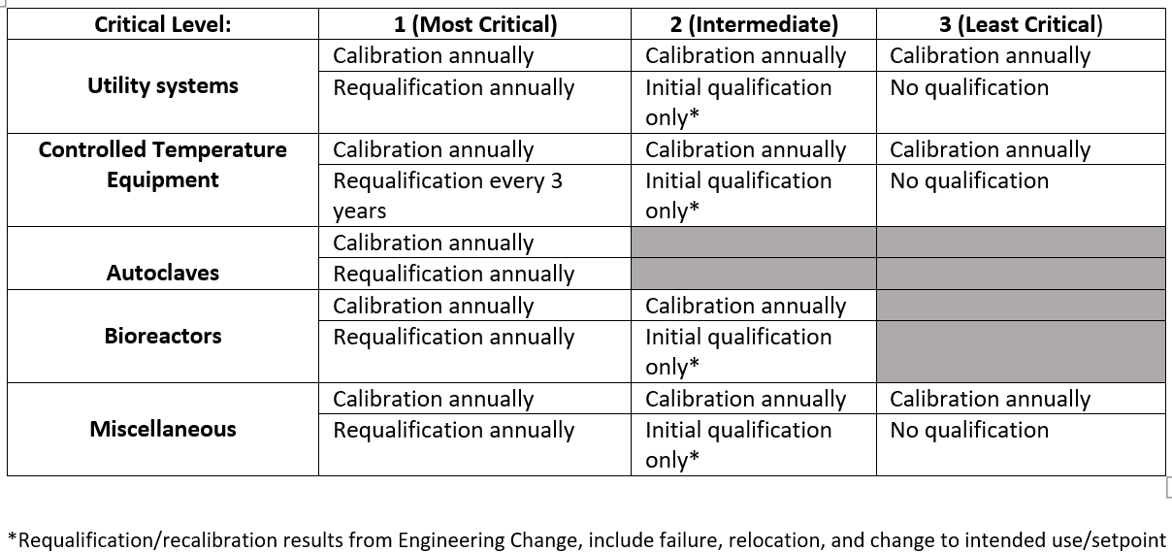
Risk Analysis & Control – Tools FMEA - Example

Slide 92
Monitoring, Trending, and Follow-up
Monitoring
The chance that an event will happen again is increased if its already happened once.
“Fool me once – shame on you
Fool me twice – shame on me”
Be forewarned! Be aware of similar situations!
Trending of critical variables and data (EM, deviations and other non-conformances)
Internal Auditing
Needs to include a review of past non-conformances.

Slide 93
Questions?
Please contact BQA Management if you have any questions.

