Slide 1
Biopharmaceutical Development Program
cGMP Training – Equipment

Slide 2
What We Know So Far
Here are the key points from the GMP Orientation Module:
Regulations on drug products are a result of tragedies that resulted from a lack of control by drug manufacturers
The Good Manufacturing Practices (GMPs) are one of the regulations applied to drugs
GMPs are found in the Code of Federal Regulations (CFR)
GMPs define the minimum requirements for control in the manufacture, holding and distribution of drugs to assure the quality of drugs.

Slide 3
What We Know So Far (Continued)
HOW manufacturers design their processes and systems to provide this control is up to them and will be judged by FDA based on the control achieved and current industry practice.
Failure to produce drug products within a system compliant with GMPs causes the products produced from the system to be ADULTERATED and subject to regulatory action.

Slide 4
Applying GMPs
Reading the GMPs is easy. APPLYING them appropriately to your operation takes knowledge of GMP requirements, knowledge of the specific needs of your products and processes, knowledge of current industry practice, and knowledge of how FDA is currently interpreting this issue.
And because compliance is affected by current industry practice, and because current practice can CHANGE, we all need to be on our toes.
It’s good to ask questions about what we do and why we do it. These are the same questions FDA will ask.
4

Slide 5
What’s in the GMPs about Quality? SISQP
Safety: Does no harm
Identity: Is what it’s supposed to be
Strength: Sufficiently potent
Quality: Meets requirements
Purity: Free of contamination
Many people remember these attributes with the acronym SISQP because most often, that is the order you find them in the GMP regulations.
In fact, the phase “identity, strength, quality, and purity” or some combination thereof appears in the GMPs at least 20 times, and in almost all of the 11 subparts in the regulation. It’s hard to miss the theme that the GMPs have been written to assure the SISQP of the product.

Slide 6
IPO Model – Making a Drug (IPO: Input-Process-Output)
In the GMP Orientation, we look at the GMPs as an IPO Model (Input – Process – Output). The quality and attributes of the product that is produced is affected by the inputs to the process. A bad input affects the quality of the product that comes out the other end.
EQUIPMENT is one of the inputs that is important in the manufacture of a quality drug product.
Why is it significant that the production of a drug product generates TWO products?
The drug product and the documentation. The documentation is important because the production records are reviewed and help to determine if the drug product is good. Therefore, there will be documentation to demonstrate that the buildings used to produce the drug product were acceptable during the manufacture.

Slide 7
Acceptable Final Product Testing Does Not Guarantee Quality Drug Product
Drugs are one of the few products where the consumer cannot assess quality.
Did you know that a batch of drug product that has 10% of units contaminated (100 of 1,000) will be detected as contaminated by the USP Sterility test only 86% of the time.
How do you like those odds?
And another statistic that you might find interesting. Research shows that even in 100% inspection, up to 15% of defective items are not detected.
(Validation of aseptic Pharm. Processes – Carleton, Agalloco, pg 14)
Obviously, final product testing by itself isn’t capable of providing the assurance that we need on the quality of drug products.

Slide 8
Subpart D: EQUIPMENT Objectives For This Module
Explore the GMP requirements for EQUIPMENT
Review some Warning Letter citations related to Equipment
Discuss some situations
Complete the knowledge assessment

Slide 9
Subpart D: EQUIPMENT The Drug GMPs
A: General Provisions
B: Organization and Personnel
C: Buildings and Facilities
D: EQUIPMENT
E: Control of Components and Drug Product Containers and Closures
F: Production and Process Controls
G: Packaging and Labeling Control
H: Holding and Distribution
I: Laboratory Controls
J: Records and Reports
K: Returned and Salvaged Drug Products

Slide 10
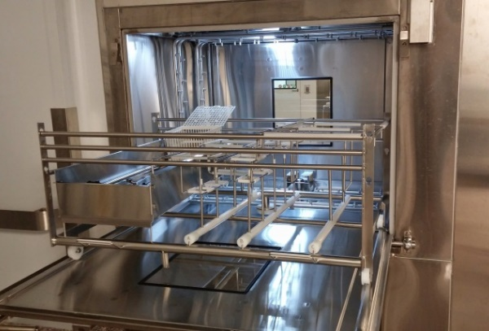
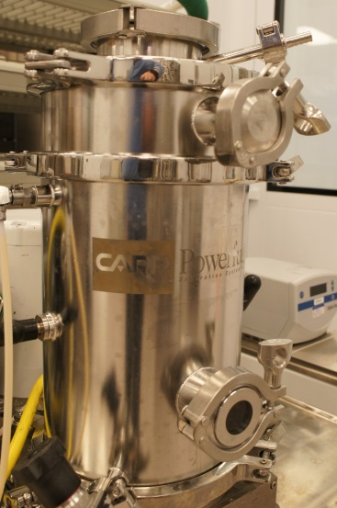
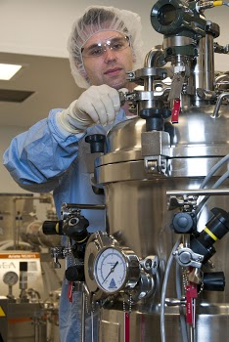
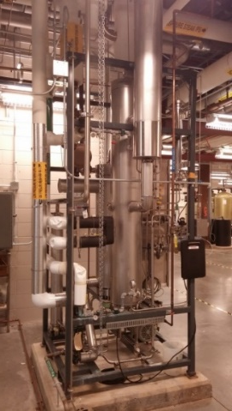
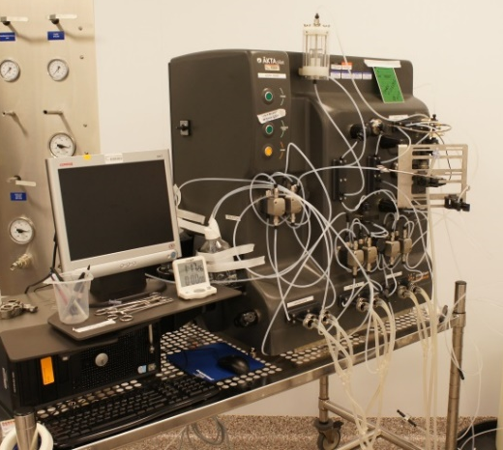
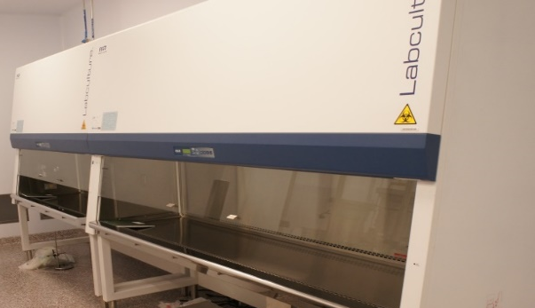
Equipment
Example of Equipment List:
Spatulas
Ovens
Balances
Vialing Equipment
Microscopes
Fermentors
Particle Counters
Computerized Systems
Autoclaves
Hoses & Tubing
Beakers
Vial Washers
Filters
Bioreactors
Chromatography skids
Ovens HPLCs

Slide 11
About Equipment
The type of equipment used for the manufacture of drugs is amazing in its variety and scope of complexity.
The spatula you use to scoop a chemical out of its container for weighing is equipment, so is the beaker that you put it in.
Microscopes, balances, spectrophotometers, fermenters, air handlers, filters, particle counters are all equipment and if used in any aspect of drug manufacture are subject to certain requirements imposed by FDA in the Good Manufacturing Practice Regulations.
“Equipment” encompasses those instruments that “do” something – a bucket for carrying water, a spatula for transferring chemicals, a label printer for making labels. “Equipment” also encompasses instruments that “measure” something – a pH meter for taking pHs, scales for weight measurements, timers, thermometers, pipettors, etc. Equipment that is permanently attached or installed to the building is considered part of the building and facilities and is regulated under GMP subpart C (Buildings and Facilities).
11

Slide 12
The Drug GMPs – Equipment
Design
Construction
Cleaning & Maintenance
Automatic Equipment
Filters
Documentation
12

Slide 13
The Drug GMPs
The GMPs require that equipment be selected so that the design and size of the equipment are appropriate to the job it will perform.
Design
Construction
Cleaning & Maintenance
Automatic Equipment
Filters
Appropriate design, size and location
So that it can do the job
Easy to get to when you need to use it
It can be cleaned and maintained

Slide 14
Design & Size
A trowel, shovel, and a backhoe all transfer dirt from one location to another, but I’m sure you have some definite ideas about when to use each piece of equipment. Certain selections have distinct advantages over the others in certain applications. GMPs require that you choose the right equipment to do the job.
Equipment needs to be located so that it can be operated and cleaned properly. If disassembly of the unit is required for adequate cleaning, then the unit should be designed so that it is easily disassembled and re-assembled.
While these factors are control requirements for the production of drug products, they are the same factors that you consider for any piece of equipment that you use. When you buy a vacuum cleaner, cake mixer, spray painter, lawn mower, floor mop, these factors are important to you also.

Slide 15
Equipment Construction
GMP requirements for equipment also require that equipment be appropriately constructed.
Appropriate Construction
Surfaces contacting product or product components must not be reactive to adversely affect product quality.
Lubricants and coolants should not come into contact with product or product components.
Leachables and extractables do not contaminate product.

Slide 16
Equipment Materials of Construction
The intent of this section is to use inert material for equipment and materials that come into contact with products, knowing that while this is desired, it is not always possible.
Some necessary materials used in equipment construction may be reactive to some extent. These materials may be used if their use does not affect the safety or quality profiles of drug products. You should be able to demonstrate that this is true for your product.
Be careful about paint chipping from equipment. FDA will evaluate whether chipping paint could be a reactive surface that a product is exposed to. Paint chips in product can adulterate the product. Also, chipping paint can expose an area for equipment to rust, which can also create flakes that may potentially adulterate a product.
Any substances necessary for the operation of equipment, such as lubricants, heating fluids or coolants, should not contact intermediates or drug products so as to alter their quality beyond the official or other established specifications. Wherever possible food grade lubricants and oils should be used.
16

Slide 17
Stainless Steel
What is it made of?
Advantages of stainless steel
High chemical resistance to most bioprocess buffers
Can be electropolished (reduces surfaces that can harbor microbes and facilitates sanitary operations)
How is it constructed?
Are there nooks and crannies?
Potentials for pooling / stagnation of contents
Can it be easily disassembled for cleaning or designed to be cleaned in place?
Can the parts be disposable, and therefore don’t have to be cleaned?
Does it DO what you need it to DO?
17

Slide 18
EQUIPMENT Stainless Steel (Continued)
Stainless steel is “stainless” because it contains chromium. Non-stainless steel easily oxidized
http://www.howstuffworks.com/iron.htm (information on how iron becomes steel)
Grades 304 and 316 are used frequently in pharmaceutical, biotech and other GXP industries. 304 steel is used generally in non-process contact while 316 is for process contact. Stainless steel is deemed “stainless” because it is highly resistant to corrosion and does not easily oxidize the iron content, especially in ambient environments. Oxidized iron – either rusting or rouging is likely to contaminate a process and rusted surfaces are more difficult to clean. The high chromium content is primarily responsible for the corrosion resistance of stainless steel. The surface of 300-series stainless steel is almost entirely chromium oxide. When this surface is scratched, there is enough chromium in the metal that the newly exposed material also forms a chromium oxide “skin”. This self-maintenance of the chromium oxide skin is the primary mechanism of corrosion resistance. Chromium oxide is less reactive than the other components of the steel and is, therefore, often referred to as the “passive layer”. Also, finish is important. SS can be grinded, sanded, polished or buffed to reduce surface variation. Electropolishing is also known as anodic protection of SS and utilizes an electric current to induce the formation of a complete chromium oxide layer. It only slightly smoothes the surface but renders it more resistant to corrosion. Electropolishing is performed not as much to smooth the surface as to induce the formation of the chromium oxide passive layer. The relationship between electropolishing and passivation is often misunderstood. Electropolishing establishes a good passive layer of chromium oxide; passivation and acid washes maintain that passive layer. If a piece of steel is electropolished, there is no need to subsequently passivate that surface.
From Journal of GXP Compliance, Winter 2009, pg 13.
18

Slide 19
Stainless Steel (Continued)
An industry staple, an alloy of iron containing a minimum of 13% chromium by weight.
304 for non-product contact
316L for product contact, “L” is for low carbon.
Electropolishing measured in Ra, the lower the smoother.
Stainless steel
Rust resistant – not rust PROOF
Chlorides are a problem
Passivation for maintenance

Slide 20
Plastics
Reusable or Disposable
Benefits
Cost
No cleaning for disposable
Pre-sterilized
Drawbacks
Leachables/ extractables
Temperature resistance
Cleanability

Slide 21
Plastics (continued)
WARNING LETTER
Plastic pail-type containers purchased at
a home improvement store are used as
vessels to hold bulk liquid drugs, such as
***********, in filling operations.
There is no documentation of studies to
demonstrate that the containers’ surface
materials do not react with the drug products
while holding the liquid drugs.
Shamrock Medical Solutions Group
Lewis Center, Ohio
This April 2010 warning letter regarding container construction: FDA cites the firm: “Your firm failed to ensure that equipment is constructed so that surfaces that contact components, in-process materials, or drug products are not reactive, additive, or absorptive so as to alter the safety, identity, strength, quality, or purity of the drug product beyond the official or other established requirements [21 C.F.R. § 211.65(a)]. “

Slide 22
Glass
Pharmaceutical Glass
Hard, Smooth, Easy to sterilize
Type 1, Borosilicate Glass
Boric oxide, aluminum oxide, and alkaline earth oxides.
High hydrolytic resistance
Thermal shock resistance

Slide 23
“Equipment Shall be of Appropriate Design”
Both measuring and process equipment have to meet GMP requirements.
Manufacturing, testing, warehousing, and support equipment all have to meet GMP requirements.
Measuring Equipment
Equipment that MEASURES something must be CALIBRATED to prove that the measurement is accurate enough for your needs.
Process Equipment
Equipment that DOES something must be VALIDATED to prove that it does what you need it to do.
May also include components that take measurements and therefore must also be CALIBRATED
23

Slide 24
What Makes Equipment GMP???
Whether a piece of equipment is suitable is NOT a subjective decision. It is based on your needs and DATA that demonstrates that the equipment meets your needs.
Some equipment doesn’t just “do” something – it measures some product attribute – the physical dimensions, weight, pH, particulate counts, optical density.
It is important that the measuring equipment being used has the reliability and accuracy needed for the job. This is part of the product’s design and depending on what you are doing with the instrument, may or may not be suitable for your application. A scale used to measure bulk quantities of chemicals with an accuracy of +/- 1 gram may be fine for that use. But using a scale with an accuracy of +/- 1 gram for weighing small quantities for pilot formulations is inappropriate and not “suitable” for that intended use.
24

Slide 25
Calibration Range & Tolerance
The challenge is to confirm that your measuring equipment is measuring accurately. I think you can accept that no measuring equipment is “Perfect”. There is some degree of imprecision in every measurement. The question you have to answer is how much imprecision is acceptable for you.
Take this example: You are on a diet and expect to lose ½ - 1 kg / week (roughly 1 – 2 pounds). Are you OK with your scale weighing accurately to within 1 kg (2 pounds)? Probably not. You are going to miss your weight loss because of the imprecision of the scale. What if the scale was +/- ½ kg (1 pound) or +/- ¼ kg (1/2 pound)
Calibration is the activity that confirms a measuring equipment’s ability to generate accurate and reliable results. In calibration, technicians not only determine whether the device measures accurately, but they can often make adjustments to tweak the unit to return the unit to its calibrated state. So, if over the years, you scale reads 150 pounds instead of 148 pounds, often calibration technicians can adjust this so the scale now reads 150 pounds as 150 pounds.
25

Slide 26
Calibration
Criteria
Choosing the right equipment and calibration criteria.
An example scale can be calibrated to be accurate to within 5 pounds. It may be able to be calibrated to be accurate within 2 pounds, maybe even one pound. But the fact that the scale is calibrated doesn’t always make it useful for you. In this example, if the scale is calibrated to +/- 5 pounds, it still won’t be useful to you in monitoring the results of your dieting.
In our example of dieting, we expect weight to change from week to week by between 0 – 1 kg (0 - 2 pounds). We don’t want a scale that has a tolerance of +/- one kg because we’d potentially miss some significant changes that we’d want to know about. Can you imaging dieting hard for a whole week, sticking to your diet, depriving yourself and loosing 1 kg only to have the scale fail to register that loss?
So, we decide that we need a scale that is accurate to at least a quarter of a kg.

Slide 27
Calibration Importance
Calibration is a critical activity that demonstrates the measuring equipment’s ability to generate accurate and reliable results within a specified range. Part of the consideration is whether the equipment is designed to measure in the range appropriate for your work AND whether the equipment’s accuracy and reliability are appropriate for your work.
Calibration is a process where the equipment designed to measure an attribute is tested to assure that it can measure according to the manufacturer’s claims. Calibration is an on-going effort. Measuring equipment is checked on a periodic basis to be sure it’s continuing to perform as expected by generating measurements that are reliable and accurate.
Scales and balances are common pieces of equipment to calibrate. But anything that measures must be calibrated – thermometers, timers, pH meters, conductivity meters, voltage meters, pressure gauges, etc.
27

Slide 28
Calibration
Requirements
We must understand the requirements of our manufacturing processes and analytical needs in order to set appropriate ranges and tolerances. The “End User” input is key!
Range & values that a device is calibrated for
Manufacturers Tolerance vs Calibration Tolerance vs Process Tolerance
The process tolerance will determine what BDP calibration standard is necessary.
The tolerance of a standard should be at least 1/4th of the desired process tolerance. Stated differently, a 4:1 ratio should be maintained.
The tolerance of the external standard should be at least 4 times more accurate than the BDP Standard.

Slide 29
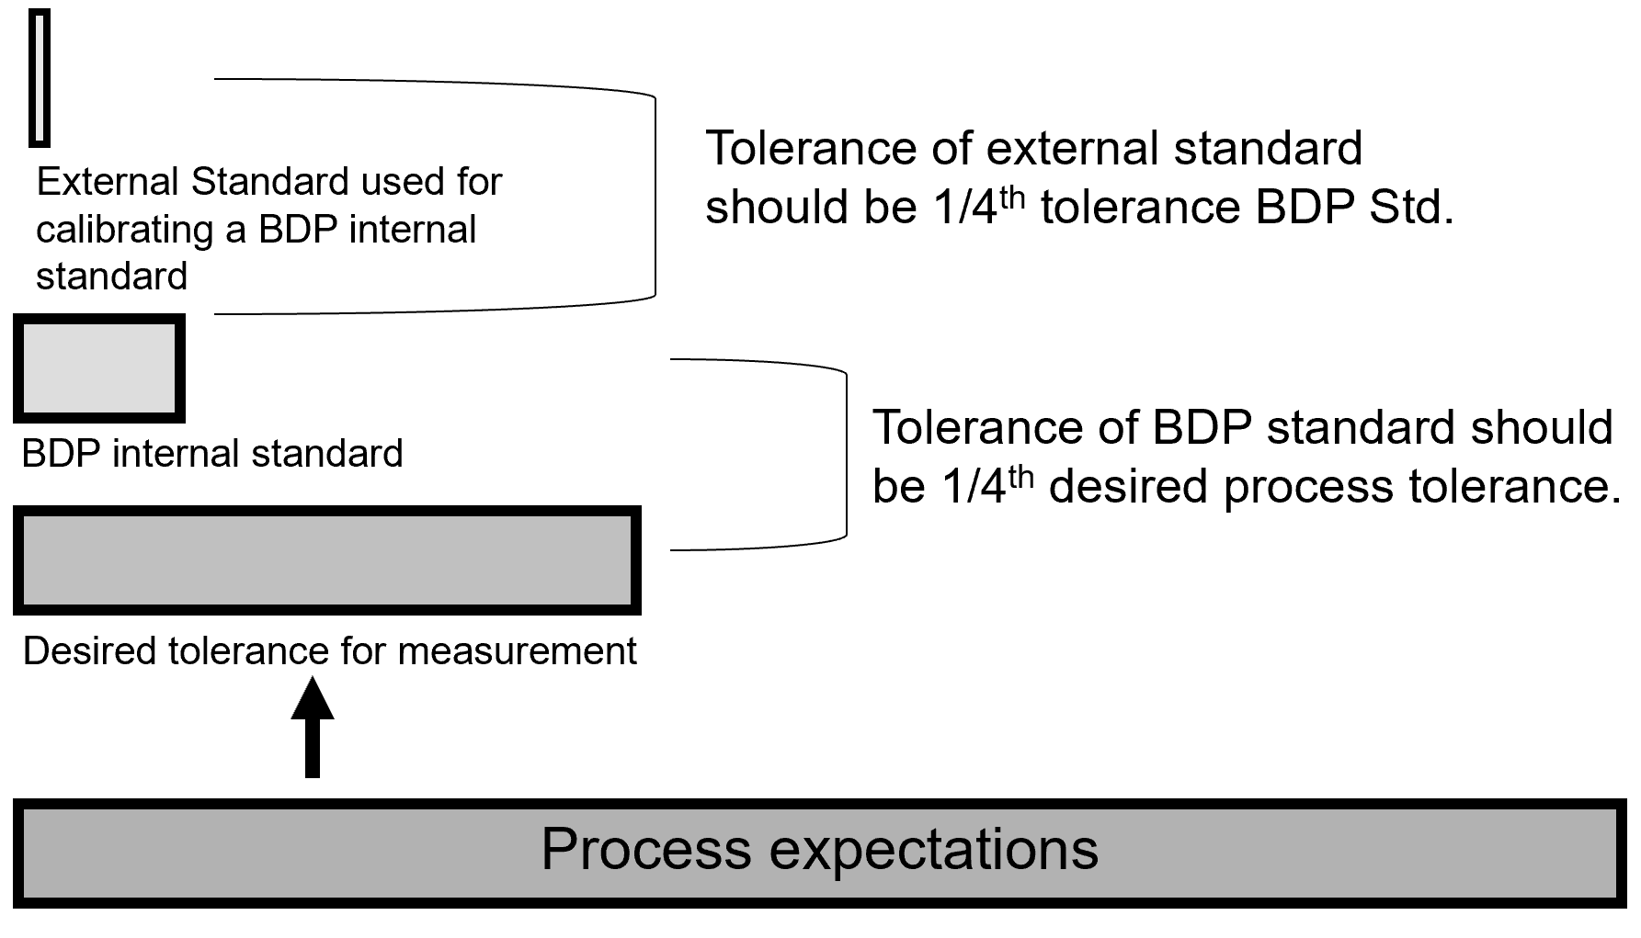
Calibration
Tolerance

Slide 30
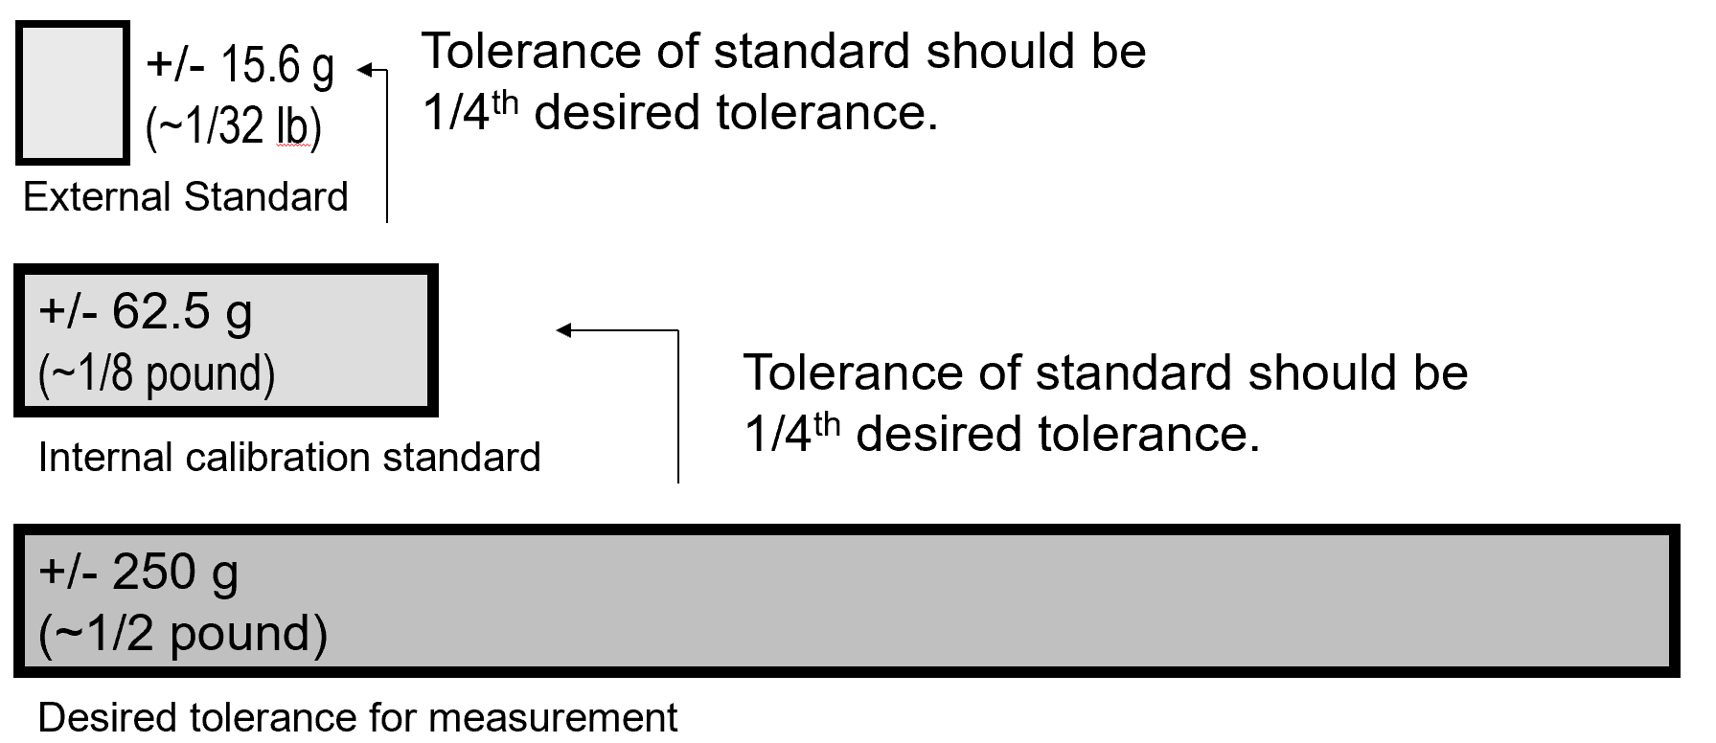
Equipment Selection – Dieting
Understand the requirements of the process to set tolerance.
Your tolerance will set your standard.

Slide 31
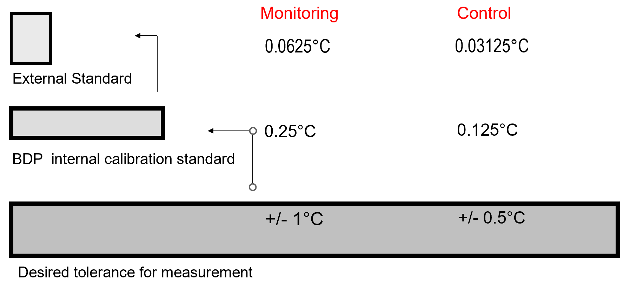
Cold Storage Establishing Tolerance
In this process, cold storage monitoring, we’d be interested in monitoring a range between 2 – 8° C and with a tolerance of +/- 1°C.
Note, not all tolerances need to be equal as noted between what is used to control the temperature of the unit and what is used to monitor the temperature.

Slide 32
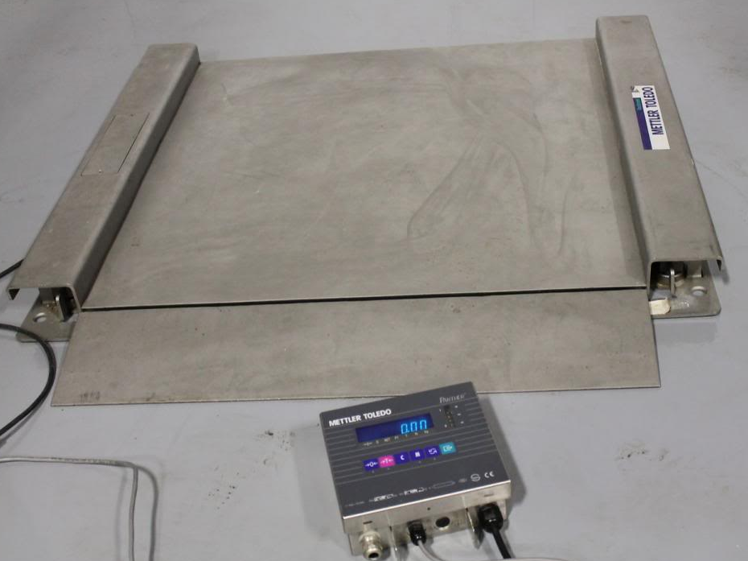
Calibration
Budget – Price vs Cost
Price
Calibration can appear costly
Standards
Down time
Vendor or Contractor costs
Example
The price to have an external contractor calibrate a balance annually is approximately
$75 dollars.
Cost
The “cost” of using a non-calibrated piece of equipment to manufacture drug products is likely to be even higher

Slide 33
Calibration
Performed according to written procedures at an established frequency
Performed by properly trained people
Any instruments used for calibration must themselves be calibrated
Documentation detailing your procedures and the results of your calibration efforts must be maintained. These records will help you prove to FDA that you have selected equipment that is “suitable” .
Know what to do for failures
Out of Tolerance (OOT)
Establish “safety” margins whenever possible

Slide 34
Warning Letter: West Chester, PA
WARNING LETTER
Failure to ensure that all inspection,
measuring, and test equipment is
suitable for its intended purposes
and is capable of producing valid results
in that thermometers used to monitor
temperature in incubators and
refrigeration units are only
calibrated upon receipt.
Biopool International, Inc.
West Chester, PA
34

Slide 35
Types of Calibration
Equipment may be tested to confirm different levels of calibration depending on the intended use of the instrument. This is important because it indicates what range of use is “safe”. If you are using measuring equipment OUTSIDE the range it was calibrated, then you are using equipment that is not designed for your use and this is a GMP violation.
Various calibration stickers that you see will indicate what range of calibration has been demonstrated.
“CALIBRATED” designation confirms the reliability and accuracy over the manufacturer’s stated range.
“LIMITED RANGE” designation confirms the reliability and accuracy in a range more limited than (but still within) the manufacturer’s stated range. For example, the BDP monitors room temperature. The temperature monitors that are used are capable of monitoring temperature in a range of – 196C to +495C. We don’t need our temperature monitoring range to be that wide, so we calibrate these temperature monitors to a range of 0 – 50C. This is a limited calibration.
“MODIFIED TOLERANCE” designation confirms the reliability and accuracy within a range OUTSIDE the manufacturer’s claim. For example, incubators are purchased with a manufacturer’ specified tolerance of +/- ½ °C. But when these incubators are used to grow cells, they don’t need to have such a tight tolerance. For cells a tolerance of +/- 1°C is acceptable. Therefore, incubators are often calibrated to a tolerance of +/- 1°C. Incubators that are older and no longer can maintain their original manufacturer’s tolerance and still be used appropriately with a modified tolerance.

Slide 36
Types of Calibration (Continued)
“SINGLE POINT CALIBRATION” designation confirms the reliability and accuracy at one specific point. For example, -80°C freezers are often calibrated only at –80°C. These freezers are full of product (at –80°C) and to move the product presents the potential for the product to be adversely affected by the transition from one freezer to another, and creates a safety issue for the personnel that would need to perform this product transfer. In this case, these freezers are calibrated only at –80°C, a single point calibration. It is important to note that single point calibration is the least optimal calibration for equipment. Our SOPs state that single point calibration is to be used only to protect the product or personnel.
“VERIFIED” When a non-calibratable signal is tested for its on/off characteristics.
Be careful that the equipment you are using has the calibration that is appropriate for the measurement that you need.

Slide 37
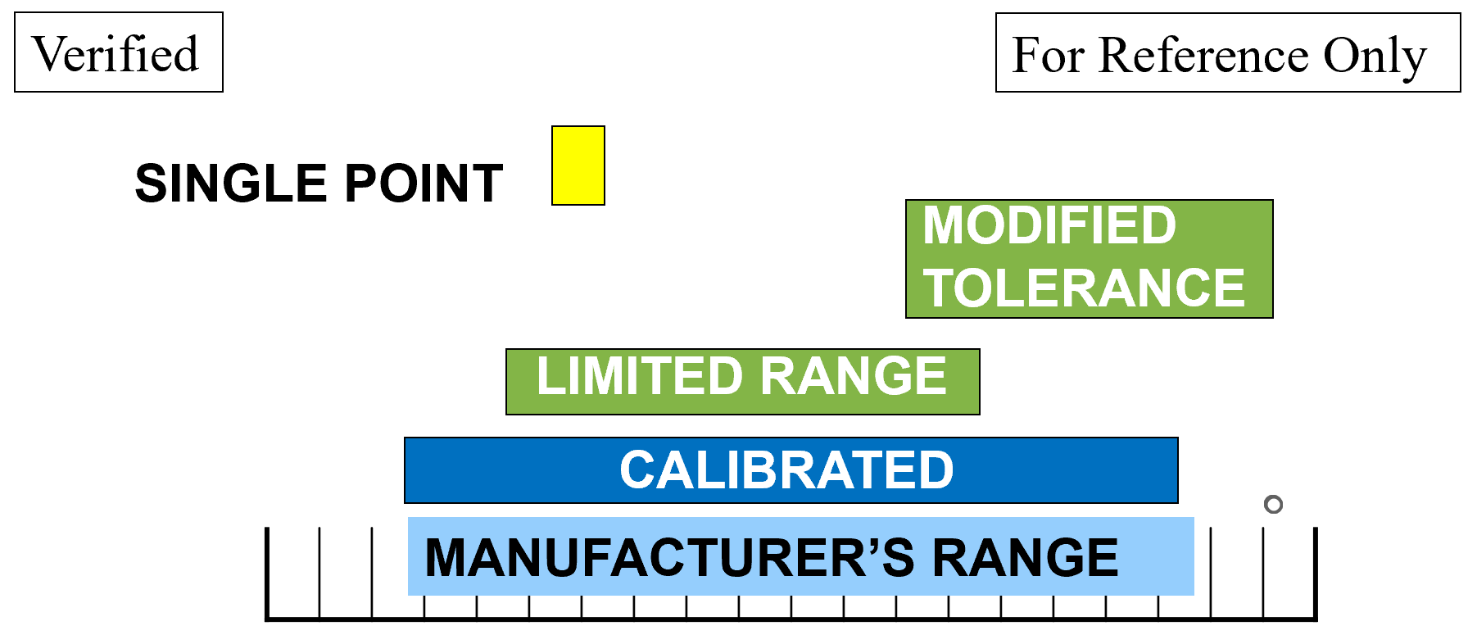
Identifying Calibration
How do I know if an instrument is calibrated, and which method was used?
..Check the calibration sticker

Slide 38
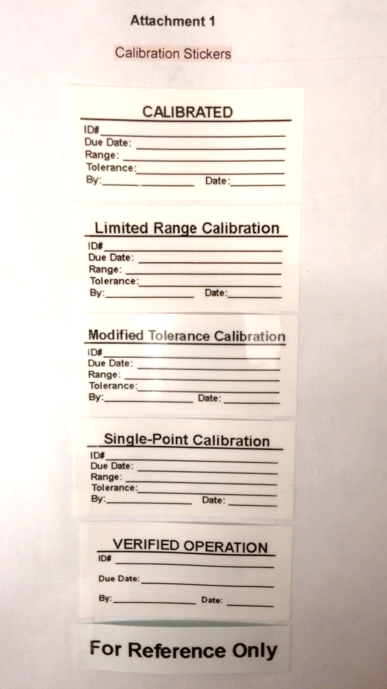
Calibration Labels
Understand what these various equipment labels are telling you.
External Vendor Cal Label
FME Cal Labels
External Vendor PM Label
External Vendor Cal Label

Slide 39
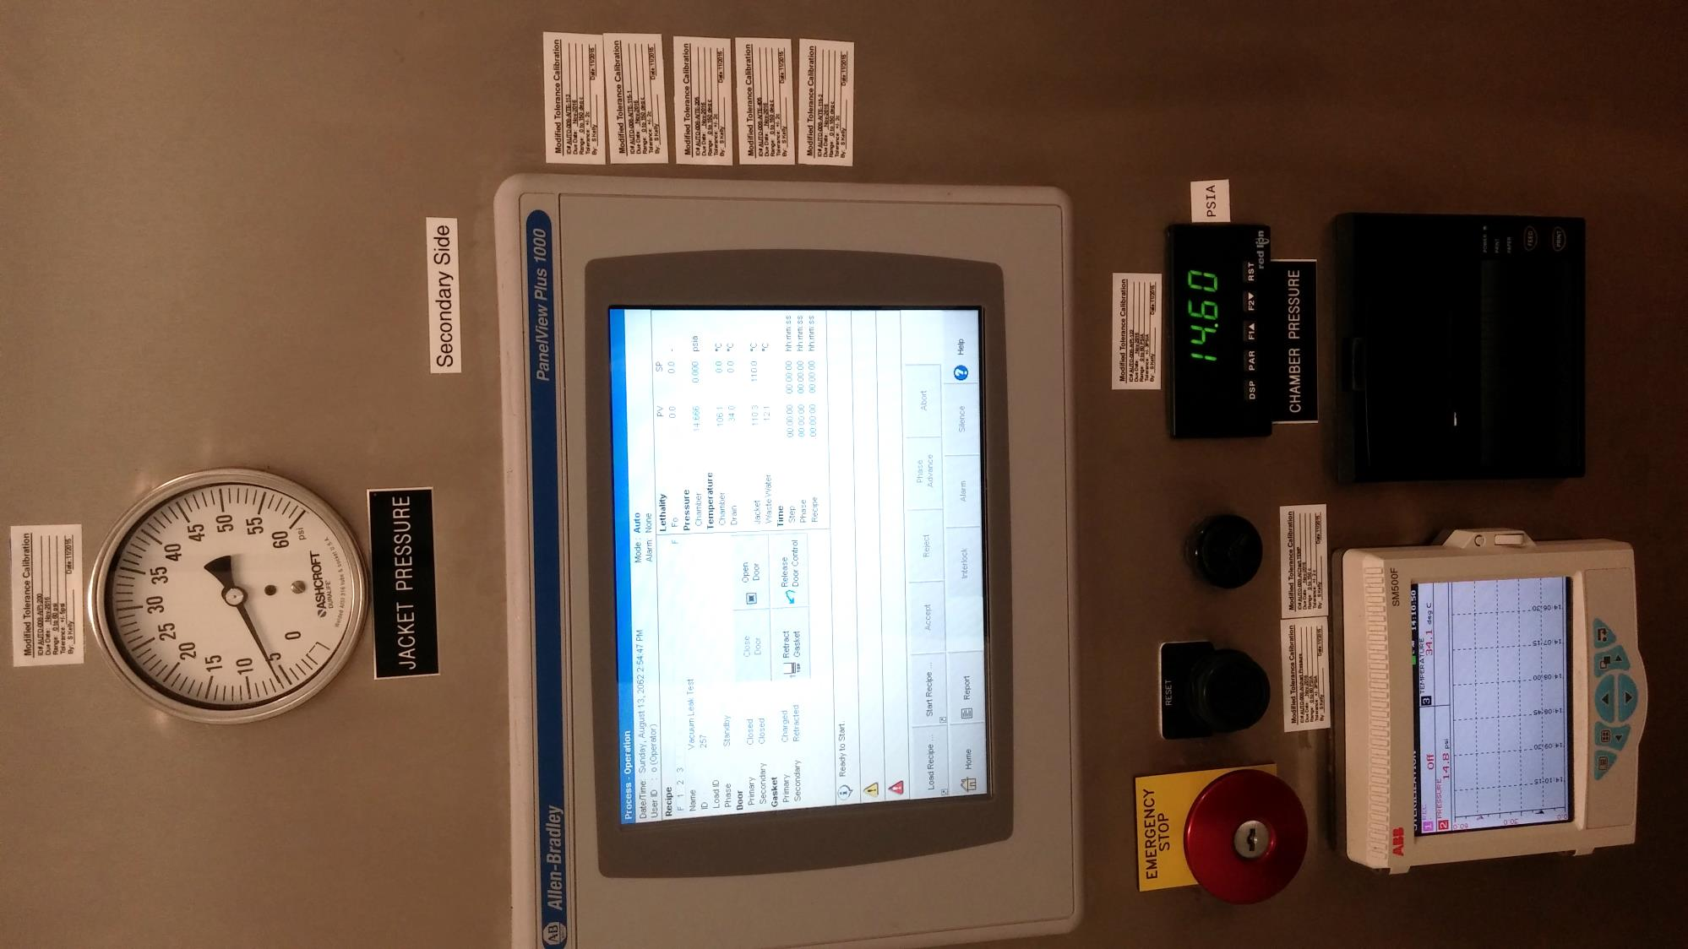
Calibration Labels (continued)
This autoclave has 9 visible calibration stickers.
The old label is removed before the new one is put on.
This equipment has multiple measuring devices, and each is calibrated
Stickers are affixed to or near each individual device.
Calibration expiration is triggered by earliest due date

Slide 40
Calibration Suitability
Does CALIBRATED = APPROPRIATE ???
Is the Range appropriate?
pH Meter
Calibration/Standardization Range: 1 – 5 pH standards
Expected result of Solution “X”: 4 – 10 pH units
Are all calibrated units suitable? Be careful. Not all equipment that is calibrated is suitable for every application. A piece of equipment that needs to measure in a range of 4-10 units but is only calibrated from 1 – 5 units isn’t suitable for that intended use even though it carries a calibration sticker. Therefore, for this application, the pH meter is not GMP.
In this case, a pH value of “6” is not known to be reliable. We have no information that tells us that this instrument can detect that quantity accurately and reliably because the calibration range is only from 1 – 5 units.

Slide 41
Calibration Tolerance
CALIBRATED = APPROPRIATE ?
(Tolerance)
Weight requirement: ± 0.1 gram
Balance Tolerance: ± 0.2 gram
If we need to measure a weight to within ± 0.1 gram, can we use a balance with a tolerance of ± 0.2 gram?
Be careful. No measuring equipment measures perfectly. There is always some degree of
inaccuracy in the measurement, and you need to determine if the degree of inaccuracy is acceptable for your processes.
If you are on a weight loss diet and expect to lose 2 – 3 pounds per week. You can’t use a scale that measures ± 2 pounds. If you do, you’ll never know whether the 2 pounds the scale says you lost last week was due to your discipline in your diet or the variability of the scale.

Slide 42
Calibration Signage
WHAT IF THERE IS NO CALIBRATION STICKER OR THE CALIBRATION IS EXPIRED???
Equipment can’t be used for GMP work until resolved.
There is no assurance that the measuring equipment will measure with the needed accuracy and reliability.
Who should be contacted? Your manager and QA
Affix “ Out of Service” signage.
Notes:
(read from slide)

Slide 43
Calibration – Out of Tolerance
WHAT HAPPENS IF CALIBRATION FAILS? Out of Tolerance (OOT)
Equipment can’t be used for GMP work.
There is no assurance that the measuring equipment has been measuring with the needed accuracy and reliability.
“Out of Service” signage is required.
An investigation is required to assess possible product impact (starting from date of last successful calibration).
Notes:
(read from slide)

Slide 44
Calibration Out of Tolerance Examples
Look at this recent example of a calibration issue. Because of the calibration tolerance required for the standard, it needed to send it out to a commercial calibration service for calibration. You can see from the top page what tolerances are assigned to our BDP standard.
The data from the second page (page 2 of 2) shows the results when the BDP unit was calibrated against another standard (that was at least ¼ the tolerance of the BDP standard). You’ll see that our BDP standard is out of tolerance, reading higher than the actual temperature.

Slide 45
Out of Tolerance
So where do we go from here?
This unit was used to calibrated a large number of other temperature monitoring devices and was last calibrated a year ago.
Without any other information, you have to assume that the standard could have been out of tolerance since its last calibration. So a report needs to be run that traces all the calibrations that were performed and that used this standard in the past year. Once that is obtained, it was determined that this standard was used for temperature measuring devices that just monitoring temperature (with a needed tolerance of +/- 1C) and sometimes it was used for calibrating a temperature measuring device that was CONTROLLING a storage unit’s temperature (with a needed tolerance of 0.5C). Therefore, the amount of out of tolerance of this standard when used for temperature monitoring met the 1:4 ratio (1/4th of 1C = 0.25C).
However, for the temperature controlling devices, the 1:4 ratio wasn’t met (1/4th of 0.25 = the standard for the temperature.
45

Slide 46
Equipment Validation Defined
VALIDATION – proving the equipment does what you need it to do (Validation is required for sterilizing and other critical equipment).
Design Qualification (DQ) – Defines the functional and operational specifications of the equipment.
Installation Qualification (IQ) – Did we get what we ordered? Is it installed properly?
Operational Qualification (OQ) – Does it operate the way it was claimed to run?
Performance Qualification (PQ) – Does it run the way it needs to for our process? Is its performance repeatable? May require multiple runs.
Process Validation (PV) – Does it, when used in the manufacturing process, repeatedly produce product that meets its specifications.

Slide 47
Equipment Validation
We’ve already discussed that equipment that performs a process is VALIDATED to prove that it is capable of performing the way we need it to perform. The process of validating a piece of equipment is divided into parts to answer specific questions about the suitability of the equipment.
The Installation Qualification answers the questions “Did we get what we ordered” and “Is it installed properly?”
The Operational Qualification answers the question “Does it run the way it was claimed to run?”
The Performance Qualification answers the question “Does it run the way it needs to for our process?” And “Is it repeatable?”
Obviously, the tests that you would do to investigate these questions fully will depend on the type of equipment that you are trying to validate. And since some equipment is very complex, the validation effort will also be complex.
47

Slide 48
Temperature Mapping
Since product will be stored throughout the unit, we need to prove that the temperature throughout the unit is within range. Just watching the probes at the top of the unit (or wherever they are located) doesn’t tell us that. So, a “temperature mapping” is performed and the unit with monitored with temperature monitoring devices (that must be calibrated) and run the unit for a while to show what happens inside the unit. When it is shown that all locations within the unit maintain an appropriate temperature range, the unit passes its mapping.
Sometimes we identify an area that is out of range. For example, a location right at a cold air stream that runs when the unit is trying to cool itself. It’s possible that this area might be prohibit from use for storing of items and this area would be identified with placards.
48

Slide 49
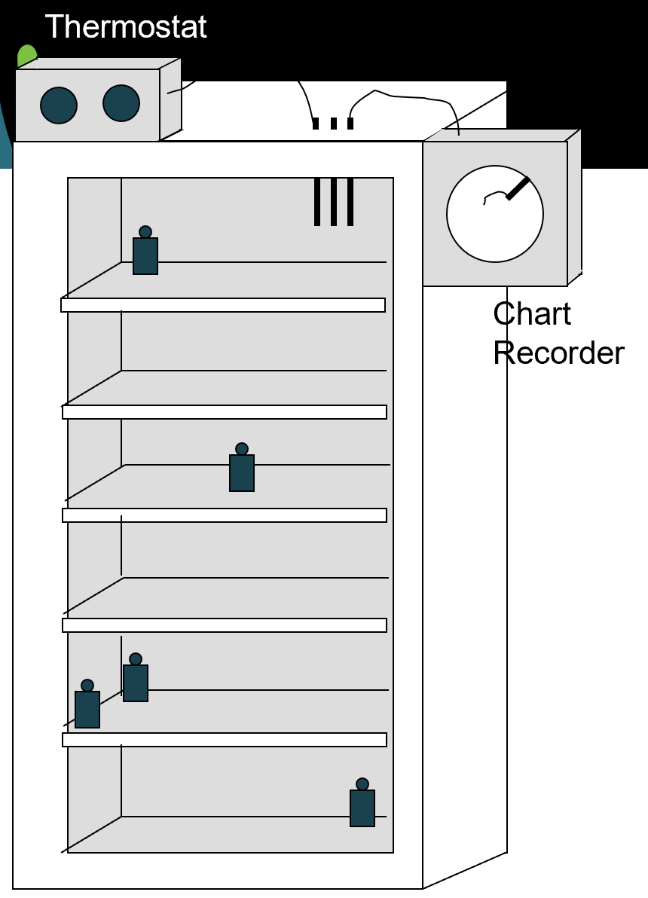
Examples of Temperature Mapping
To building alarm system
Since product will be stored throughout the unit, we need to prove that the temperature throughout the unit is within range.

Slide 50
Duration of Study
Duration of monitoring studies is important in creating a meaningful set of data. The total duration of the study must capture enough of the system’s operation to justify consistent and repeatable operation. The study must also attempt to capture events that could be considered “worst-case”. A study of a small room or environmental chamber may justify that 24 hours is sufficient amount of time to capture day and night operation of the buildings HVAC system. Time duration of 24 hours is also sufficient to capture the numerous temperature cycles of the refrigerator.
A large room or warehouse, however, is impacted by the outside weather conditions. A warehouse study should be conducted for several weeks or months during the summer and winter. This is the only method to ensure that the HVAC systems are capable of maintaining the required temperature specs during both hot and cold months.
50

Slide 51
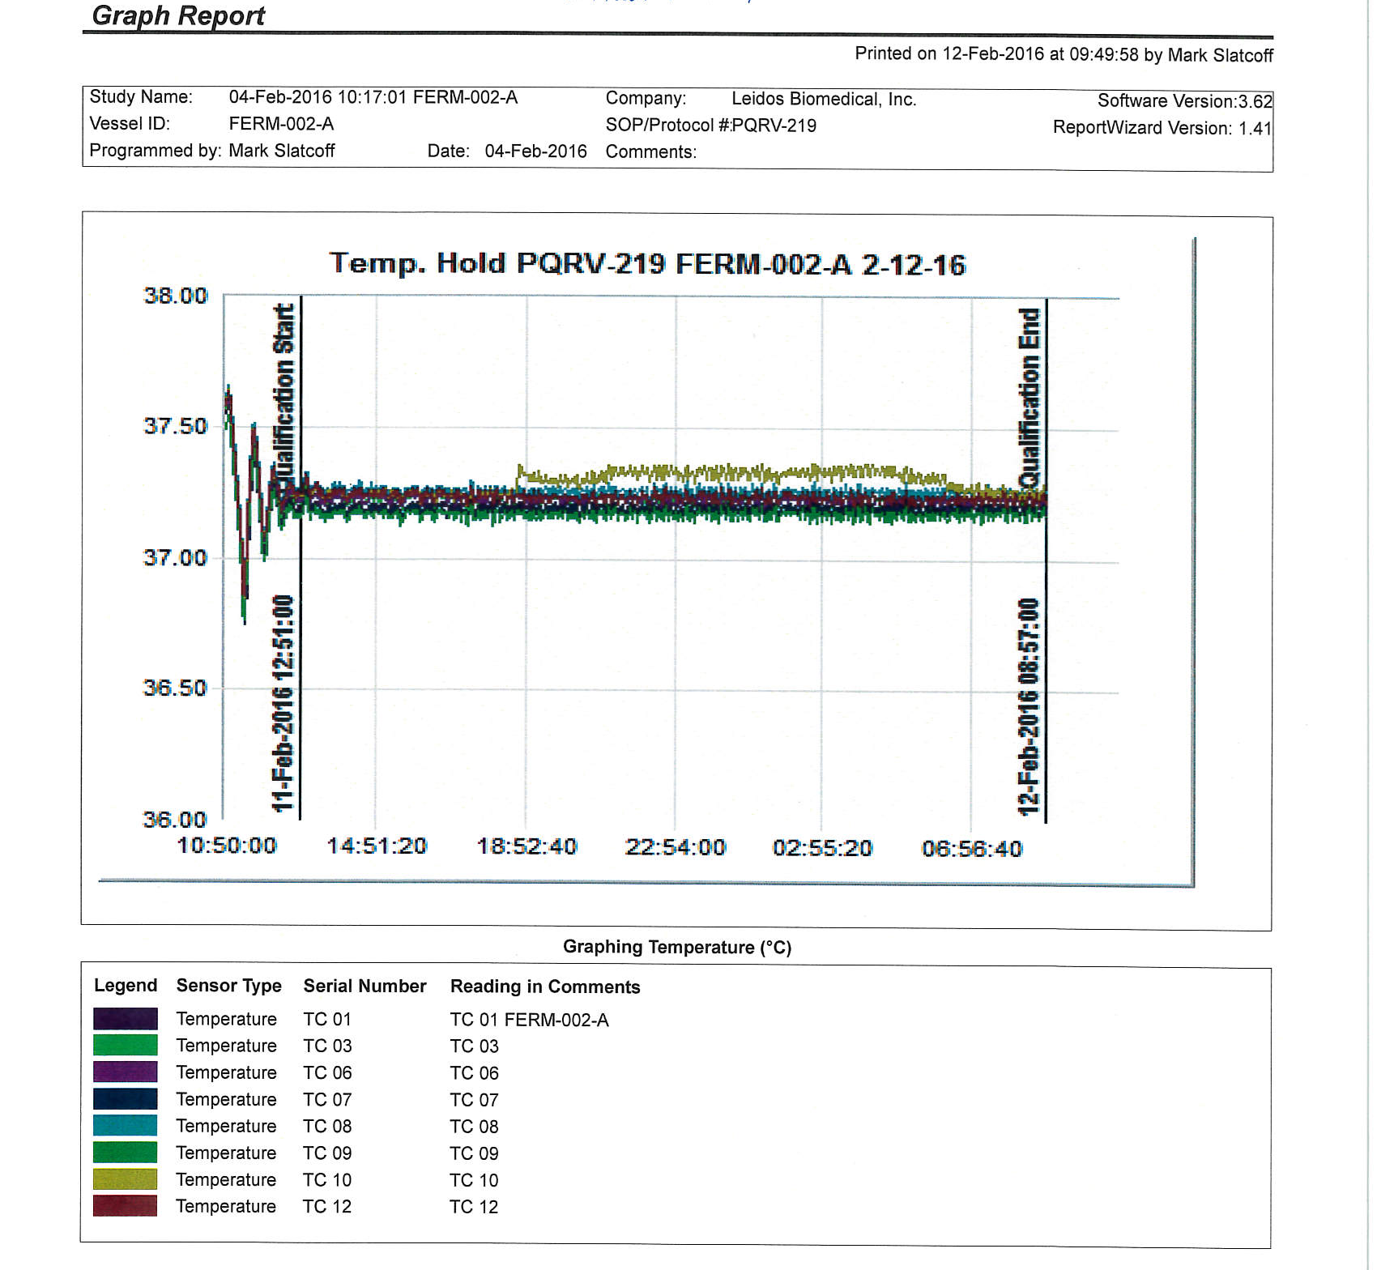
Duration of Study (Continued)
Acceptance criteria
Distribution and number of probes
Include “worst-case” events & conditions
Open door
Power outage
Seasonal changes

Slide 52
Equipment Cleaning
52

Slide 53
Warning Letter: Lewis Center, OH
WARNING LETTER
Disposable silicone tubing sets are cleaned
with isopropyl alcohol and distilled water
between uses and then reused to fill liquid
oral drug products such as ******.
No studies were conducted to demonstrate
that the silicone does not react with the drug
products when used to dispense
the drugs.
Shamrock Medical Solutions Group
Lewis Center, Ohio

Slide 54
Cleaning & Maintenance
FDA requires that there be controls for the adequate cleaning and maintenance of equipment.
Controls for adequate cleaning and maintenance require that equipment be:
Cleaned and maintained at appropriate intervals to prevent malfunction or contamination
Written procedures for cleaning and maintenance
Documenting work (Equipment cleaning and use logs, Master Equipment Files)
Inspection of equipment for cleanliness before use (verification required)

Slide 55
Subpart D. Equipment Cleaning & Maintenance
The cleaning procedure should be validated for each piece of major equipment. Cleaning validation will prove that the cleaning procedure used adequately removes substances that could be on the equipment (residuals from the previous product, degradants from the previous material, environmental contaminants, etc.), and that the cleaning agent is removed or reduced to acceptable levels. Such validation should include the breakdown procedure and method of cleaning to be utilized.
FDA inspectional observations often have criticized firms for not having established specifications for cleaning. Residue levels of the cleaning agent AND the agent being removed, should be based on valid scientific criteria.
Equipment maintenance is also critical to assure that the equipment will continue to operate as expected. A maintenance program for the equipment must be designed, documented and executed. A record of each maintenance activity for the equipment must be maintained in the Equipment cleaning and use logs. Eventually, these logs will be filed in the Master Equipment Files that will fully document the purchase, installation, qualification, and maintenance history of a piece of equipment.
55

Slide 56
Cleaning & Maintenance (Continued)
Goals of Cleaning
Remove product residues
Minimize bioburden
Prevent cross-contamination of products (from one batch to another or one product to another)
To remove cleaning agents
Inadequate cleaning can lead to microbial growth in equipment which can affect the final product. Even if the final product is sterilized to kill any viable organisms, the toxins or byproducts that the organism produced may not be removed in further processing. If you aren’t looking for a toxin in the final product, your testing may not detect the unknown agent.

Slide 57
What Needs To Be Cleaned From Equipment?
Proteins
In-process & final product
Proteins (intra/extra-cellular) of the host organisms (HCP)
Media constituents (i.e., Serum)
Organic Compounds
DNA, RNA
Endotoxins
Carbohydrates
Lipids
Media constituents (sugars, amino acids, vitamins)
Biological Residues
Viruses
Viable and non-viable host organisms
Inorganic Compounds
Buffers used in purification
Salts in media
Cleaning solutions such as detergents, acids, and bases
These are examples of the types of contaminants that might be on equipment used for the manufacture of biologic drugs. Some of these contaminants have their own challenges when you are trying to remove them from surfaces. Knowing what could be on equipment, because you know what the equipment was used for helps, when trying to design a cleaning procedure for the equipment.
Note that most of these materials that may need to be cleaned from equipment contain carbon. There are tests that detect carbon, and so later, when you need to TEST to assure that these materials have been removed, you can look for the presence of carbon.

Slide 58
Warning Letter: Naperville, IL
Warning Letter
Your firm failed to clean, maintain, and as
appropriate for the nature of the drug, sanitize
and/or sterilize equipment and utensils at
appropriate intervals to prevent contamination
that would alter the safety, identity, quality or
purity of the drug product (21CFR 211.67a).
Martin Avenue Pharmacy
Naperville, Illinois

Slide 59
Types of Cleaning
Between batches of the same product
Between different products
Campaign Changeover
The cleaning you would do between batches of the same product may be different than the cleaning you would do between different products. In the first example, the carryover of materials between batches of the same product doesn’t usually introduce anything NEW to the batch. Carryover between batches of DIFFERENT products could potentially contaminate the second batch with something that was never intended to be in the batch.
Often, different cleaning procedures are approved for these different types of cleaning.

Slide 60
FACTORS AFFECTING CLEANING EFFICIENCY
Type of soil
Time since equipment became “dirty”
Temperature
Concentration of the cleaning agent
Type of material being cleaned (stainless steel, plastic, glass, etc.)
Contact time
External energy (agitation, turbulent flow)
All of these factors must be taken into account when designing a cleaning process. It’s possible to design many adequate cleaning processes by varying these factors. But remember, that whatever processes you design and plan to use, you must VALIDATE them – prove that they work. Unless you need a large variety of cleaning procedures, most companies try to design one process to accommodate all of their potential cleaning situations and then validate that process.

Slide 61
Dirty Hold
How long can you let the soil stay on the
Dishes and still get them clean with the standard cycle?
When is the easiest time to clean dishes…when the food is still wet, or later when it has dried?
Do all foods clean away equally?
Cleaning usually gets harder the longer you wait.
Your standard cleaning procedure may not be adequate if you wait too long to clean.
FDA expects you to know how long you can hold a piece of equipment dirty and still be able to adequately clean it.

Slide 62
Methods Of Cleaning
Manual – (least effective)
People do the cleaning. (People are variable).
Process more difficult to validate.
People must be well trained and qualified.
Mechanical Cleaning
Glassware washers using pre-programmed wash/rinse steps.
Process including load patterns must be validated.
Clean-In-Place (CIP)
Equipment stays where it is, the cleaning system is brought to the equipment.
Often utilize spray balls placed within the unit to be cleaned.
Processes can vary for different pieces of equipment or products. Each process must be validated.
If you have a choice, the preferred method of cleaning is “clean in place”. You don’t have to bring materials to be cleaned to the unit, don’t have to package the washed material to keep it clean. Potential contamination during transport is eliminated since nothing is transported.

Slide 63
Cleaning Effective
Validation – proving that your cleaning process CAN work.
How does this compare to Cleaning Verification?
Do I have a test that will detect the contaminant?
Rinse samples
Swab samples
How effective is the test at detecting the contaminant?
Can I show that my cleaning process on a representative surface removes the contaminant?
Can I show that my cleaning process is adequate when I clean up after a real production?
When I put this cleaning process into actual use, what testing should be routine as a check on the cleaning?

Slide 64
Is The Cleaning Effective? (Continued)
GMPs require that you prove that the cleaning process you are using on a piece of equipment WORKS. This is validation. You must generate DATA to PROVE that your cleaning process works.
The first step is to find a test that will detect the contaminant. If you are going to generate data, you need a test that will detect the contaminant. We said earlier that most contaminants are carbon based. Companies often use a test method called TOC (Total Organic Carbon) as the test they use to detect contaminants.
The second step is to determine how effective this test is at detecting the contaminant. What kind of quantitation can you expect.
The third step is to use your designed cleaning process on a representative surface and demonstrate that your cleaning process removes the contaminant. This is often done using “coupons” – square surfaces made out of the same material that your equipment is made from. So if you are validating the cleaning of a fermenter and the fermenter is constructed of stainless steel, the coupon you would use would be stainless steel.
The fourth step is to show that your designed cleaning process actually works for a real production.
The last step is to decide what testing is appropriate when you put this validated cleaning procedure into routine use.
Keep in mind that ALL of these steps require that you have a test method (which includes how you will obtain the sample) that you can trust. To start a cleaning validation – you need to start with a validated test method for detecting the contaminant.
64

Slide 65
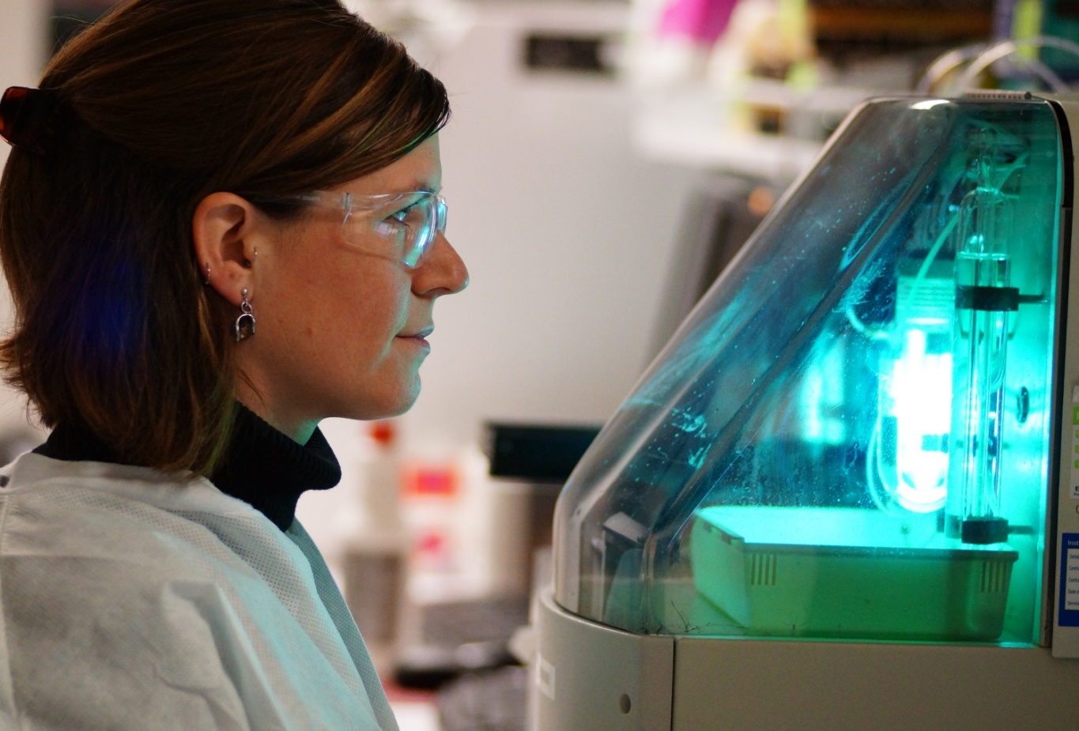
Verification of Cleaning Total Organic Carbon (TOC)
This TOC instrument can measure the total organic carbon content of a sample to 50 ppb. It is used in the analysis of water, environment, raw material, and equipment cleanliness samples.
65

Slide 66
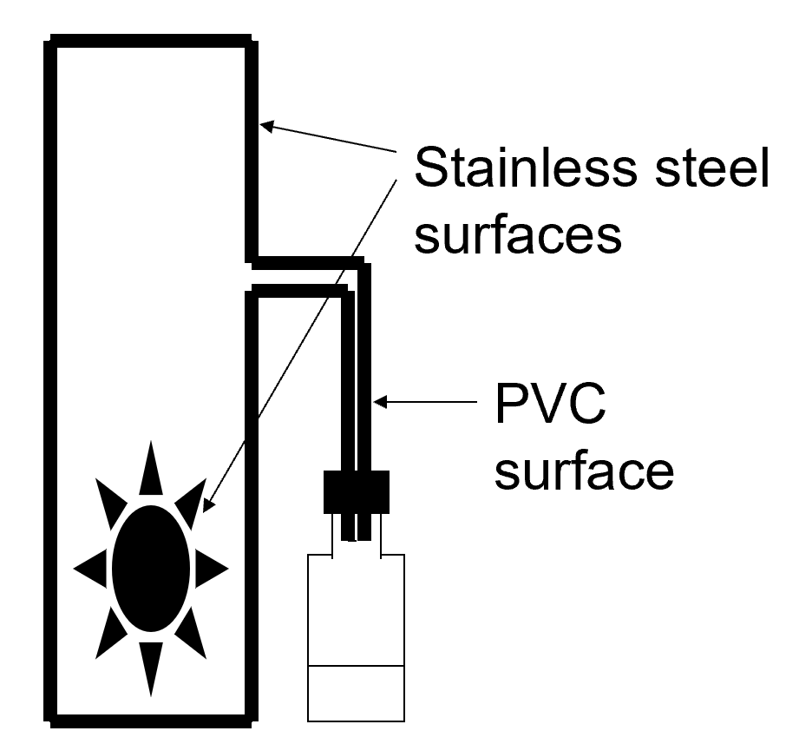
Is The Cleaning Effective?
PRODUCTION OF BATCH “BLUE”
This is a set-up of a production of batch “blue”. Batch “blue” is made in a tank with a mechanical agitator. The material is drawn from the tank by a hose into a storage vial.

Slide 67
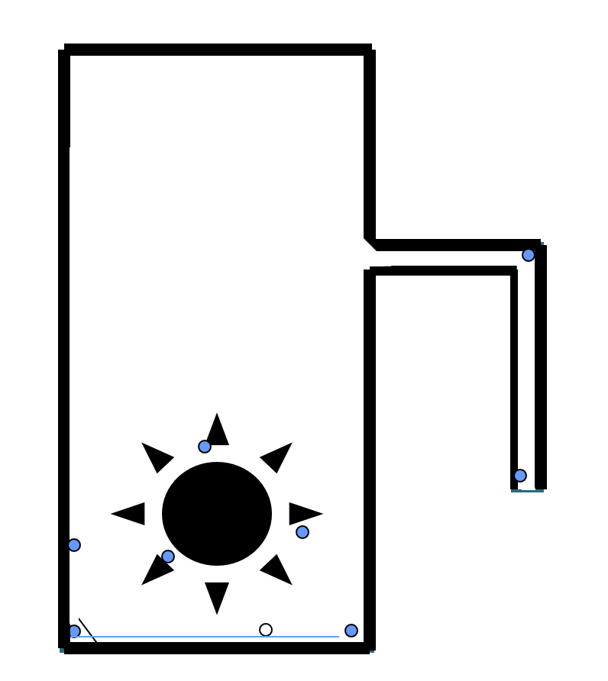
Is The Cleaning Effective? (Continued)
COMPLETION OF BATCH “BLUE”
After the production of batch blue, residual product remains. It’s coating the walls of the tank, it’s on the agitator, it’s in the tubing.

Slide 68
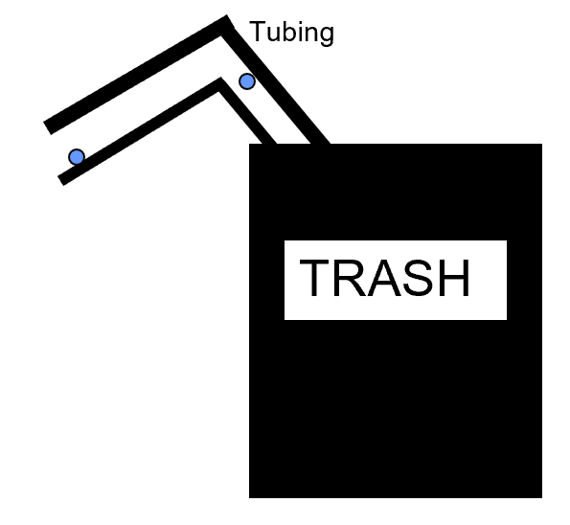
RESIDUAL “BLUE” AFTER CLEANING
This is what remains after cleaning of the tank. No cleaning process is guaranteed to remove 100% of a soilant. You can see that there IS some residual batch “blue” that remains.
What about the tubing? - It was thrown out. This company selects equipment that can use disposable parts so the parts can be exchanged between runs. – then you don’t have to do cleaning validation to prove that you have a cleaning process that can remove contaminants from these parts.

Slide 69
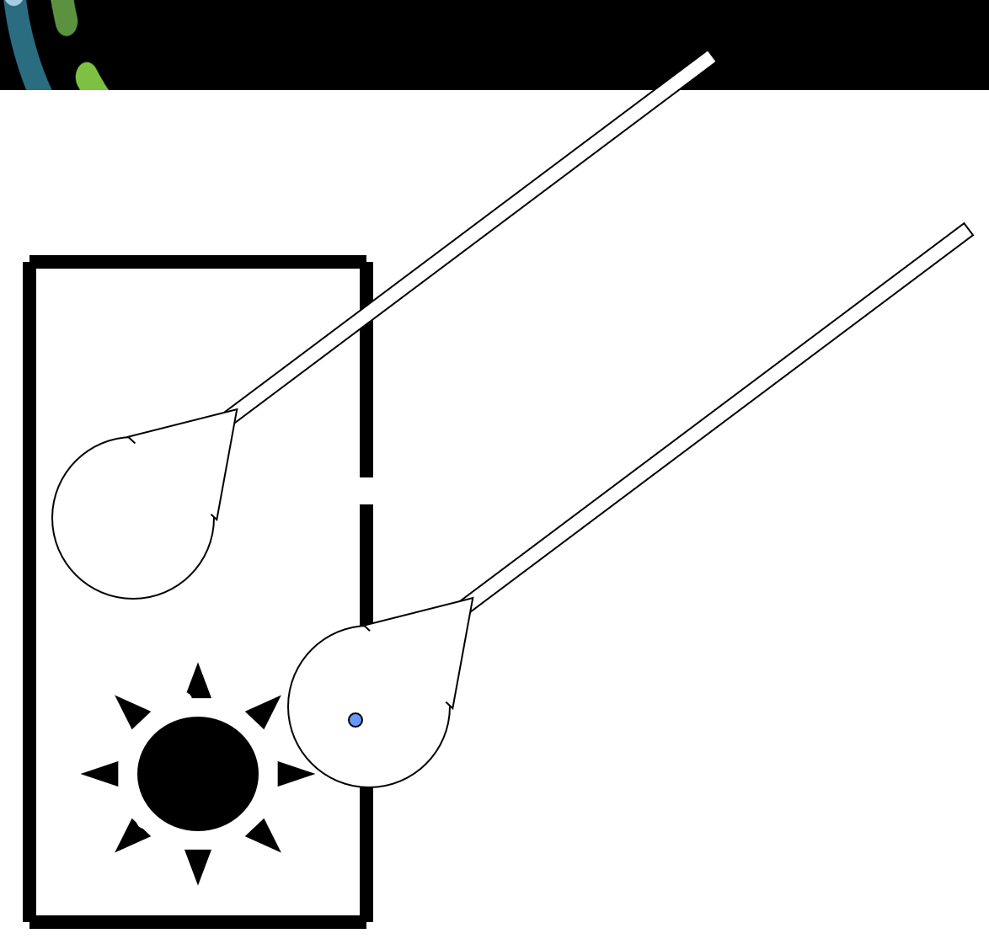
Swabbing
RESIDUAL “BLUE” AFTER CLEANING
Swabbing after a piece of equipment is cleaned. What is detected?

Slide 70
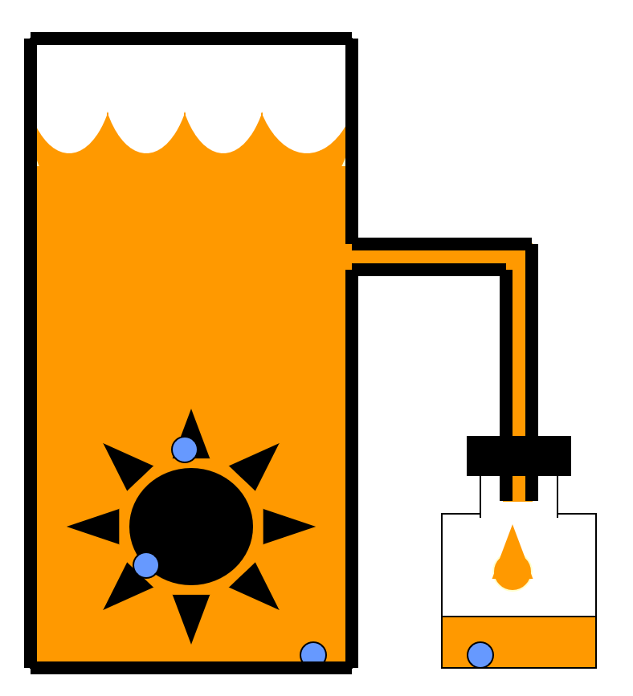
PRODUCTION OF BATCH “ORANGE”
Carryover of batch “blue” into batch “orange”.
Is this, OK?

Slide 71
HOW CLEAN IS CLEAN ENOUGH?
It depends . . .
What amount of left-over contamination will cause a SISQP problem in the next batch produced? (size of the next batch and the maximum dose for a patient of the next batch are important considerations)
Can this amount of contamination be measured?
Is the cleaning process capable of removing contamination to this level?
Is any residue visible in the tank?

Slide 72
HOW CLEAN IS CLEAN ENOUGH? (Continued)
If you are making product “orange” in the same equipment that product “blue” was made in, you have to expect some amount of carryover. How clean is clean?
Like a lot of things in GMP, questions aren’t easily answered.
These are some considerations for answering this question:
Most products are visible at levels of 25ug/in2.
(GL Fourman and MV Mullen, Pharm Tech. April 1993, pp 54-60)
Once a cleaning procedure is validated, it must be strictly adhered to for every cleaning. If a 1:100 dilution of cleaning agent is specified in the approved, validated cleaning procedure, you must measure a 1:100 dilution. You can’t “eyeball” the dilution and expect to be compliant with your validated procedure.
72

Slide 73
Cleaning Validation Warning
WARNING LETTER
Cleaning validation of tanks _____,
______, and _______ was not
successful.
Cangene Corp.
Winnipeg Canada
Here’s a Warning Letter earned by a company for having no cleaning validation data to prove that they can adequately clean tanks.

Slide 74
Cleaning Validation (Continued)
WARNING LETTER
There was no test performed for
residual Product A after cleaning tank #4
prior to manufacture of Product B Lot XYZ.
Cangene Corp.
Winnipeg Canada
Here’s a Warning Letter earned by a company for having not cleaning validation data to prove that they can adequately clean tanks.

Slide 75
Written Procedures
The GMPs state specific requirements about what must be included in written procedures for cleaning and maintenance. Written procedures are required to address -
Responsibility for maintenance, cleaning and sanitizing
Schedules for maintenance, cleaning and sanitizing
Description of methods, equipment, materials, methods of disassembly and reassembly
How to remove the previous batch identification
How to protect clean equipment before use
How to inspect clean equipment before use
Requires a “checker.”
Be careful that you are using the correct dilutions of cleaning agents for cleaning. Cleaning validation would have been conducted using accurately measured formulations of cleaning solutions. In routine cleaning, you must accurately reproduce the cleaning solutions that were validated. Proper measuring is required.

Slide 76
The Purpose of Maintenance
Not just to FIX problems
Must PREVENT problems
Must maintain the validated state
Most equipment is affected by use. It needs to be lubricated, hoses or other parts replaced, maybe parts re-aligned. You can’t wait to detect a problem with equipment and then fix it. What would that mean for the drug product you just produced and NOW you find out that the equipment wasn’t working properly? You’ve just made drug product with equipment that wasn’t “suitable” – your product could be considered adulterated.
You need to anticipate problems so that a drug product is always produced with equipment in working order. Equipment needs to be on a preventive maintenance program that is appropriate for the piece of equipment. Expect questions about a piece of equipment’s preventive maintenance program and be prepared to present documentation that you keep up with the prescribed maintenance.
Equipment that is suitable for use will not only be calibrated or validated, but clean and maintained.

Slide 77
Address Issues When Discovered
Don’t ignore problems, address them at the time they are discovered
WARNING LETTER
During the inspection, our investigators
observed leakage in the RO water system.
Your Director of Operations told our investigators
that your RO system had been leaking
for more than six months. No action was
taken to repair the leaks during that interval.
Chemolee Lab Corporation
Irving, Texas

Slide 78
483 Citation
(After the Production Manager consulted the batch record to relay to the inspector that the temperature of the batch was “right on target”). “I asked the Production Manager to examine the thermometer (which extends into the reaction mass).
It was determined that not only could it not be read, but the thermometer bulb was also broken, and the fluid had emptied.
It could not be determined when the thermometer had broken nor where the contents of the thermometer had gone.”
____________________________________________________________________________________

Slide 79
Equipment Cleaning and Use Logs
Maintaining equipment Cleaning and Use Logs for major equipment is required by GMPs. These logs capture information on:
Equipment logs are required to maintain info on:
Date, time, product and lot #,of each batch processed
Dates of cleaning and signature / initials of person performing or verifying cleaning or maintenance
Lot entries must document that cleaning procedures were followed. The cleaning agent used, its dilution, etc must be recorded.

Slide 80
Equipment Logs A Quality Issue – A Communication Issue
YOU need to know:
That equipment is working and is suitable for use
When equipment is NOT working or is not suitable for use
If maintenance, calibration, and cleaning is up-to-date
If equipment has changed
This information needs to be organized and easily accessible to everyone who uses the equipment.
This communication occurs through the equipment logbook. This is one place where appropriate information about a piece of equipment is located to help YOU, the technician build quality into your work.

Slide 81
Equipment Logs A Regulatory Issue
The GMPs are just reinforcing and requiring an activity that makes quality sense.
There … are reliefs from logbooks when equipment is dedicated to manufacture of one product.
GMPs , Subpart J (Records and Reports)
Equipment Cleaning and Use Log
“A written record of major equipment cleaning, maintenance …, and use shall be included in individual equipment logs that show the date, time, product, and lot number of each batch processed. …
The persons performing and double-checking the cleaning and maintenance shall date and sign or initial the log indicating that the work was performed. Entries in the log shall be in chronological order.” 21 CFR 211.182

Slide 82
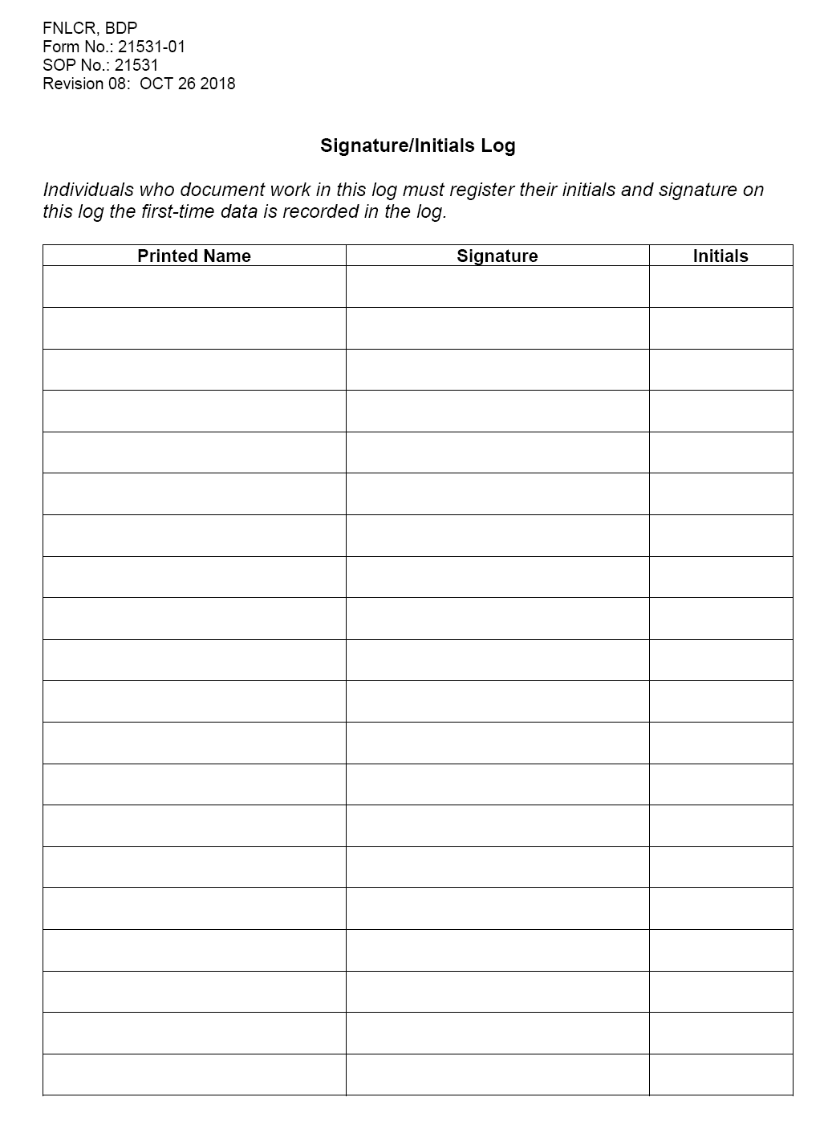
SOP 21531 Equipment Logs How they are configured
Need a signature log (page 1)
Rest of contents are customized to suit user needs.
Consider document folders to store printouts, charts, etc.
Consider customized pages or using forms from SOPs.

Slide 83
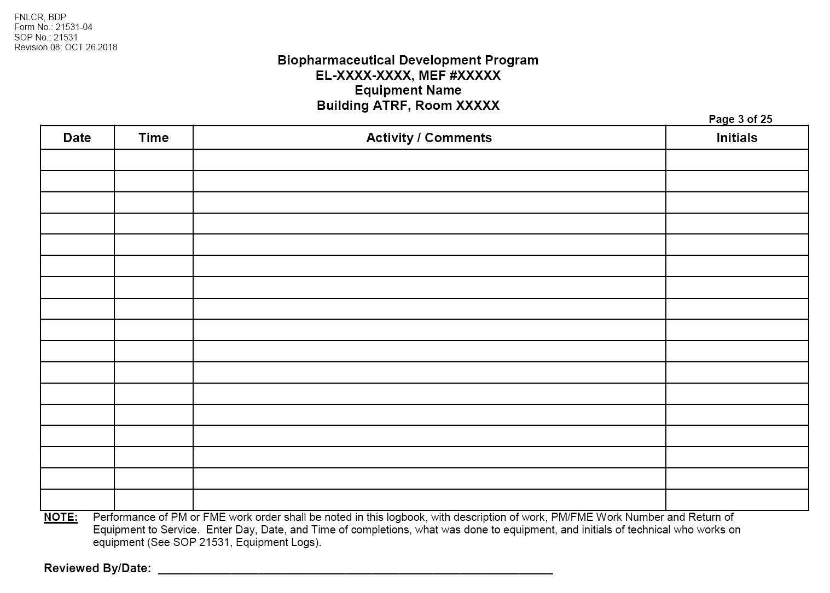
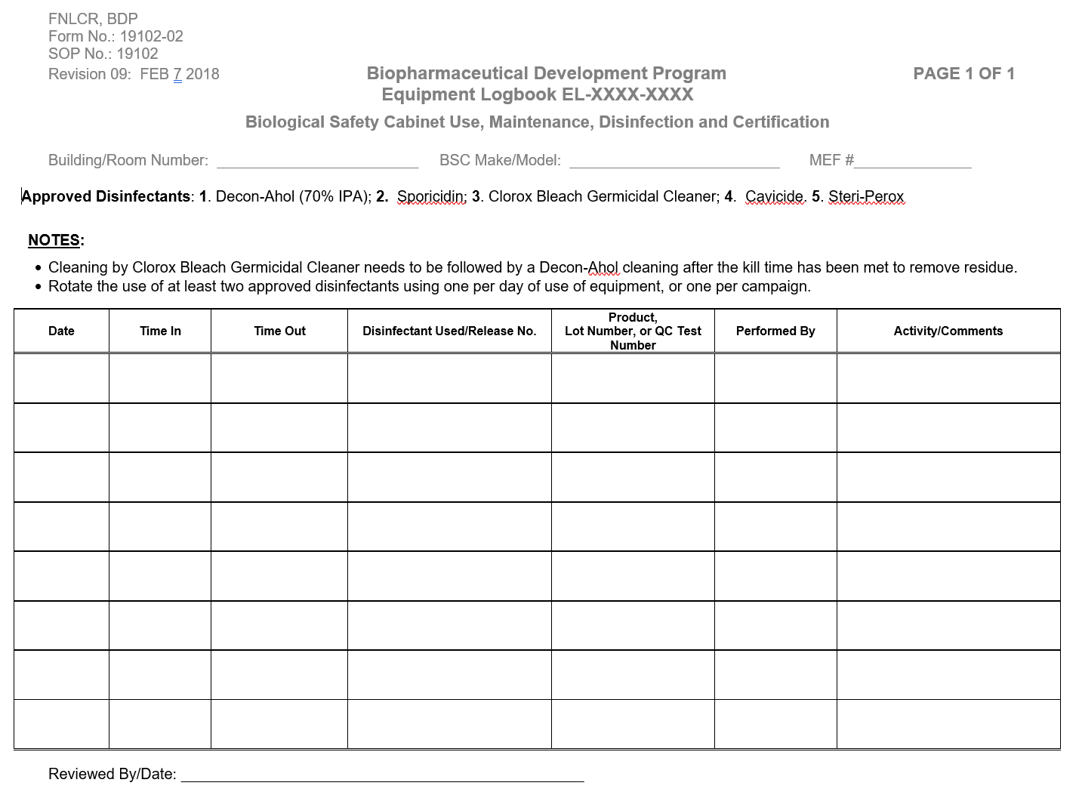
Equipment Logs Example Data Capture Pages
83

Slide 84
SOP 21531 Equipment Logs How to make entries
Use military time, no colon (1310)
Must make a notation every time the equipment is “accessed” in a manner that its future use might be affected. (remember routine set-up / changeover)
Each notation must provide:
Date
Time
Event description
Initials of person making entry

Slide 85
SOP 21531 Equipment Logs How to make entries (Continued)
Include entries for maintenance activities.
Non routine, need a lot of information
Routine, less information
Include entries if software is reloaded and include description of the software control # and edition date.
Work performed by FME needs to be captured with a short description of work, PM / FME work number and returning of equipment to service. If no PM / FME work number, need more description of the event.

Slide 86
SOP 21531 Equipment Logs Logging Considerations
QUESTION: We use this equipment only about every 6 months. If you look at a log page, it suggests that we aren’t consistently documenting our use of the equipment, but in reality, we only use the equipment infrequently.
Consider how credible the document appears. It raises the suspicion that you may be neglecting proper documentation for the equipment. Consider logging into the logbook - “no activity during month of April….No activity during month of May”, etc. (individually review actual data entries.

Slide 87
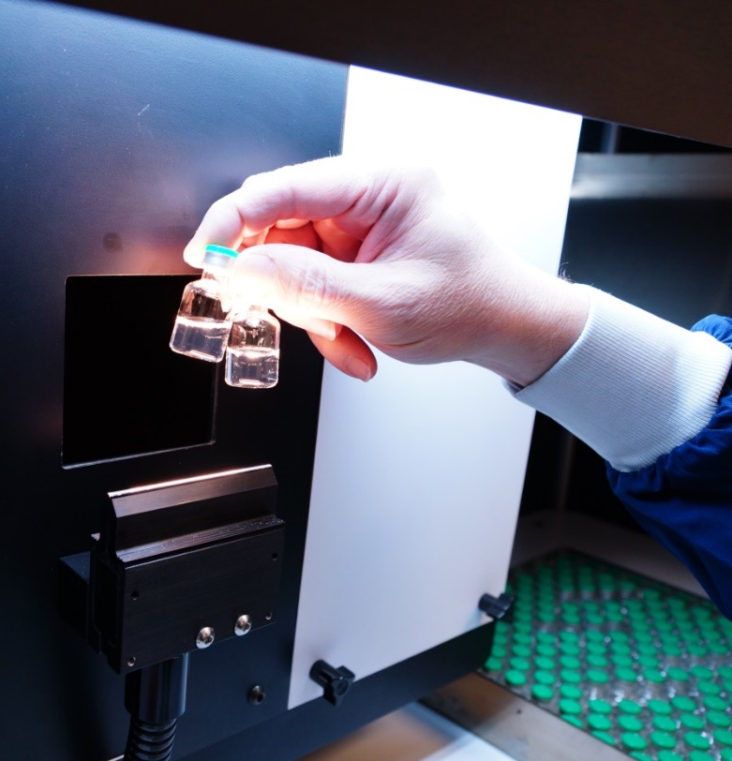
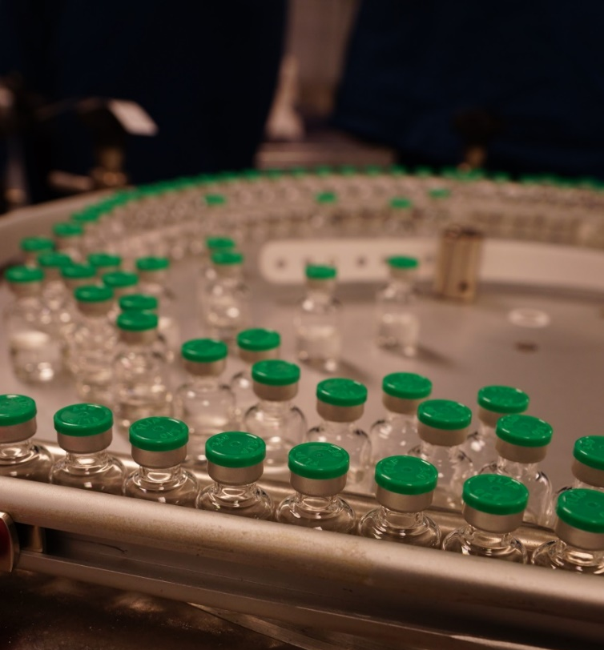
How Are Equipment Logs Useful?
. . . Investigation, trending and troubleshooting

Slide 88
How Are Equipment Logs Useful? (Continued)
A tableted drug product received consumer complaints for metal filings in the tablets. On investigation, this observation was confirmed for this batch and several others. Since this observation was a recent complaint, the Company looked at changes that were implemented to the process recently. Equipment logs were helpful in this effort.
How deep did the recall have to be?
The Equipment Log revealed that the screen that had been replaced was not chipped and the date it was replaced. The screen damage occurred AFTER this maintenance was performed.
They discovered that during routine maintenance the screen on the machine that sieves the powdered drug product before tableting had been replaced. But a bolt was loose! The screen was being abraded causing metal pieces to fall into the tableting blend!
This information was vital to the company. They could now isolate and identify specific lots that could have been affected by this issue and recall them. They knew from the Equipment Use Log that the screen that was replaced was not chipped, so they could determine that the chipping of the screen occurred AFTER this maintenance was performed. Otherwise, they were looking at a potential recall of ALL BATCHES OF THE PRODUCT.

Slide 89
Solve the Real World Challenges
Equipment Logs
When are they needed per SOP 21531?
For certain categories of equipment regardless of CGMP status
Autoclaves
BSCs
Centrifuges
89

Slide 90
Solve the Real World Challenges (continued)
Logbook Entries
Use Operation and Maintenance SOPs to guide entries
Maintenance or repair work by FME should contain WO#
BDP staff may need to make entries for vendor work where vendor does not sign the log
Entries must tell a story

Slide 91
Automatic Equipment
The GMPs state special controls are required for automatic equipment. These controls require that automatic and electronic equipment be:
Special requirements for automatic, mechanical, and electronic equipment
Routinely calibrated, inspected and checked according to written procedures
Maintain written records for manufacturing, testing, warehousing, shipping, and support equipment
For computer systems:
Changes can only be made by authorized personnel
Input and output must be checked for accuracy
Back-up files must be maintained
Validate - must be 21 CFR Part 11 compliant

Slide 92
Automatic Equipment (Continued)
FDA considers computer output as “records”, and they must be as accurate and credible as written records. With a written record, you would document the result you obtained from a measurement and would show any calculations on a worksheet or in a lab notebook. These calculations would be checked and verified. This assures that the data generated are accurate and credible.
What happens with computer generated or manipulated data? Input goes into this “black box” and an answer comes out. Is it accurate? GMPs require that you prove (validate) that whatever that “black box” is doing to your data is appropriate. The GMPs also require that you control changes to that “black box” so that you know that the data manipulations that were appropriate yesterday are still OK today because you know nothing was changed.
And paper documents are permanent, but if your data is only “in the computer”, and it crashes, what happens to your data?
92

Slide 93
Computer Systems 21 CFR, Part 11 Compliance
Part 11 applies to hardware, software, controls, and attendant documentation (SOPs, data capture forms, etc.)
Systems must be designed to ensure the authenticity, integrity, and confidentiality of electronic records.
Computers must be validated to ensure accuracy, reliability, consistent intended performance, and the ability to discern invalid or altered records.
Data must be securely backed up.
Secure user identification and passwords are required.
Secure, computer generated, time-stamped audit trails are required.
Developers, users, and system personnel must have the education, training, and experience to be able to perform their tasks properly.
Many other requirements
93

Slide 94
Warning Letter: Rockville, MD
WARNING LETTER
Failure to validate computer software for
its intended use according to an
established protocol when computer
software is used as part of the
production or the quality system
in that the _____ computer system is
not validated for the purpose of shipment
of finished goods.
(Calypte Biomedical Corp
(medical device)
Rockville, MD.

Slide 95
Filters
The GMPs describe special controls for filters. The controls for filters require that filters :
Cannot release fibers
If the use of a fiber-releasing filter is necessary, an additional non-fiber-releasing filter shall be subsequently used
The use of asbestos containing filters is prohibited
Sterilizing filters require integrity testing

Slide 96
Keep in mind for Equipment use
This is a piece of equipment you were told to use for a GMP assay. What questions might you have prior to using it?

Slide 97
Considerations using Equipment
Is it suitable for GMP work?
Is the calibration in date?
Is my expected value for the test within the equipment’s calibration range?
Has it been properly maintained?
Where is the logbook?
Are there standards that I need to run to standardize the unit?
Is there an SOP for use and do I have the latest revision?
Do I need an access code or password?
Is my training up to date on this equipment?

Slide 98
Application
The computer system that holds the calibration records for production equipment crashed. All data was lost.
… Is this a GMP violation?
Maybe, equipment breaks, but the GMPs require that data not be lost in the event of equipment failure. Therefore, if data can be retrieved from back-up paper documents, or a back-up disk, there is no violation.
Not having any provisions to recover data is a GMP violation.

Slide 99
Application (Continued)
Chromatography column “A” has been dedicated only to the manufacture of one drug product. As a result, this equipment can’t become contaminated with another product.
… Does this equipment need to be cleaned between batches?
Yes. Obviously, between product cleaning will not be needed because the equipment is being prepared to process the same product, but periodic cleaning IS indicated to prevent build-up and carry-over of contaminants, degradants, or objectionable levels of microorganisms from processing many batches of the same product.

Slide 100
Application and Cleaning
In the cleaning verification of equipment “X”, the method used to detect the expected contaminant can detect a level down to 250 ppm. (It doesn’t detect the contaminant when it is present at less than 250 ppm)
When testing this equipment for the contaminant after cleaning, a value of 0 is obtained.
QUESTION: Does this mean that the equipment is clean?
No, this doesn’t mean that the system is clean. It only means that the concentration of the residual contaminant is less than 250 ppm. If your cleaning validation study indicated that the equipment was clean “enough” when the test value was less than 500 ppm, then the equipment is clean. If it indicated the equipment was clean “enough” if the value was less than 100 ppm, then you don’t know if the equipment is clean or not.

Slide 101
Containers
Chemical “B” is weighed and temporarily stored in a closed container until it is added to the drug product being formulated.
… Is the material that the temporary container is made of important?
Yes, this temporary container is “equipment” and subject to applicable GMP requirements for equipment. While the container is used only temporarily, GMPs require that it be non-reactive (enough), so it does not adversely affect the quality of the drug product. Therefore, the construction of the container is important.

Slide 102
Re-cleaning
After a production run, Equipment “A” was properly cleaned, sanitized and protected from subsequent contamination. Equipment A will not be used again for 6 months.
… When it is used again in 6 months, does it
need to be re-cleaned and re-sanitized?
Maybe not, the interval that protected equipment can sit after cleaning and sanitization must be established with data from validation studies. Six months may be OK, or it may not. Internal specifications for time limits after cleaning should be established from validation data and should clearly answer this question.
Also keep in mind that FDA sees a lot of firms. They will be aware of the typical “holding intervals” allowed between cleaning of equipment. If you don’t want a lot of questions, don’t set your “holding interval” different from what is typical in the industry, even if you have the data.

Slide 103
GMP Training Equipment Presentation
Please contact BQA Management if you have any questions.
103

