Slide 1
cGMP Training Data Integrity – Compliance with CGMP
Biopharmaceutical Development Program

Slide 2
Introduction
In recent years, FDA has increasingly observed CGMP violations involving data integrity issues during inspections.
These data integrity issues call into question the quality of the products manufactured and the credibility of the company.
This has led to Warning Letters, import alerts, and consent decrees
FDA expects data to be reliable and accurate since it is relied on to ensure the safety, identity, strength, quality, and purity (SISQP) of drugs to protect the public’s health.

Slide 3
Introduction
The records you generate will be judged for their credibility in the same way that a jury judges the credibility of a witness at a trial . . .
The records YOU complete are YOUR testimony to the activities that YOU performed

Slide 4
Objectives
Define Data Integrity
FDA Expectations
Examples of Data Integrity Issues
Common Data Integrity Traps
Documentation Control
How Does this Apply to BDP Staff

Slide 5
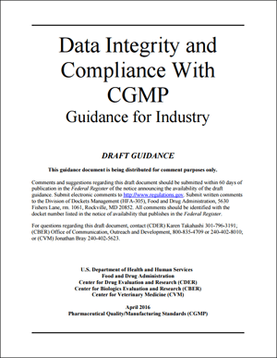
Data Integrity
Data Integrity refers to “the completeness, consistency, and accuracy of data. Data must be Attributable, Legible, Contemporaneously recorded, Original or true copy, and Accurate (ALCOA).”
A = Attributable
L = Legible
C = Contemporaneously recorded
O = Original or true copy
A = Accurate
Reference: FDA Data Integrity and Compliance
with CGMP Guidance for Industry
(Draft Guidance, April 2016)

Slide 6
Data Integrity - ALCOA
Attributable – It must be possible to identify the individual who performed any recorded task (in part to show the individual was trained and qualified to perform the task).
Legible – All records must be legible and permanently recorded in a durable medium.
Note the bad handwriting
example here:

Slide 7
Example of Bad Handwriting
Swamped with phone calls because no one can read your orders? Take our handwriting class for busy professionals and see immediate improvement.

Slide 8
Data Integrity – ALCOA
Contemporaneous – The events or actions must be recorded as they take place to serve as an accurate record of what was done or decided. Date/time stamps should follow in order.
Original – Whether on paper or electronic this is the first capture of the information (Raw Data).
Accurate – Results and records need to be truthful and complete.

Slide 9
FDA Expectations
FDA expects DATA to be reliable and accurate
Data is relied on to ensure the safety, identity, strength, quality and purity (SISQP) of drugs to protect the public’s health.
Code of Federal Regulations includes:
211.68 – requires “backup data are exact and complete”, and “secure from alteration, inadvertent erasures, or loss”
211.100 and 211.160 – requires that certain activities be “documented at the time of performance” and that laboratory controls be “scientifically sound”

Slide 10
FDA Expectations
Code of Federal Regulations includes:
211.180 – requires that records be retained as “original records”, “true copies”, or other “accurate reproductions of the original records”
211.188, and 211.194 – requires “complete information”, “complete data derived from all tests”, “complete record of data” and “complete records of all tests performed” (all data including repeat or reanalysis performed on a sample should be kept)
Raw Data must be Maintained

Slide 11
Examples of Data Integrity Issues

Slide 12
Most Common Data Integrity Warning Letter Issues Cited
Failure to Record Activities at time Performed and Destruction of Original Records
Failure to Prevent Unauthorized Access or Changes to Data and to Provide Adequate Controls to Prevent Omission of Data (21CRF 211.68(b))
Failure to ensure Laboratory Records include complete Data from all tests necessary to assure compliance with established specifications and standards (21CFR 211.194(a))

Slide 13
Examples Failure to Record Activities at time Performed
Personnel performing manufacturing steps without a batch record or a manufacturing form to document the results at the time of performance
QC personnel failing to document and provide complete data derived from all laboratory tests
Manufacturing batch record checks ‘completed’ in advance of a testing interval or step being completed
Using post-it or rough notes to capture information and then transferring that to worksheets or formal documentation.

Slide 14
Examples of Fraud Unauthorized Access & Omission of Data
Manufacturing personnel back dating official documents & signing on behalf of each other.
Fraudulent modification of cGMP raw data records. Undesirable data was found to be changed in the official versions in order to meet specifications.

Slide 15
Make sure you…
Record results at the time of performance.
Do not backdate documents or complete them in advance of a step being completed
Do not discard printouts or transcribe data into a record. Original printout or data must be attached to the record, even if verified by a second person.
Do not destroy or omit records.
Do not create fraudulent records.

Slide 16
FDA Warning Letters
Throughout these GMP sessions, you have been seeing some Warning Letter citations. You may know that after an inspection that FDA may leave a list of observations that the inspector or inspectors find objectionable. Theses are called 483 citations. When this citation is of high significance and FDA wants to get the Company’s attention, FDA re-issues these findings to the Company in a Warning Letter. These are the findings that the AGENCY finds objectionable and require a Company response. Warning Letter citations often start out as 483 citations.
Warning Letter citations are displayed in this presentation in a red stop sign as a subtle reminder that if this is what YOUR company is doing, you might want to STOP and think about how you would justify that activity.

Slide 17
Warning Letter Cleaning Record
WARNING LETTER
Our investigation team
discovered 14 instances where
cleaning records for equipment
used in manufacturing operations
included initials or signatures of
employees who reportedly verified
cleaning of equipment but were
not shown as present by
security log records.
Ranbaxy Laboratories
2

Slide 18
Ranbaxy Warning Letter
FDA will test the credibility of your documents. At Ranbaxy Labs, inspectors checked that signers of cleaning records were actually at work (based on the security logs) on the day they said they verified equipment cleaning. Now, FDA does not just have a concern with these cleaning records, but they now have a concern with ALL the company’s records. Wouldn’t you? Does this Company have a culture where fraudulent data recording is permitted?

Slide 19
Failure to Record Activities at time Performed and Destruction of Original Records
WARNING LETTER
Specifically, your employees completed batch
production record entries days after operations
ended, released lots before the proper approvals,
and failed to maintain manufacturing data for
critical steps in the batch production records.
For example,
Our investigators found that some of your
Operators used “rough notes” (unbound, un-
Controlled loose paper) to capture critical manu-
facturing data and then destroyed these records…
b) Additionally, our investigators found backdated\
Batch production records dated and...signed by
your Production Manager and Technical Director.
Mahendra Chemicals
#320-15-12

Slide 20
Warning Letter QC worksheet
WARNING LETTER
…during the inspection of the microbiology laboratory, our investigators requested the completed microbial QC worksheet for batch [X]. Your laboratory staff led our investigators out of the lab to another room, where according to your staff, the completed document was located. After approximately 30 minutes…without being provided the completed worksheet, our investigators reentered the microbiology lab and observed a microbiologist with a partially-completed QC worksheet for the batch in question.
Later a member of your lab staff told our investigators that…the original completed QC worksheet had never existed.
Zhejiang Hisoar Pharmaceutical
#320-16-26

Slide 21
Warning letter For Inaccurate Data Records
WARNING LETTER
.. Your firm lacked accurate raw laboratory data records for API batches shipped by your firm. The inspection revealed that batch samples were retested until acceptable results were obtained. In addition, your quality control (QC) laboratory failed to include complete data on QC testing sheets. Failing or otherwise atypical results were not included in the official laboratory control records, not reported, and not investigated. For example,…
A review of the High Performance Liquid Chromatograph (HPLC) electronic records from July 3, 2013, for (b)(4) batch #(b)(4) revealed an Out-of-Trend (OOT) result. The sample preparation raw data was discarded and not reported. A QC analyst indicated that these results were discarded due to some small extra peaks identified in the chromatogram fingerprint and an unexpected high assay result. The QC test data sheet reported two new results that were obtained from samples tested on July 4, 2013 and July 5, 2013, using a different HPLC instrument.
According to lab analysts interviewed during the inspection, the common practice was to complete the analysis and to record the sample preparation data only if the results were acceptable. If results were atypical, a fresh sample was to be prepared and analyzed. The original sample testing was not recorded.
Apotex Research Private Limited
#320-14-11

Slide 22
Regulatory Concern
Regulatory Concern
Failure to Prevent Unauthorized Access or Changes to Data and to Provide Adequate Controls to Prevent Omission of Data (21CRF 211.68(b))
Examples (21 CFR, Part 11)
Lack of computer system controls – need to have controls to prevent unauthorized access that could modify, delete, or not save electronic files
Sharing passwords is not allowed
No audit trial for computer systems

Slide 23
Warning Letter For Inadequate Controls
WARNING LETTER
The inadequate controls over access to your data raise questions about the authenticity and reliability of your data and the quality of the APIs you produce.
a. Your firm did not have proper controls in place to prevent the unauthorized manipulation of your laboratory’s raw electronic data. Your HPLC computer software lacked active audit trail functions to record changes to analytical methods, including information on original methodology, the identity of the person making the change, and the date of the change. In addition, your laboratory systems did not have access controls to prevent deletion or alteration of raw data. During the inspection, your analysts demonstrated that they were given inappropriate user permissions to delete HPLC data files.
b. Moreover, the gas chromatograph (GC) computer software lacked password protection allowing uncontrolled full access to all employees…
Novacyl
#320-15-07

Slide 24
Warning Letter for Lack of Access Controls
WARNING LETTER
…we observed that your laboratory systems lacked access controls to prevent deletions or alterations to raw data. For example, our investigator reviewed the electronic folder containing data files generated when your firm tested … by gas chromatography (GC). The investigator compared the file names in the folder with the metadata generated by the Chemstation software you used ….and found that two chromatograms had been deleted from the system. Because there were no controls restricting operators or supervisors abilities to alter or manipulate the data, an analyst had completed two runs and deleted the results, and then changed the subsequent file names in the folder ….to make it appear that the deleted runs never occurred.
Zhejiang Hisoar Pharmaceutical Co. Ltd
#320-16-26

Slide 25
Examples
Regulatory Concern
Failure to ensure Laboratory Records included complete Data from all tests necessary to assure compliance with established specifications and standards (21CFR 211.194(a))
Examples of testing issues:
Pooling API lots that had failed degradant testing with lots that had passed in order to obtain ‘in specification’ test results
Integration parameters are not controlled and there is no procedure to define integration. Regulatory Agencies are concerned over re-integration of chromatograms.

Slide 26
Warning Letter
WARNING LETTER
For example, during the inspection, we reviewed electronic data from your high performance liquid chromatography (HPLC) system. An unknown impurity peak was present with the original three-month stability sample of [X]. This unknown peak was OOS and would have caused the sample to fail for unknown impurities, but it was not included in the official record for this stability test. Instead, an analyst ran a new sample to obtain a passing result on October 10, 2014, and only the passing result from the second sample was reported in the official record.
Zhejiang Hisoar Pharmaceutical
#320-16-26

Slide 27
Uncontrolled Documents
WARNING LETTER
…on March 18, 2013, the FDA investigators found unofficial batch records for approximately 75 batchs of injectable finished drug products torn in half in a waste area. These records contain data indicating some of the batches failed to meet the in-process visual inspection specifications of not more than 4% defects, while the official batch records for these batches state that these batches had met the specifications…
The uncontrolled documents indicate that up to 14% of the vials had defects including, but not limited to, black particles, fibers, glass particles, sealing defects, and volume variations.
Wockhardt Ltd.
#320-13-21

Slide 28
Warning Letter FDA
WARNING LETTER
The FDA investigators identified the practice of performing "trial" sample analysis for High Performance Liquid Chromatography (HPLC) analyses prior to collecting the “official” analytical data for stability testing. These “trials” were performed on multiple products ... These trial runs were not recorded in the equipment use log, and sample preparation data associated with these analyses was destroyed, preventing any calculation or analysis of the resulting data.
FDA Concluded:
…The above examples raise serious concerns regarding the integrity, reliability and accuracy of the data generated and available at your facility.
Wockhardt Ltd.
#320-13-21

Slide 29
Data Integrity Requirements
Complete results of all tests need to be recorded and kept.
Equipment use needs to be recorded.
Records must not be destroyed or omitted (electronic or hard copy).
Record results at the time of performance.
Do not backdate documents or complete them in advance of a step being completed
Do not discard printouts or transcribe data into a record. Original printout or data must be attached to the record, even if verified by a second person.
Do not create fraudulent records.

Slide 30
Consequences
Notes:
E

Slide 31
Debar
FDA Debarment- The word “debar” means to shut out or exclude. FDA has the authority to debar people from the Generic Drug Enforcement Act of 1992. It basically authorizes FDA to forbid people in the drug industry convicted of certain crimes – in the drug industry - to be prevented from working in the drug industry.
One of the things FDA can do – if you have been convicted of certain crimes in the drug industry – is to debar or prevent you from working in the drug industry.
In this case, FDA debarred four QC officials at Able Labs.

Slide 32
Consequences FDA debars four QC Officials
Each of the four Able Labs employees is accused of violating standard operating procedures (SOPs) by “failing to properly investigate, log, and archive questionable, aberrant, and unacceptable laboratory results so that (it) could conceal improprieties and continue to distribute and sell its drug products”.
The FDA goes on to detail specific allegations against the QA & QC officials. The former laboratory manager in QC at Able Labs, is accused of supervising the creation of false entries in chemist notebooks to support an ANDA (abbreviated new drug application).
The former QC supervisor at Able Labs, is accused of manipulating data related to stability tests, and the assistant QC manager and VP of QA/QC faced similar accusations from the FDA.

Slide 33
And There Are Consequences
“Chinese courts call for death penalty for researchers who commit fraud”
The Watchdogs, June 23 2017
“In the past few months, China has announced two new crackdowns on research misconduct – one of which could lead to executions for scientists who doctor their data.”
“If the misconduct ends up harming people, then the punishment on the table even includes the death penalty.”
Clinical trial data fraud is in the same category as counterfeiting.

Slide 34
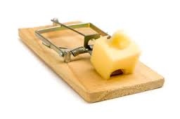
Common Data Integrity Traps
Five Common Traps
Inadequate Process Control
Lack of Process Monitoring
Lack of Training/Oversight
Inadequate Technology
Absence of a Strong Quality Culture
How to Avoid a Data Integrity Citation, What Your Company Needs to Know in Today’s Regulatory Environment; PDA Letter; Mercer, Mylan, Mylan; July/August 2016

Slide 35
Data Integrity Traps Inadequate Process Control
Need procedures to minimize unintentional errors
Examples: Second person (checker) for critical steps, in-process testing, written procedures for what was done – manufacturing records and QC testing records
Need system controls and review procedures in place to detect any manipulation of data (audit trails)
Examples:
Supervisor and Quality Assurance review of manufacturing and QC testing records, Audits of records and procedures
Need computer system controls to prevent unauthorized access to modify, delete, or not save electronic data files; 21 CFR Part 11

Slide 36
Data Integrity Traps Lack of Process Monitoring
Internal data integrity self-inspections should be conducted
Routine review of data including audit trails
Make sure contract manufacturers and testing organizations are also compliant – include data integrity commitments in Quality Agreements

Slide 37
Data Integrity Traps Lack of Training/Oversight
There should be sufficient supervisor/manager involvement in daily operations to ensure employee commitment to data integrity
Provide ongoing data integrity training to management and staff to make them aware of data integrity issues and trends
An informed and engaged staff can highlight potential issues

Slide 38
Data Integrity Traps Inadequate Technology
Computers and digitally controlled equipment must be 21 CFR Part 11 Compliant including being qualified/validated to evaluate data integrity issues
Computers need to be secure, do not share passwords.
Computer system needs to adequately define or segregate user levels and software privileges (such as who can modify records).
Computer systems need to have an audit trail (who, what, why, where, and when). The audit trail needs to track creation, modification, or deletion of data.
Example: For an HPLC, the audit trail could include the user name, date/time of run, integration parameters used, details of reprocessing if any, change justification for reprocessing

Slide 39
21 CFR Part 11 Electronic Records & Signatures
Computer systems (including hardware and software), … shall be readily available for … FDA inspection.
Validation of [computer] systems
The ability to generate accurate … copies …
Protection of records … [data & records are backed up]
Limiting system access … [passwords, PIV cards, etc.)
Use of secure, computer-generated, time-stamped audit trails …
Persons … have the education, training, and experience …
… written polices …
… change control …
Each electronic signature shall be unique … [and permanent]

Slide 40
Data Integrity Traps Absence of a Strong Quality Culture
Management must promote and encourage a strong Quality Culture.
Must set a good example
Management should reward people that raise issues, questions, and discussions that promote quality.

Slide 41
Document Control
Document controls must be in place to assure product quality (21 CFR 211.100, 211.160 (a), 211.186)
If blank forms (Batch Records, Worksheets, laboratory notebooks, etc.) are used the FDA states that they be controlled by the Quality Unit (QA).
Numbered sets of blank forms issued should be returned to the Quality Unit and reconciled upon completion of issued forms.
Incomplete, unused, or erroneous forms should be kept as part of the permanent record with written justification if replaced.
Pages of documents should be numbered when issued to ensure all pages are returned and no pages are missing.

Slide 42
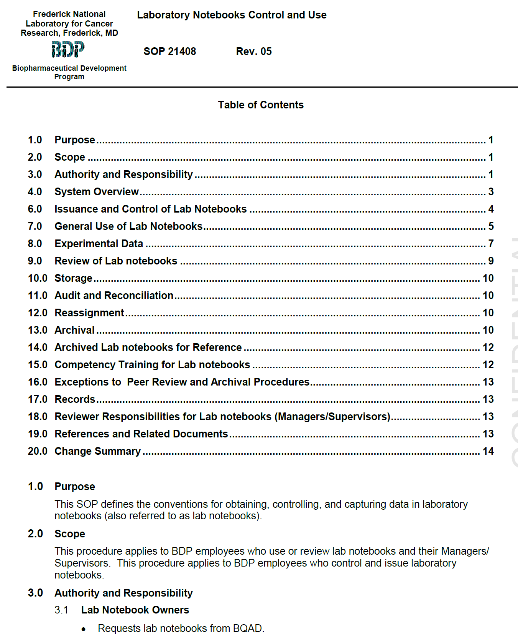
Example of BDP Controlled Documentation

Slide 43
Conclusion: How Does this Apply to BDP Staff
Always provide complete and accurate data
Document procedures and results at the time they are performed
Data must be maintained throughout the records retention period along with the associated metadata required to reconstruct the GMP activity
Do NOT discard, destroy, or delete data. Keep all data from all tests performed. Document OOS’s and investigate.

Slide 44
Conclusion: How Does this Apply to BDP Staff
Do NOT misdate records. Records should be dated at the time the procedures are being performed.
Data and metadata should be preserved in a secure and traceable manner. (Metadata summarizes basic information about data, which can make finding and working with particular instances of data easier. For example, author, date created, date modified, and file size are examples of very basic document metadata.)
Audit trials should be available for computer generated data (who, what, when, where, and why of a record).
Don’t share computer passwords.
Don’t use common passwords.

Slide 45
How to Report Data Integrity Issues
Any data integrity issue must be immediately reported to your supervisor. If this is not feasible given the data integrity issue and the people involved, it must be reported to the Quality Assurance or Regulatory Compliance Director.
BDP Regulatory Compliance Director
Sheryl Ruppel
sruppel@mail.nih.gov

Slide 46
Should you have any questions about the information presented in this training module, please contact BQA management.
Data Integrity
Thank you for taking this training module

